Slide 1
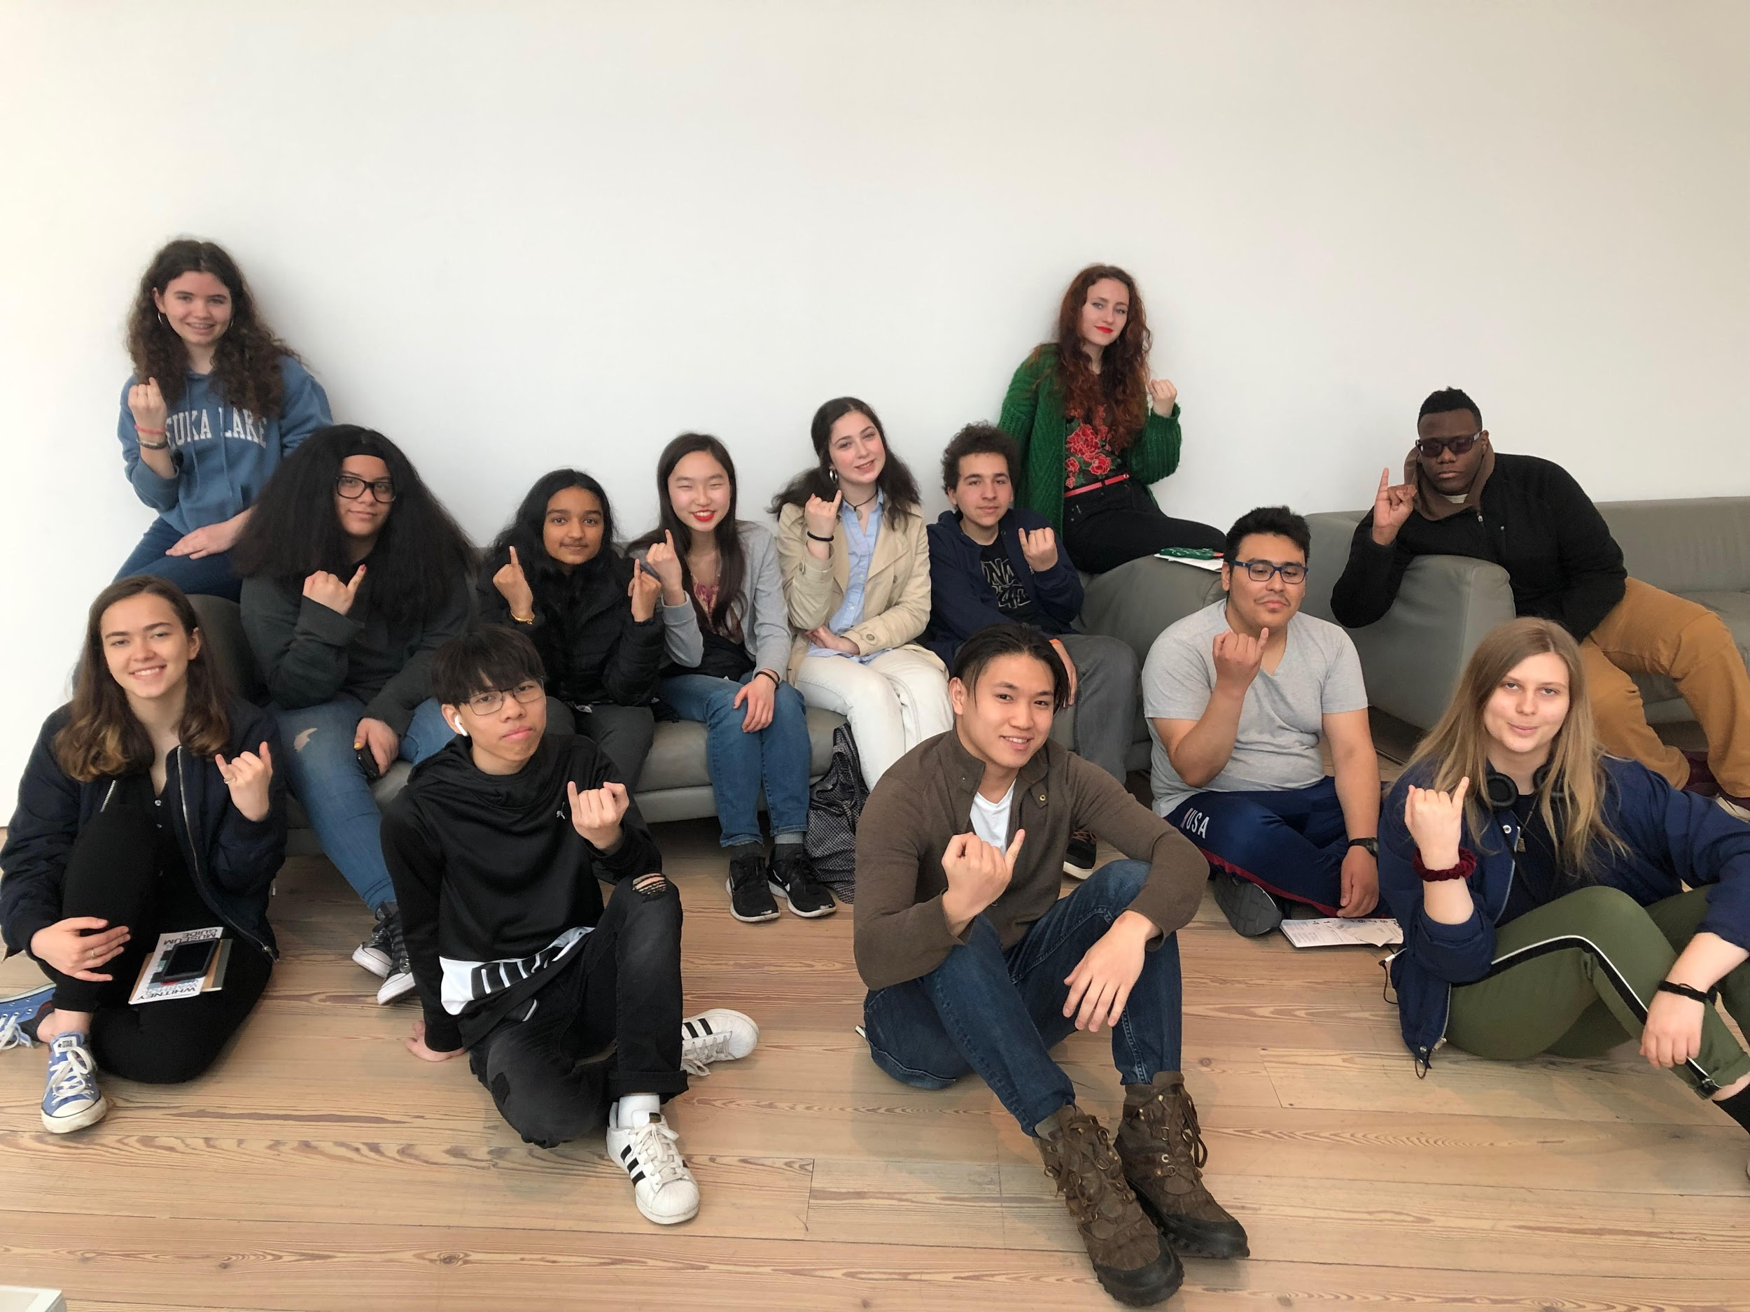
MEDIA TRaC SP2019
Pinkies Up!
On Couch (left to right)
Brisa, Nathalie, Arpita, Sadie,
Abby, Toby, Mariia, Isaiah.
On Floor (left to right):
Merima, Carlos, Thomas, Mauricio, Max
Not Pictured:
Brian

Slide 2
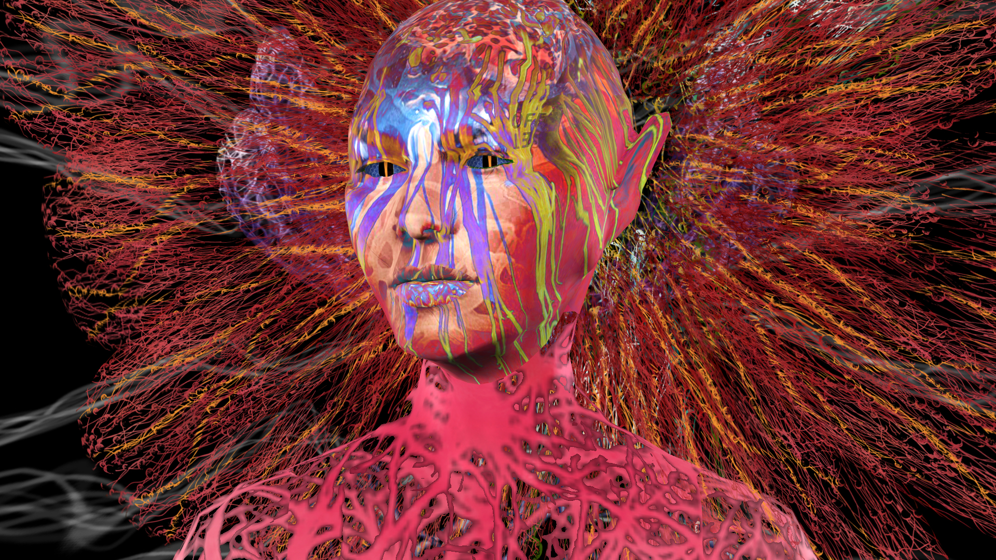
REFIGURING THE FUTURE
EYEBEAM @ 205 HUDSON GALLERY
Notes:
https://refreshart.tech/

Slide 3
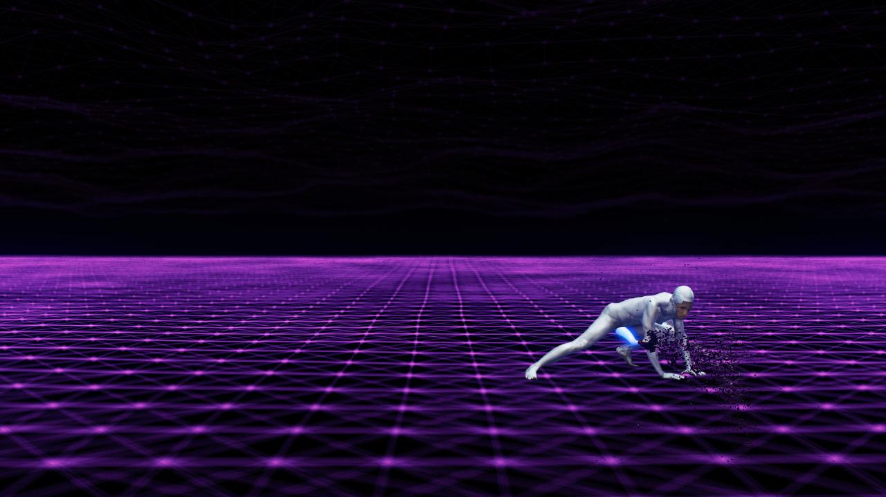


Slide 4
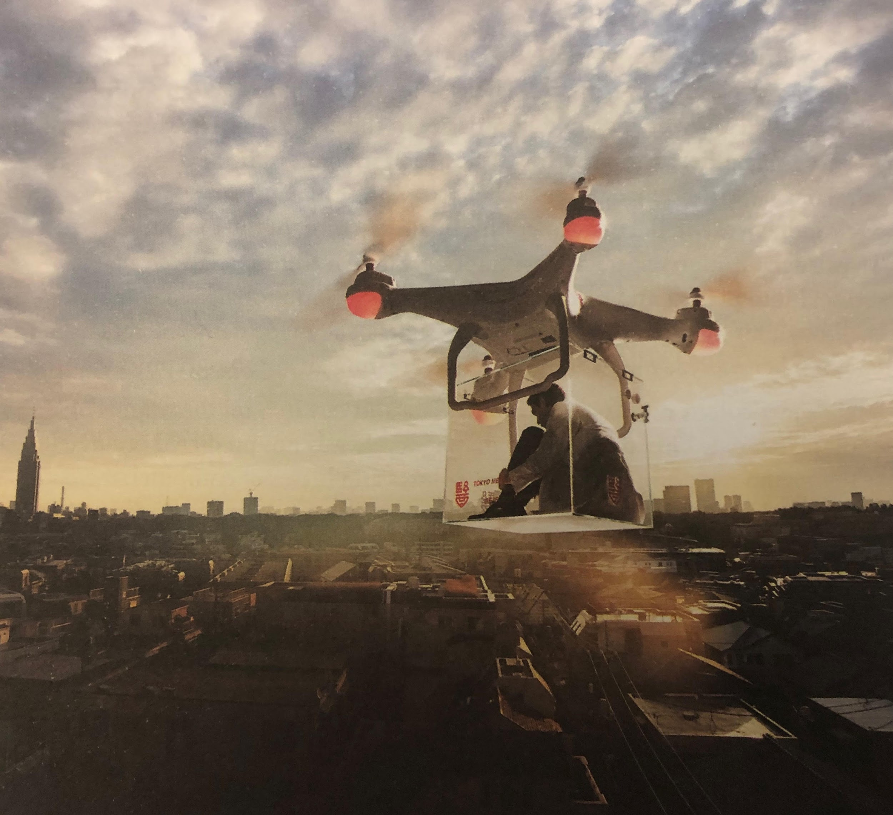
Tokyo Medical University for Rejected Women by Sputniko! + Tomoni Nishizawa
Arpita Dhar
“The back of each woman’s uniform says ‘Tokyo Medical University for Rejected Women.’”
“Even though women are capable of so much in this world, they’re still thrown to the side while men are just valued for being men. “
Read the full review here

Slide 5
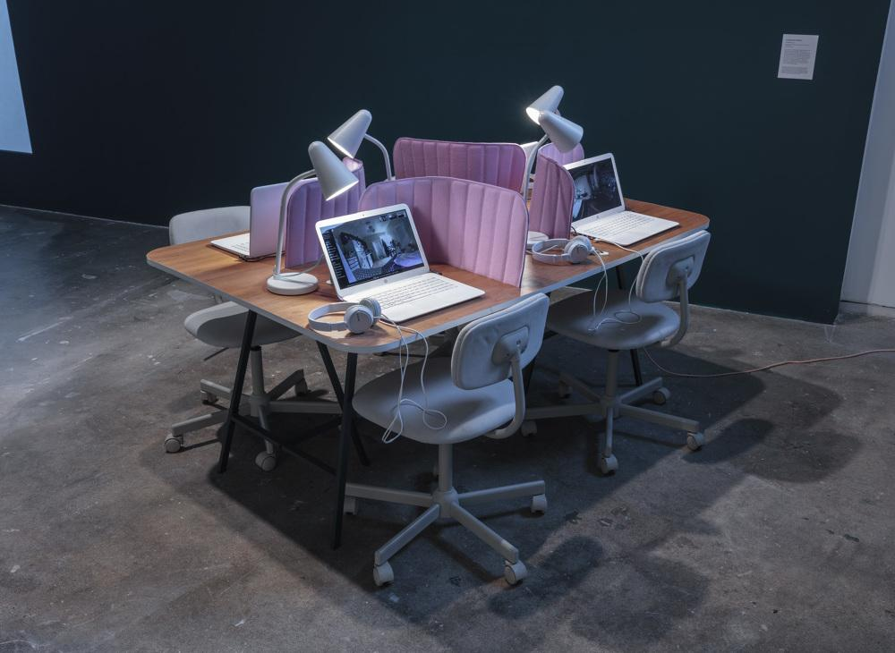
SOMEONE by Lauren McCarthy
Toby Pannone
“Every little bit of information can be used to create a digital profile of us for advertisers, and I was aware of that when voice-typing and clicking on ads.”
Read the full review here

Slide 6
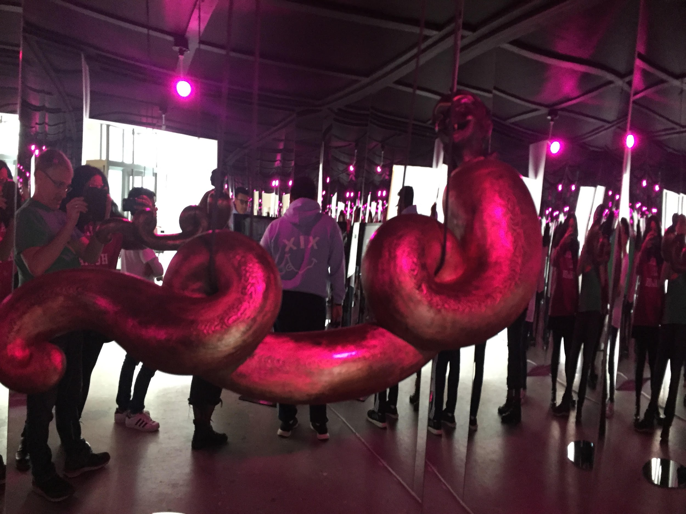
SHE WHO SEES THE UNKNOWN: The Laughing Snake
Mauricio Bejarano
“...it made me feel as if I was either in Total Recall & the Matrix with some elements of horror added in.”
“...the Laughing Snake and her origins as well as others that don’t specifically involve the snake but that explore sexual oppression.”
“..stringent religious policies imposed on women in the middle east…”
“...this work is a disturbing portrayal of misogyny and religious oppression towards females and the chance to change these positions with references to an equally disturbing mythological being.”
Read the full review here

Slide 7
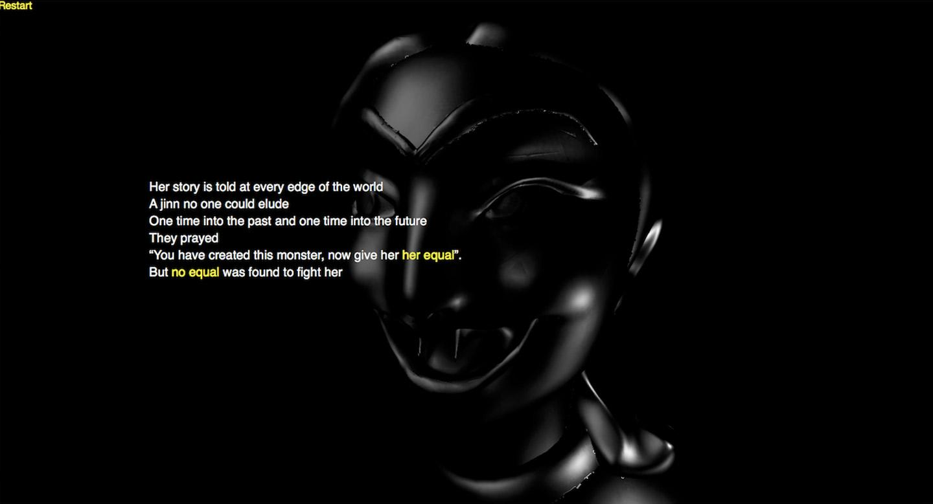

Slide 8
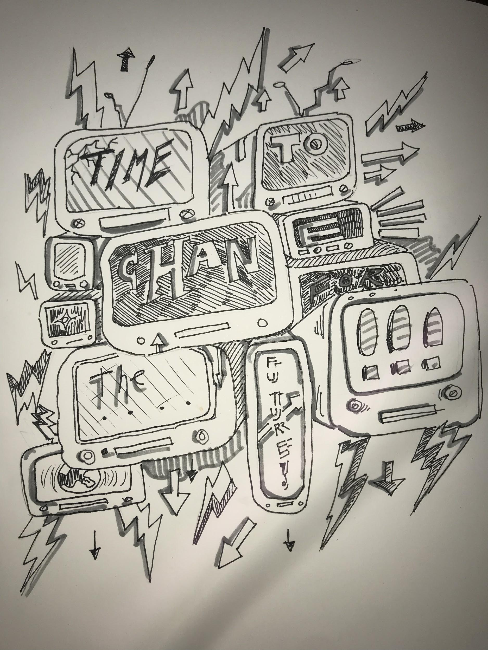
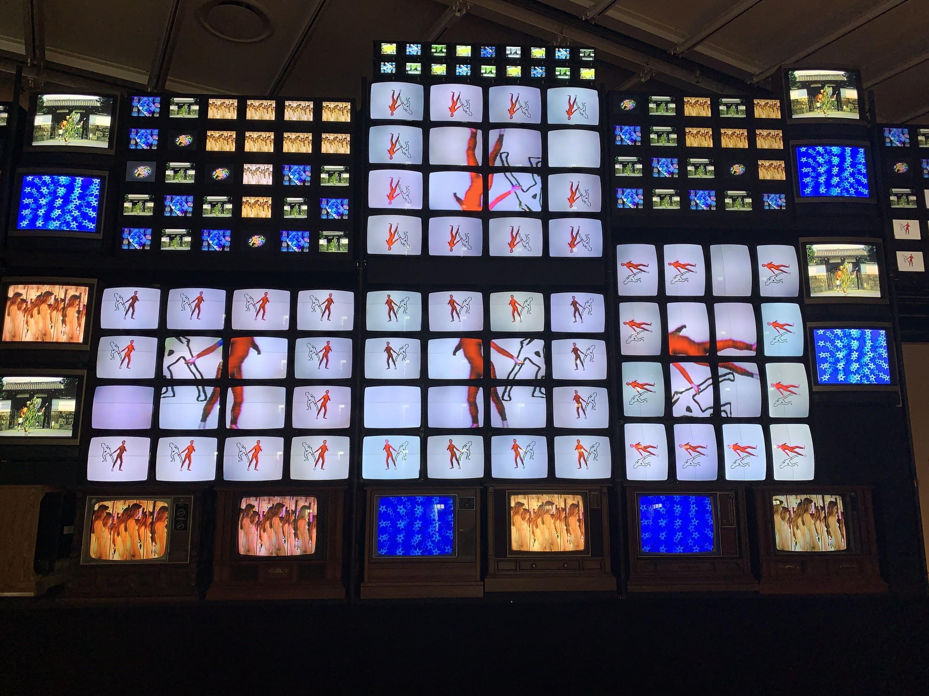
PROGRAMMED @ THE WHITNEY MUSEUM
Programmed: Rules, Codes, and Choreographies in Art, 1965–2018, an exploration of art that was created using computer programs, hence the title. The collection inherently speaks to the immense effect that modern technology has on our lives.
Fin de Siecle by Nam Jun Paik
Drawing by Max

Slide 9
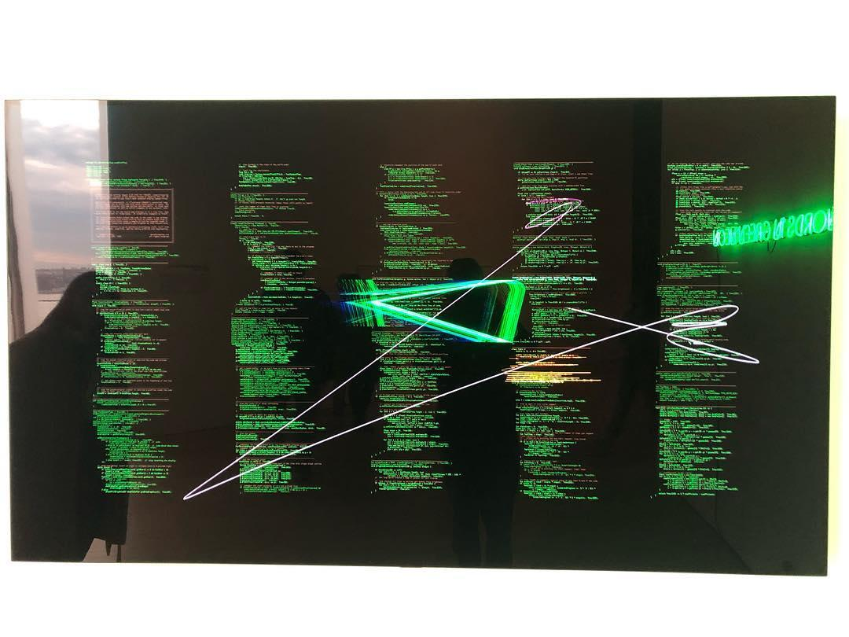
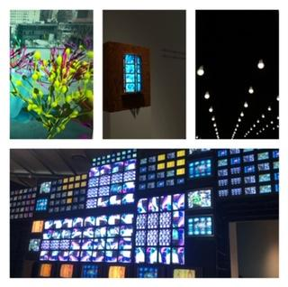
Mariia Cherkashyna
All together, the exhibition with the artwork creates a mood of “partying” and confusion at the same time - at the first view it reminds of fun and carelessness, while thinking deeper it reveals that people inside of the TV and outside of it do not know what to do, how to act and which ideas to pursue.
Read the full review here

Slide 10
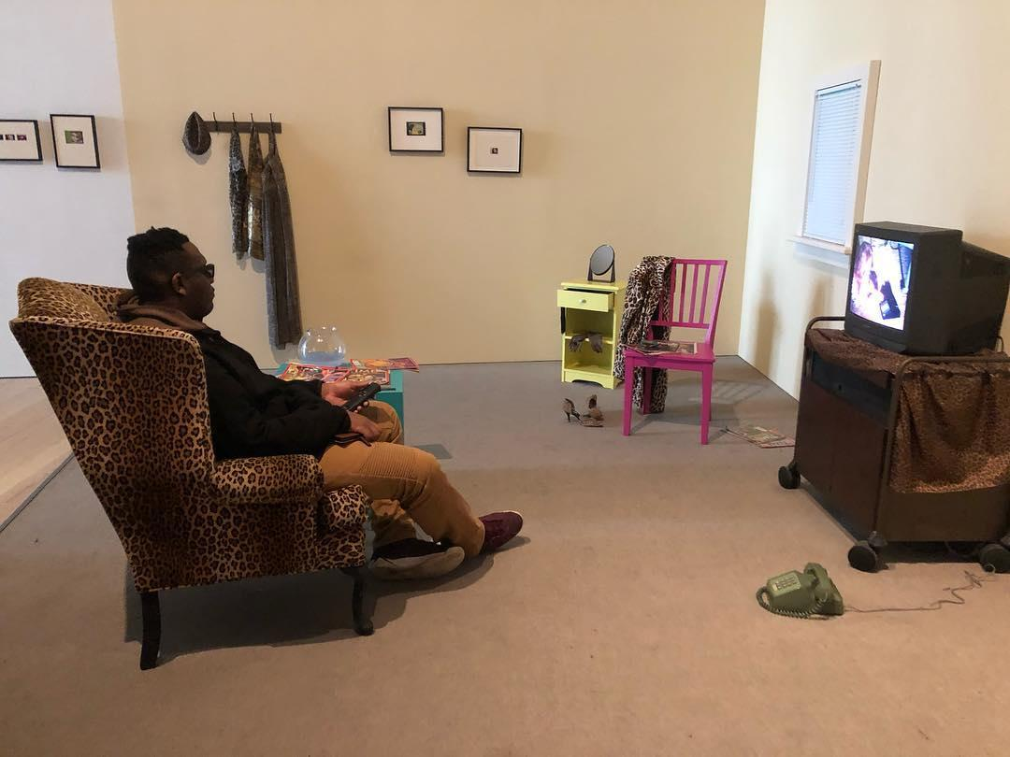
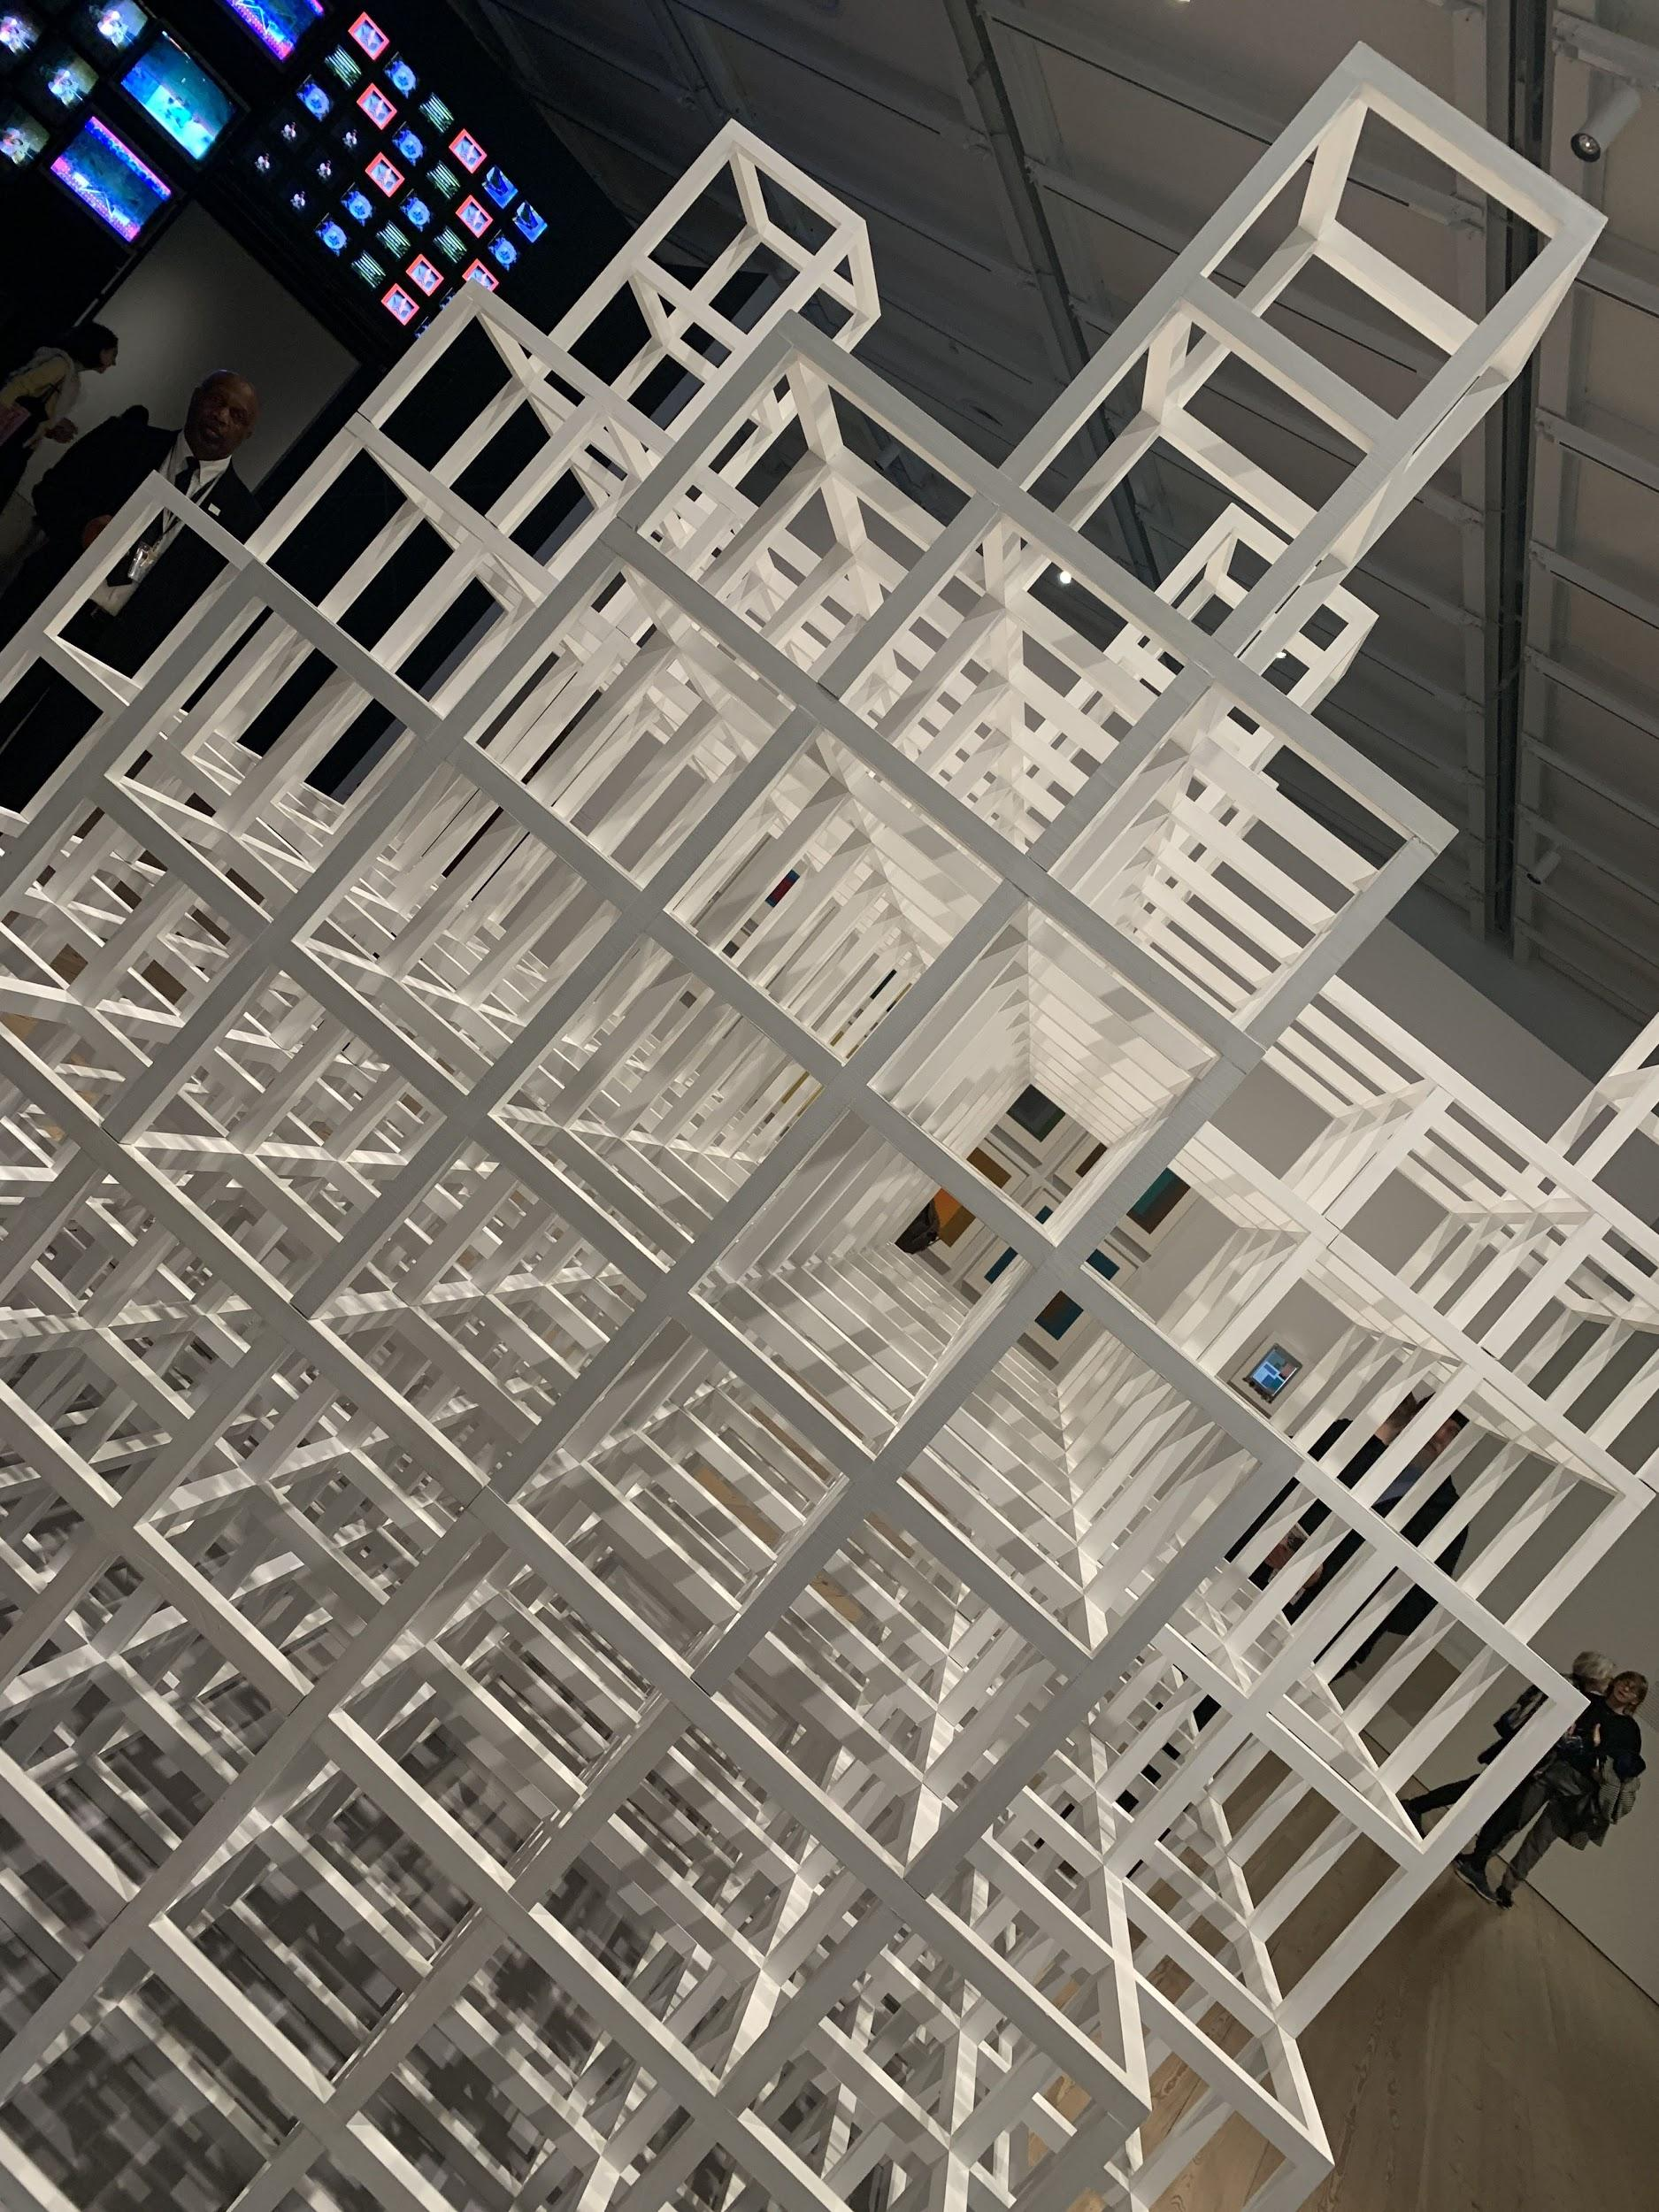
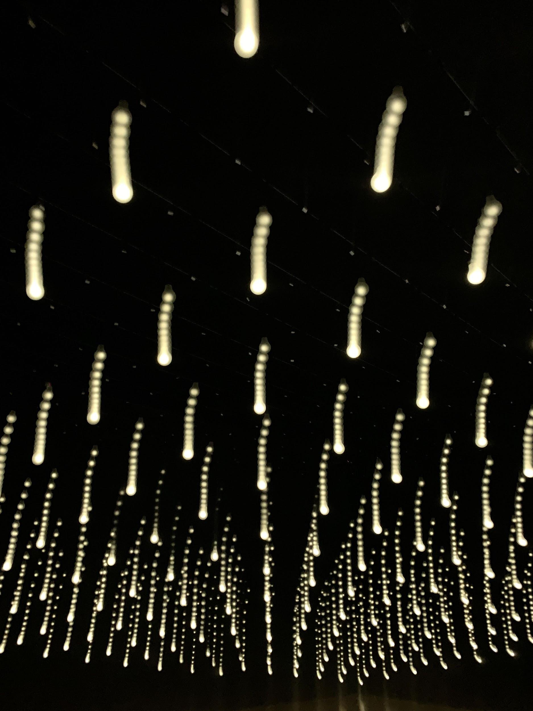
Isaiah interacts with the work of Lynn Hershman Leeson

Slide 11
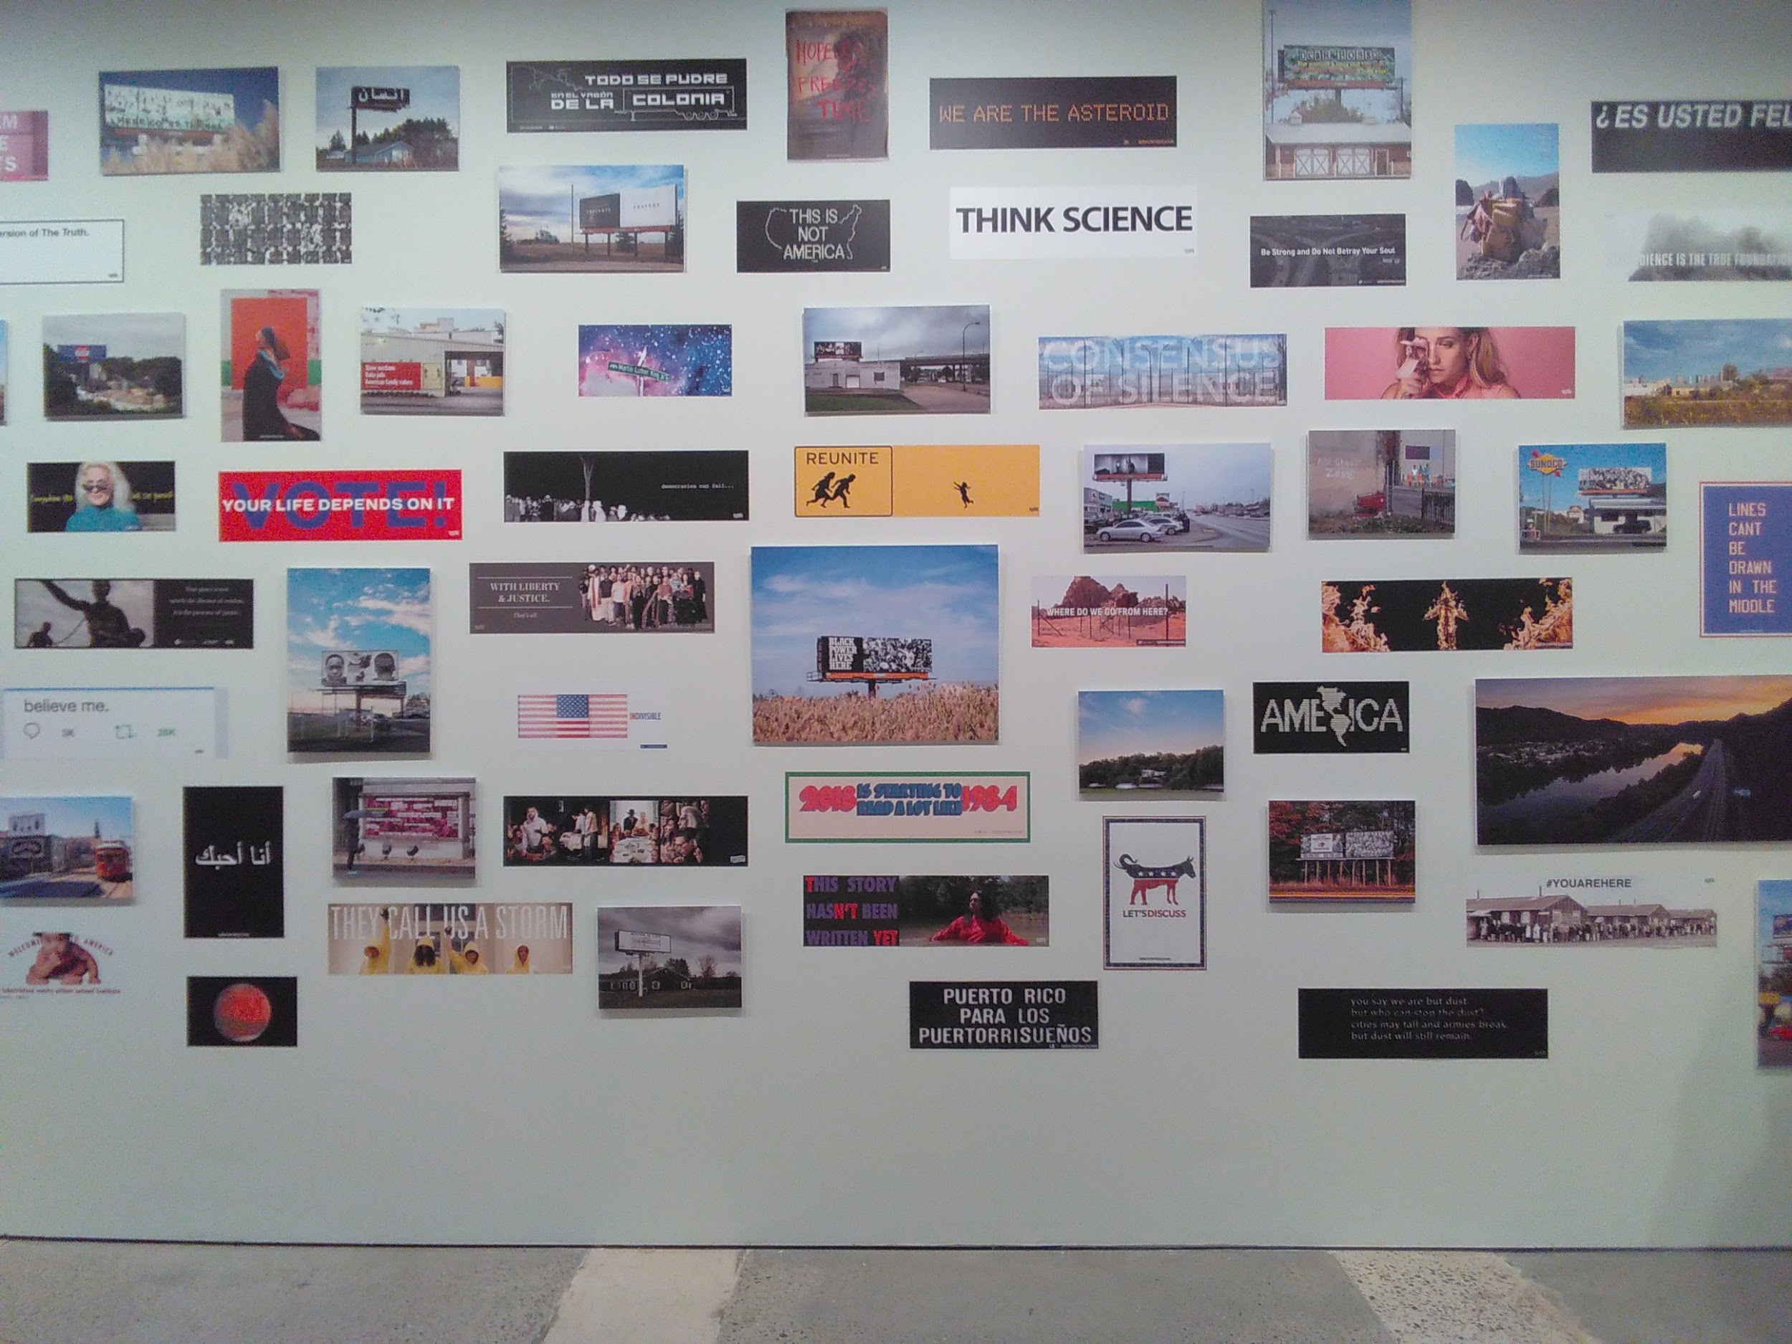
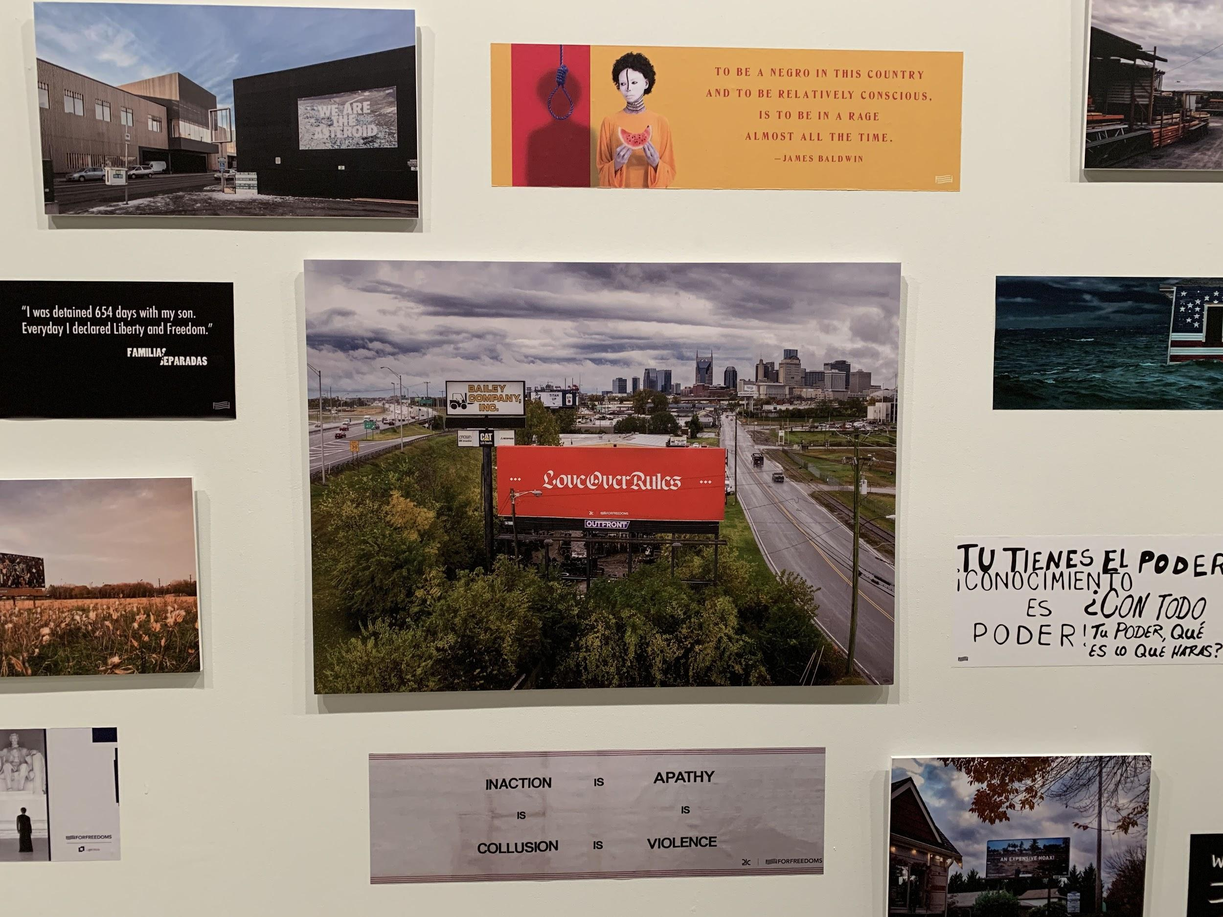
For Freedoms Exhibit @ ICP
The main focus of this exhibit was freedom, as the name suggests. This exhibit was pretty interactive since we were able to write anything in this wall. This was pretty significant because writing on all know not to do, a rule everyone knew to follow. However, here at this museum we were allowed to break this rule, we had freedom from this rule. We were given the freedom to express ourselves.
This exhibit also included a wall with stickers/ small photographs that reveal what America to those who are oppressed. This wall (on the right) said things such as “this is not America.” This phrase alone showed us how so many people have different points of view on America, and that so many people disagree with what America is today that they even go on to say that it isn't America.

Slide 12
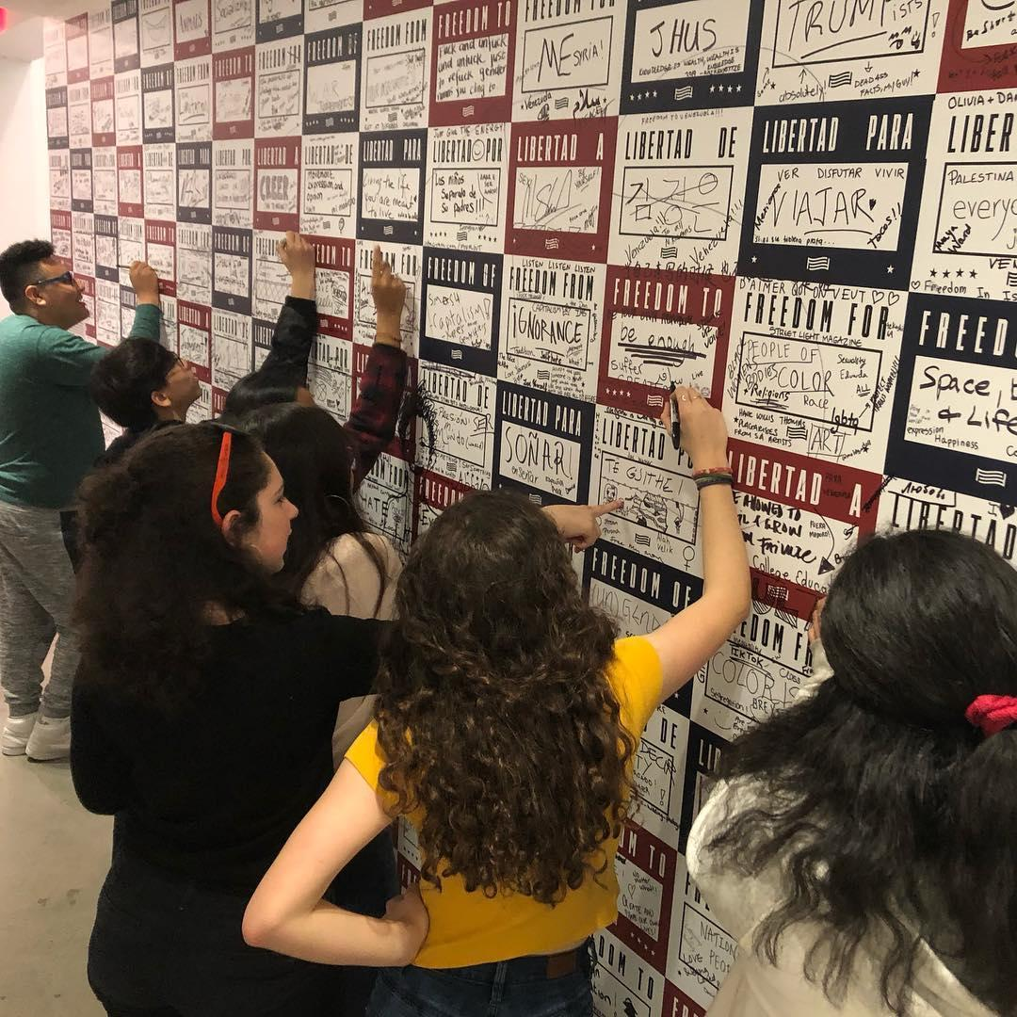

Freedoms: Of, From, For + Building Blocks

Slide 13
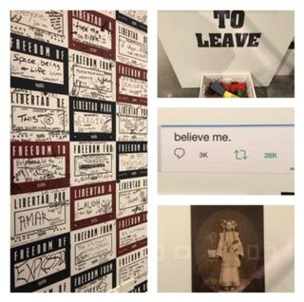
Where Do We Go From Here?
Sadie Lee
“These paintings, used for propaganda encouraging Americans to buy war bonds, have been reimagined by the For Freedoms collective with subjects that represent our nation’s diversity in twelve photographs titled Four Freedoms Posters.”
“The FOR FREEDOMS collective is a living, growing, organization. In fact, in the gallery, a map of the U.S. is displayed, with different symbols marking their influence. This collection, an of citizenship in our current political climate, appears to be a microcosm of their entire organization.”
“It seems that while the artwork is certainly intended to evoke emotion in its viewers, its true purpose is as a call to action.”
“To call this collection functional would be a disservice, but in a way, it does function as a lens for us to reflect upon our own actions in the face of an ever-changing nation.”
Read the full review here

Slide 14
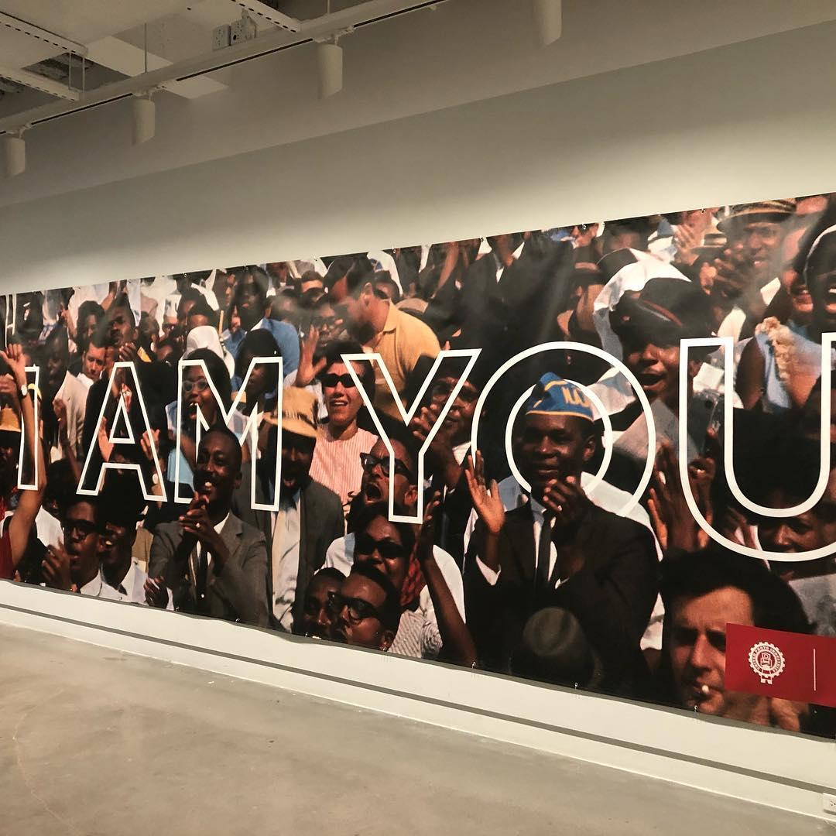

Slide 15
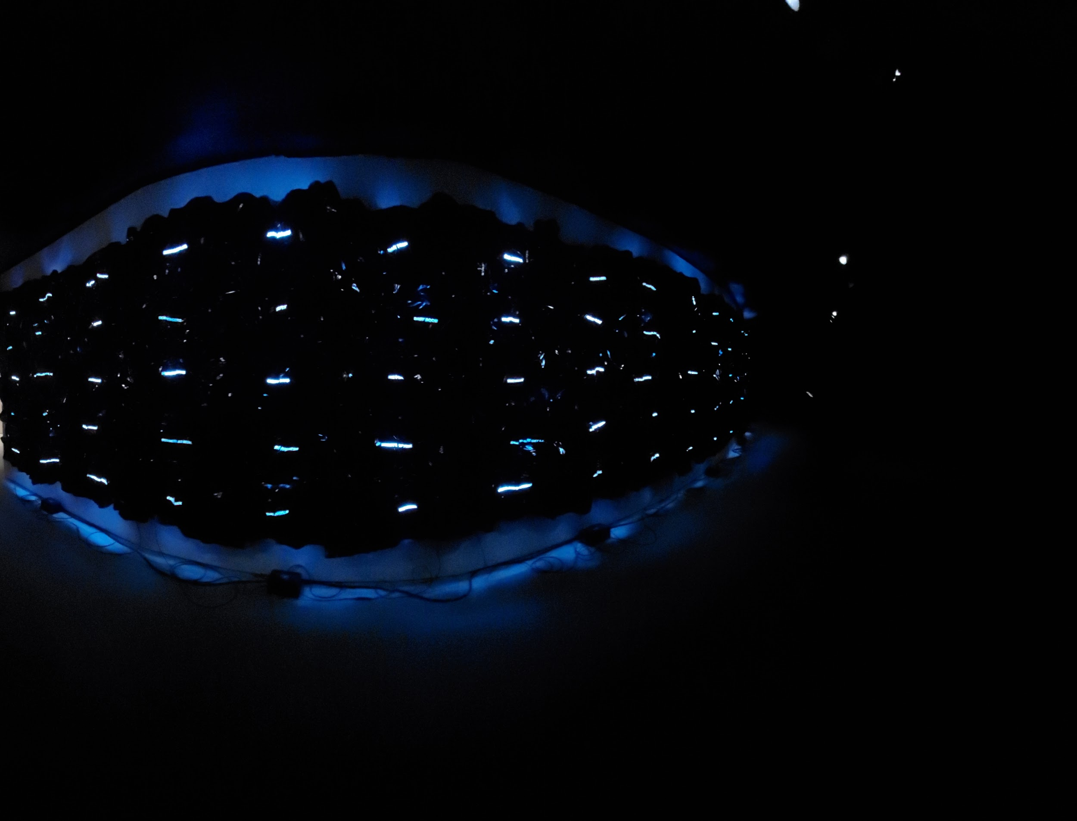
SO MUCH DEATHLESS by Gretchen Bender
Merima Ramdedović
“The “So Much Deathless” exhibition by Gretchen Bender at the Red Bull Arts New York was artistic throughout various mediums including photography, music, radio and television broadcasts.”
“Throughout her contemporary work in the exhibition she expresses dark and controversial moments throughout the 80’s and 90’s which portray the way that television had an impact on politics and entertainment during the time.”
Notes:
@ Redbull Arts NY

Slide 16
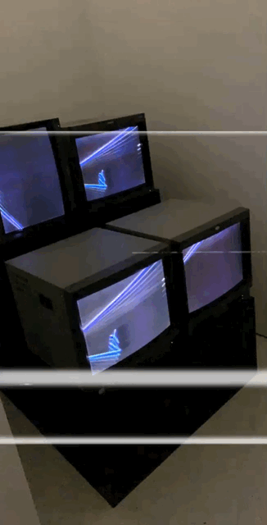
“There is also a screening of a film titled “Total Recall” from 1987, music videos shown on a monitor surrounded by photographs, and photographs and black and white drawings throughout the exhibit.”
“Gretchen Bender does a great job at using her talents throughout her work while portraying her message to the viewers that television connects and fuels politics and entertainment.“
Read the full review here

Slide 17
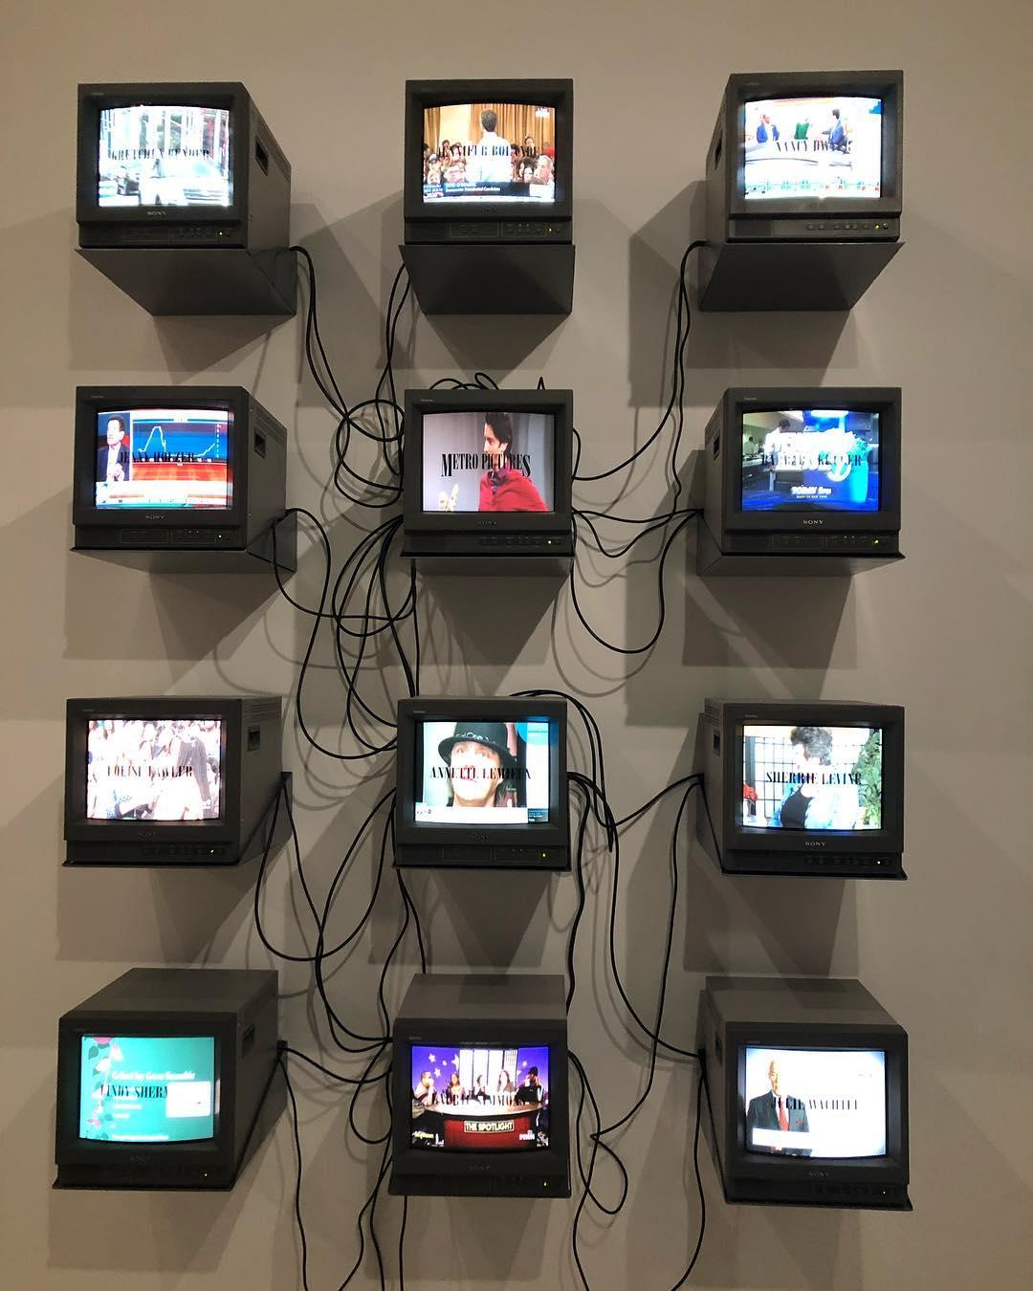
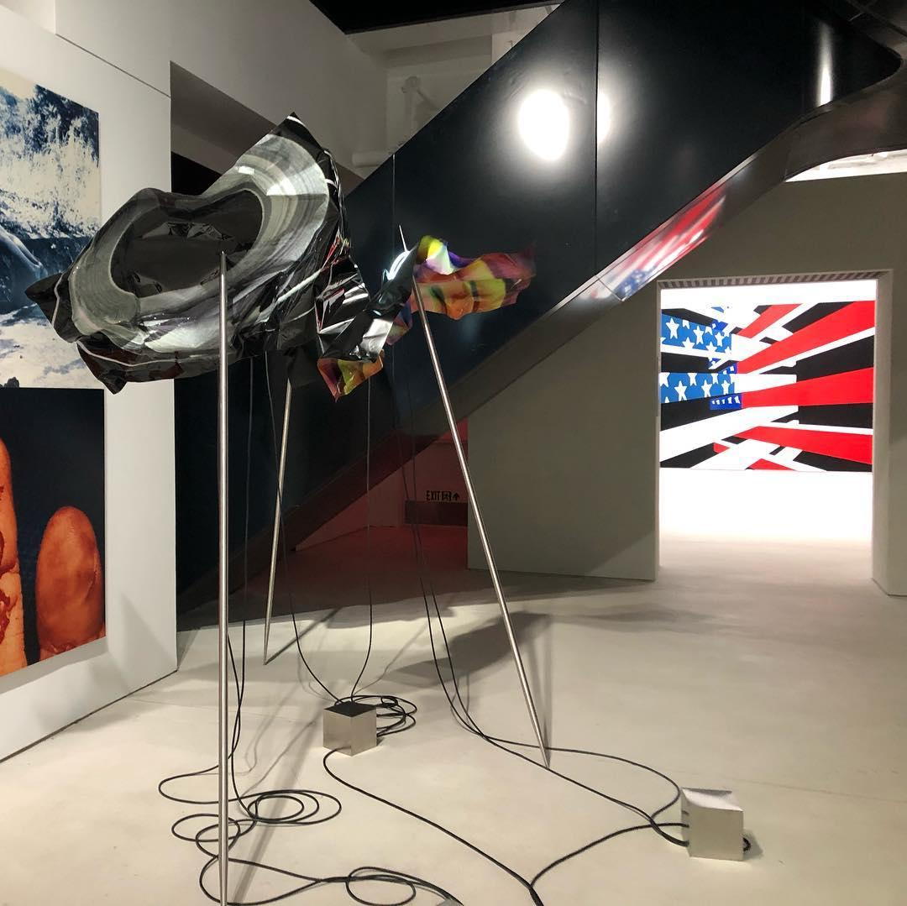

Slide 18
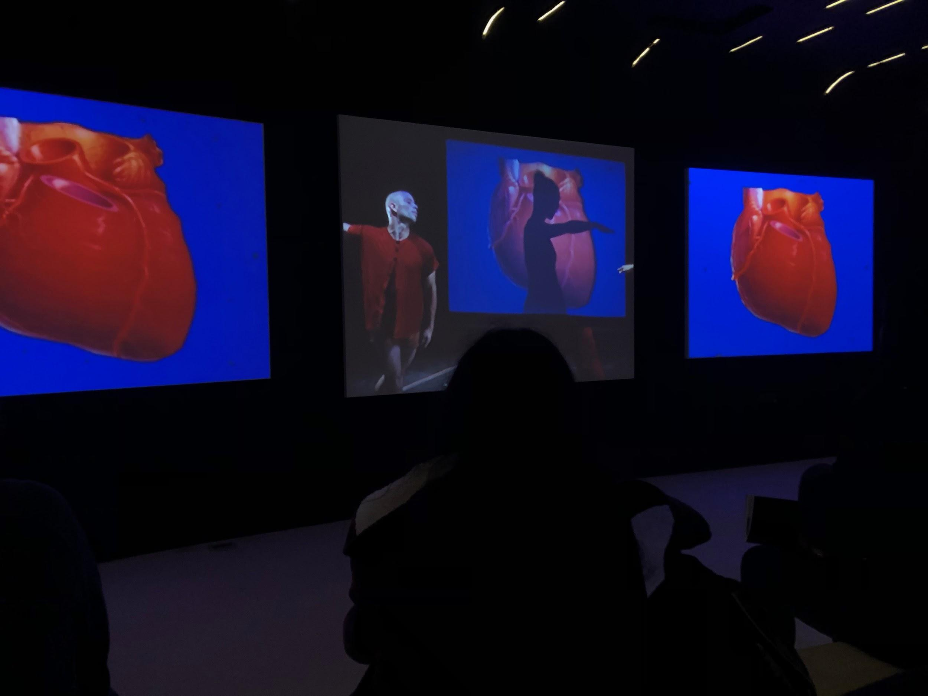

Slide 19
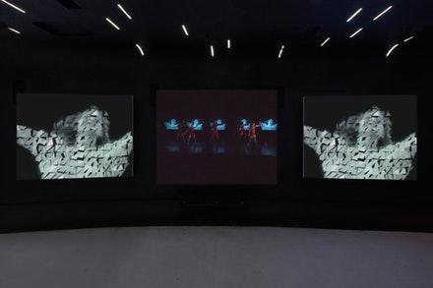
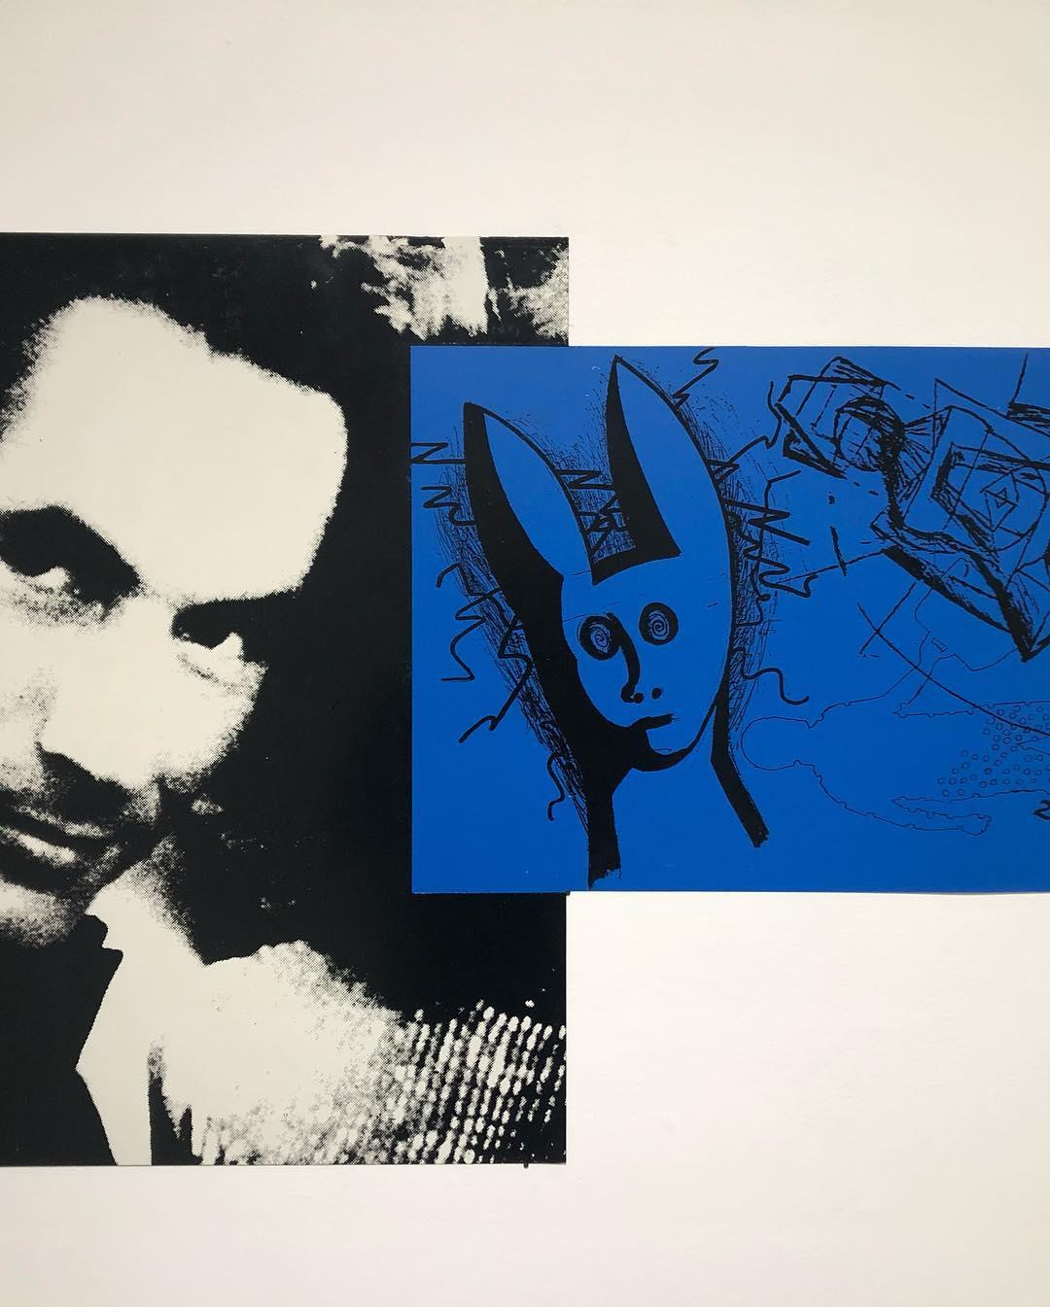
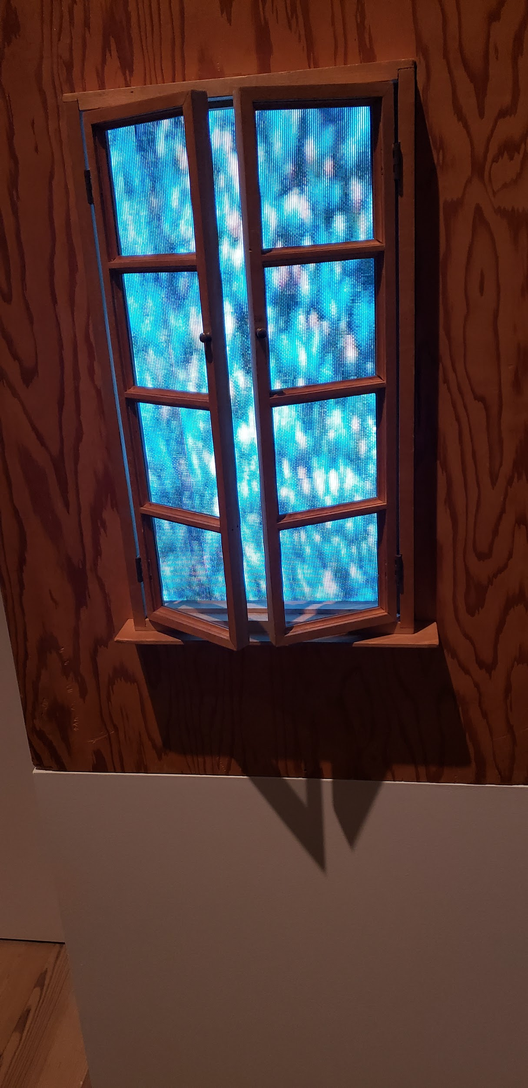
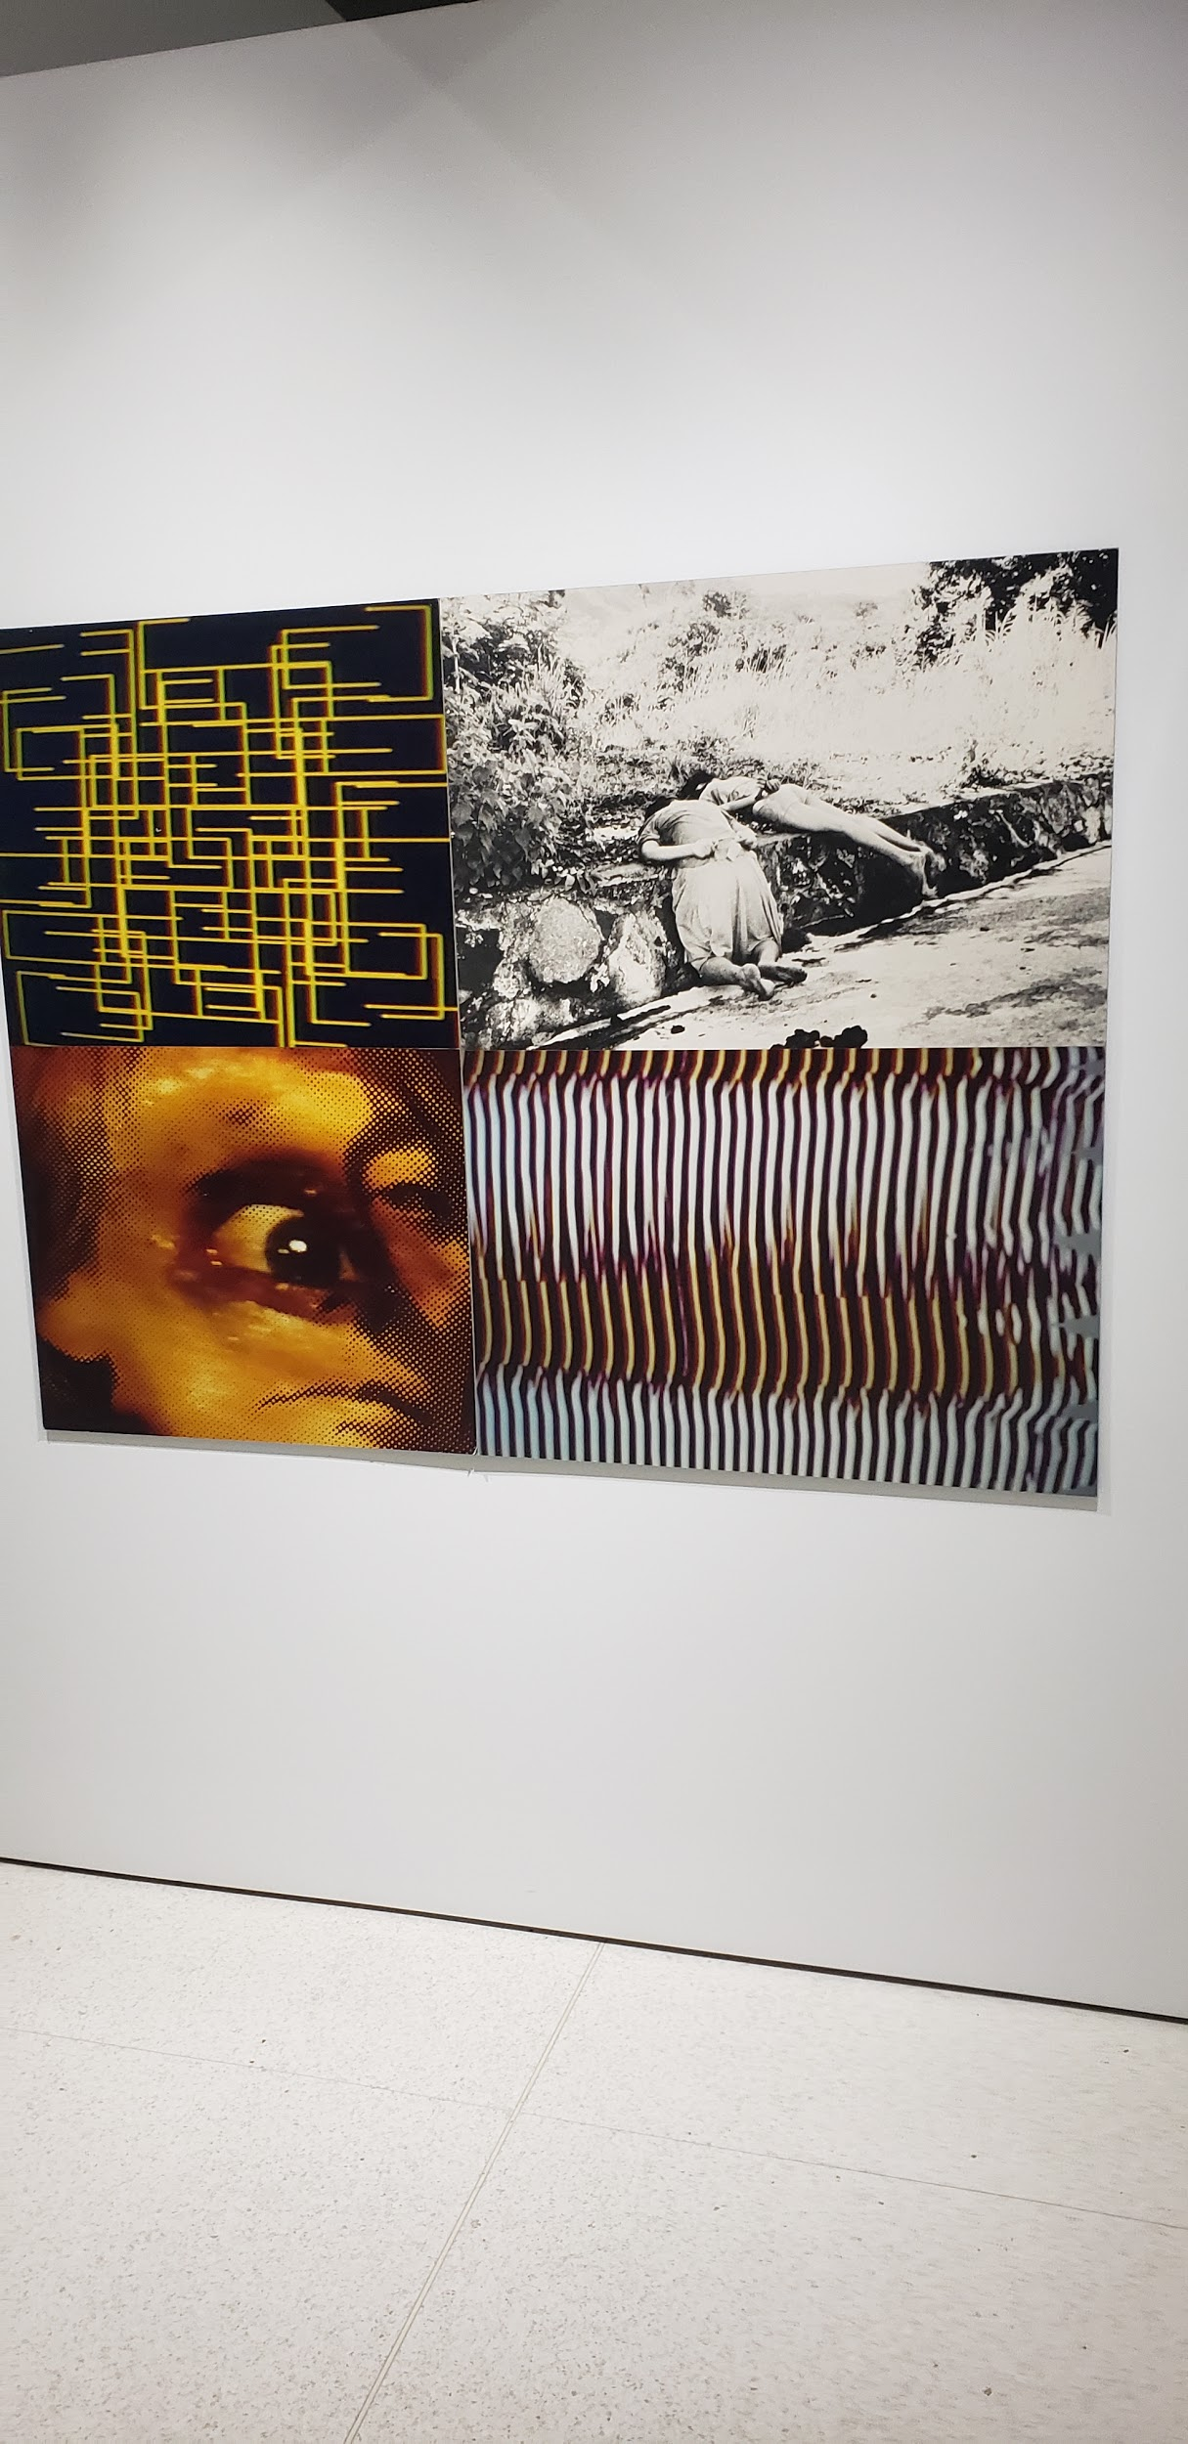

Slide 20
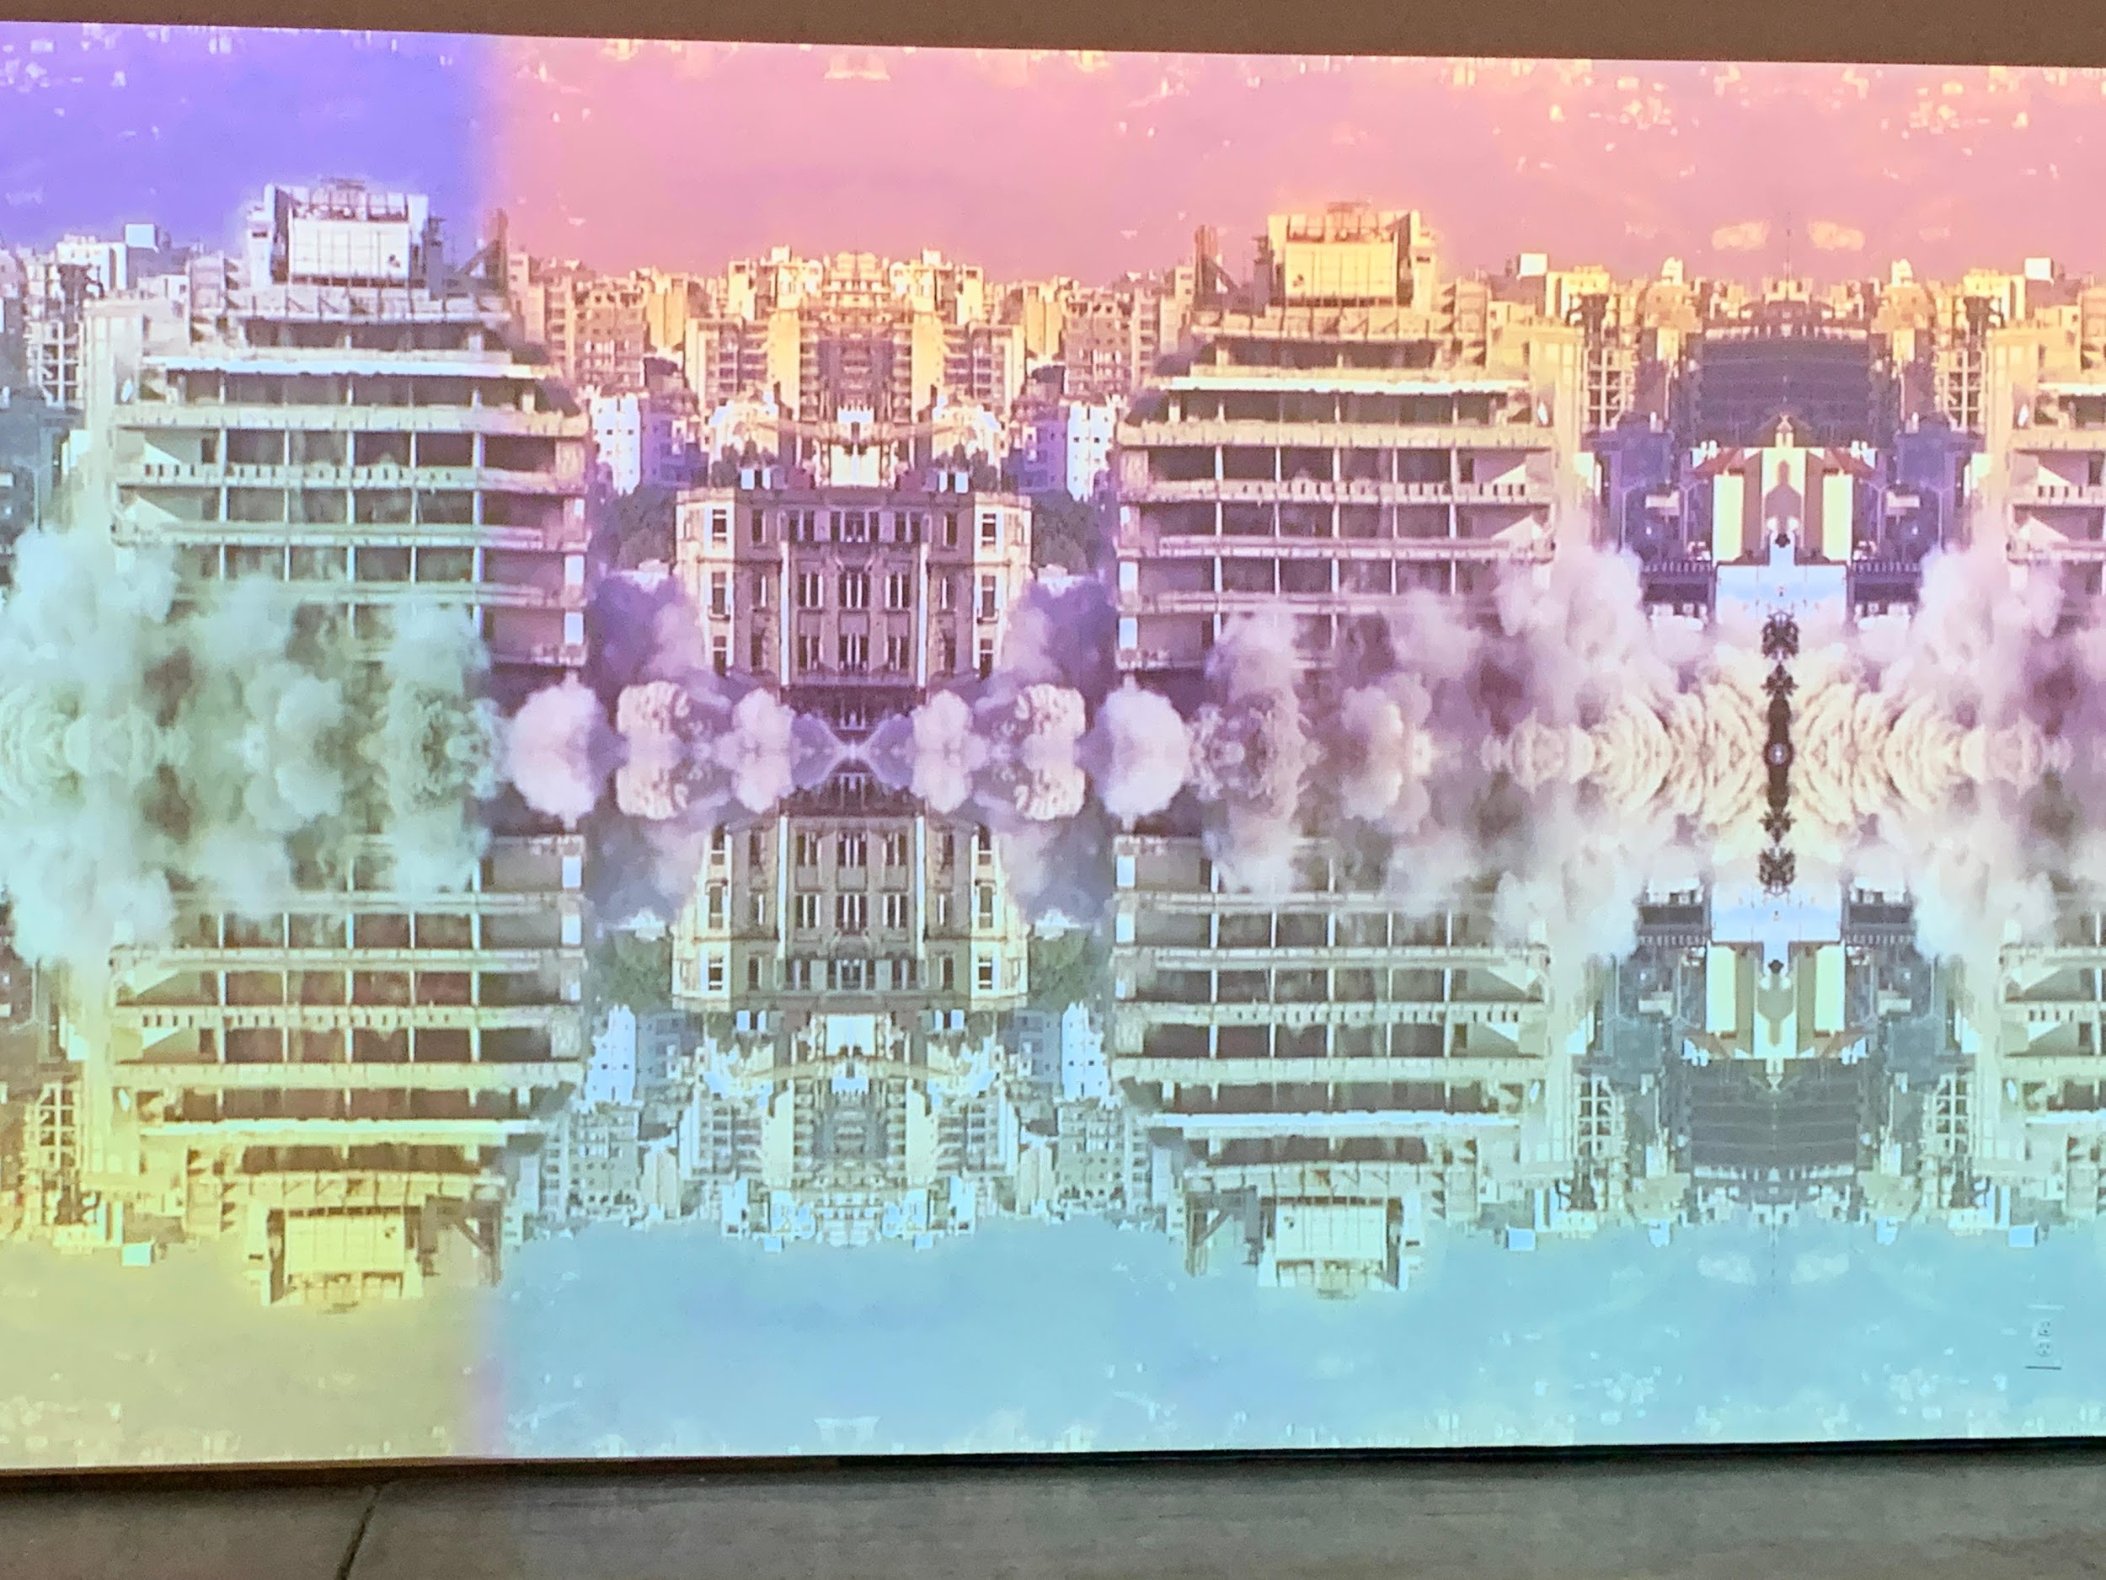
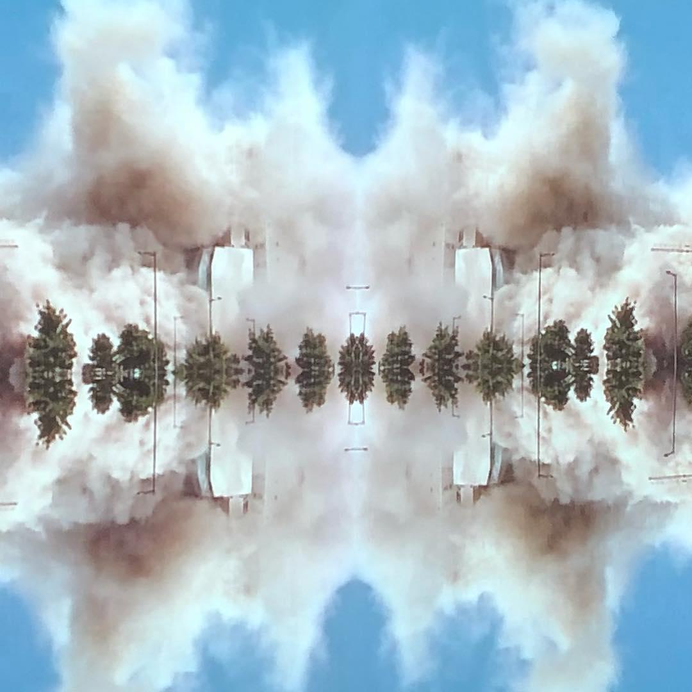
Walid Raad @ Paula Cooper

Slide 21
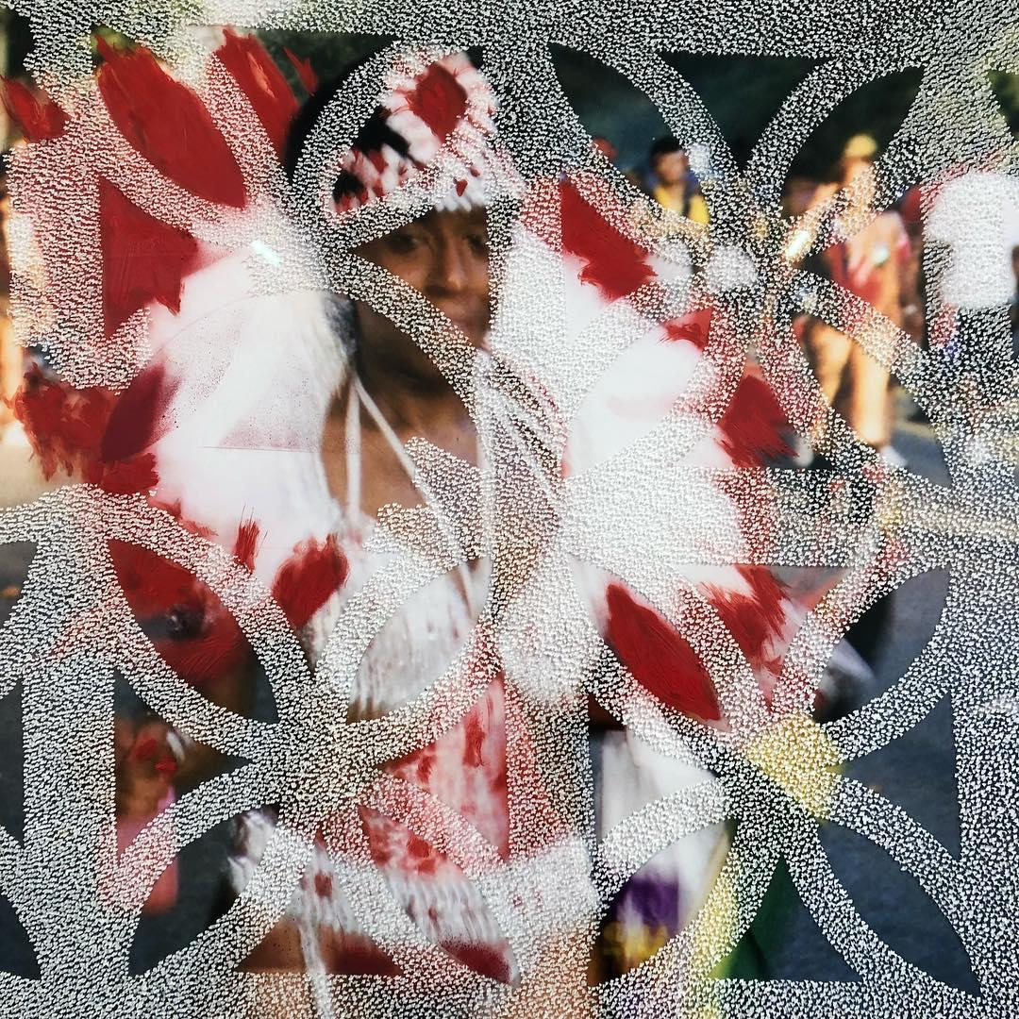
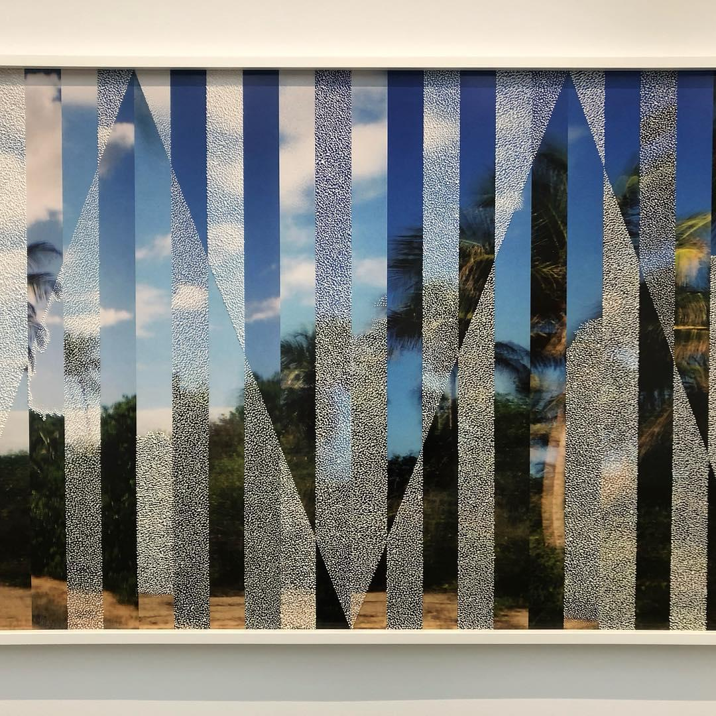
Paul Anthony Smith @ Jack Shainman

Slide 22
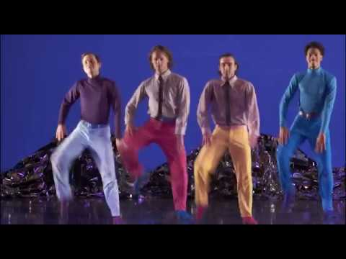
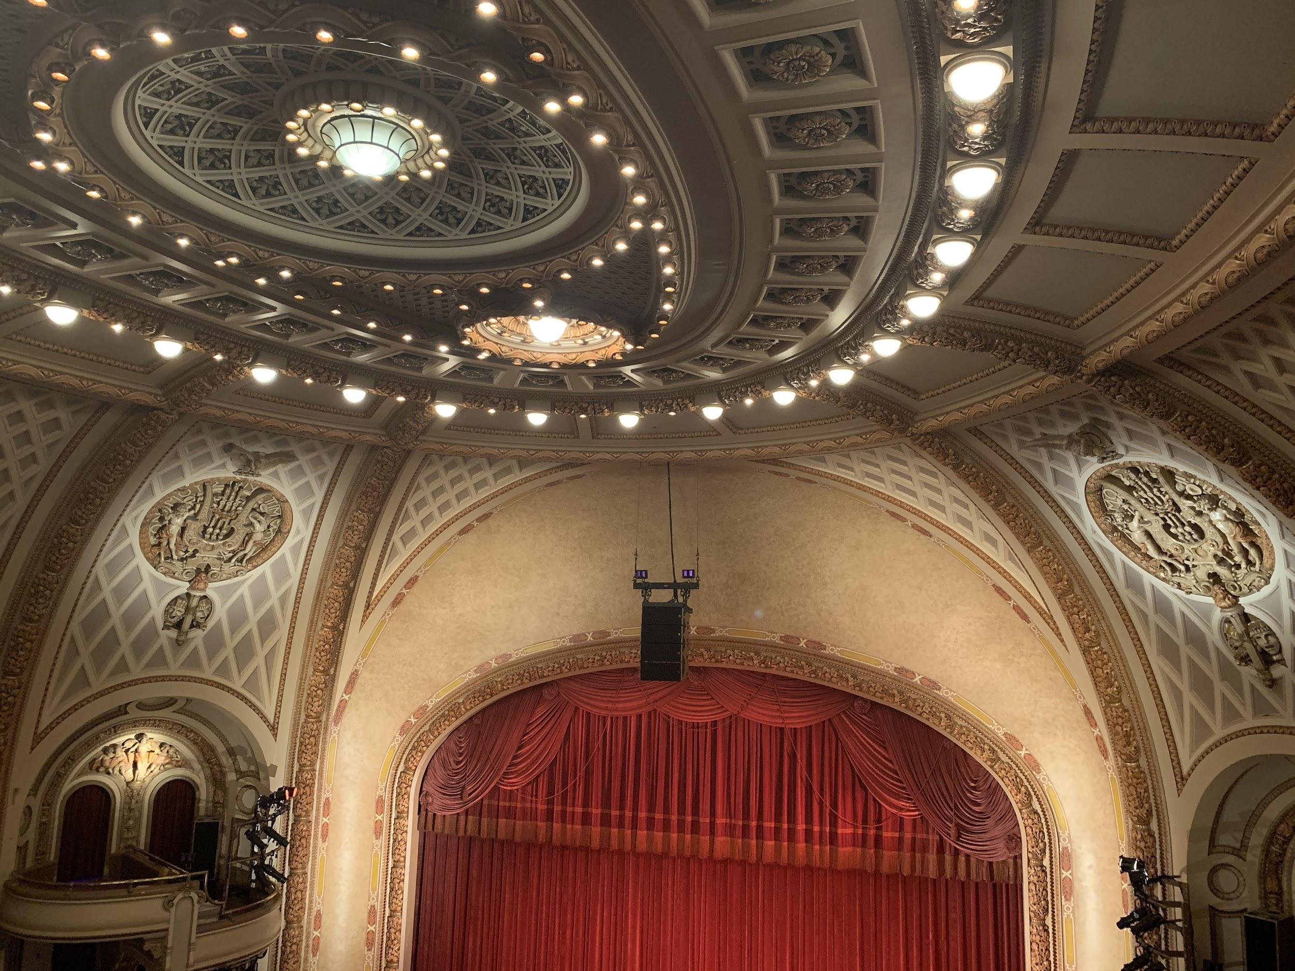
PEPPERLAND @ BAM
We are all very excited to go see our last show, Pepperland at BAM. Of course, it is sad that we must part after this last show, but that won’t put a damper on our mood!

Slide 23


Media
Trac

