Slide 1


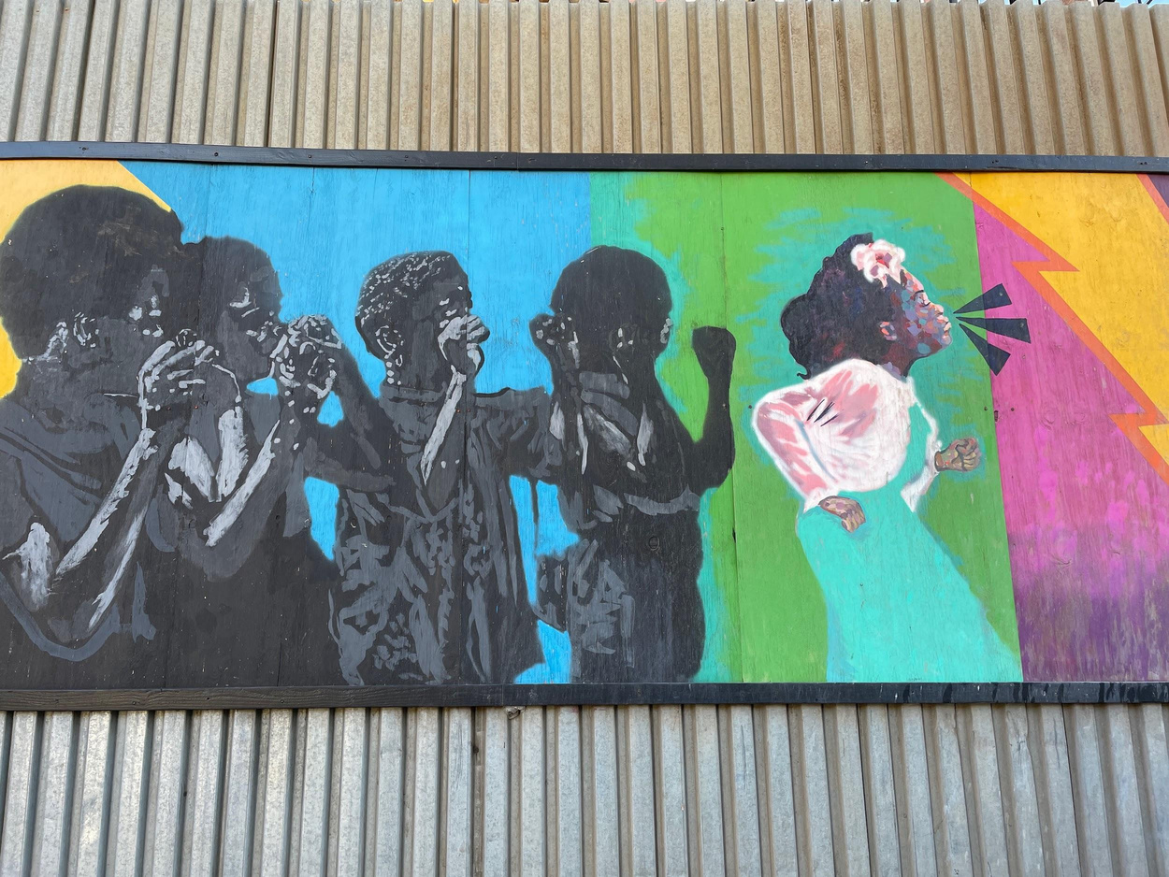

Multi-Arts TRaC
Fall 2024
@ HAUSER & WIRTH
ATISHA / DEHNVER / HENRY / MARIAM

Slide 2

New York Live Arts (NYLA)
Our ﬁrst workshop and event of the TRaC season was on November 8. The mood in the city was bleak; we considered not going to the show given
how people were feeling–but we were attending a performance that was about
healing, and we had talked about that quality at the kickoff, before the election
happened. So we went. And right before the show began, Mr. Bill T. Jones
himself–the artistic director of NYLA and acclaimed choreographer–stood up
from his front row seat, turned to the audience and began singing, “We shall
not, we shall not be moved.” It was a reminder of the resilience of art and
artists, and a beacon in the darkness that perfectly set the stage for this
meditation on humanity.

Slide 3


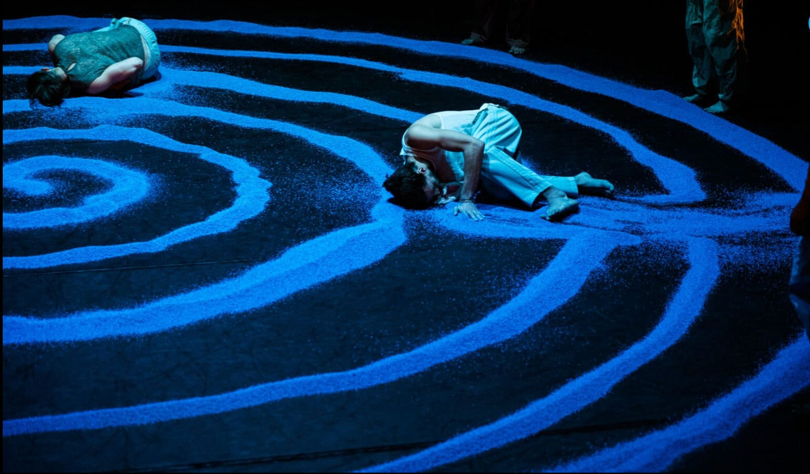
1. Ismaël Mouaraki | Destins Croisés Le Sacre de Lila @ NYLA
Meaning “night” in Arabic, a “Lila” is a set of nocturnal healing rituals that blends singing, dancing, and music, traditionally found in some North African countries. Mouaraki transposes the rites and codes of these dance rituals onto the stage, while infusing his signature contemporary street dance style to reveal the sensitivity and sensuality of the male body. Tinted with the tastes and colors of Morocco, the artists transform the performance into a celebration and exaltation of bodies that unfolds with an undeniable
energy.
https://fjordreview.com/blogs/all/a-journey-of-healing

Slide 4

The Gnawa and Their Lila
Theterm "Gnawa" refersﬁrstlytoa North African ethnic minority that traces its origins to West African slaves and soldiers.
Gnawa communities in the Maghreb (Morocco, Algeria, and Tunisia) trace their origins to the Sudan, not meaning the present-day nation of Sudan, but rather sub-Saharan African in general. (The word “Sudan,” after all, is merely the Arabic word for "the Blacks.") Thus, like the term "African-American," Gnawa refers to a group of people whose ancestors came from diverse regions of Africa but took on a collective identity in exile.
The second use of the term “Gnawa” refers to the people who participate in the musical and ritual tradition of the lila (Arabic
"night") or derdeba ceremony. Not all ethnic Gnawa participate in this tradition, and not all lila practitioners trace their ethnic
ancestry to the Sudan. However, the lila tradition is recognized to be a manifestation of the expressive culture of the historical
Gnawa.
The lila is a rich ceremony of song, music, dance, costume, and incense that takes place over the course of an entire night,
ending around dawn. An explicit goal of the lila is to allow participants to negotiate relationships with their melk (pl. mluk). The
melk is an abstract entity that gathers a number of similar jnun (genie spirits). The ritual enables participants to enter the trance
state of jadba, in which they may perform startling and sometimes spectacular dances. It is by means of these dances that
participants negotiate their relationships with the mluk either placating them if they have been offended or strengthening an
existing relationship.
https://www.sonispheric.net/the_gnawa_and_their_lila.htm

Slide 5


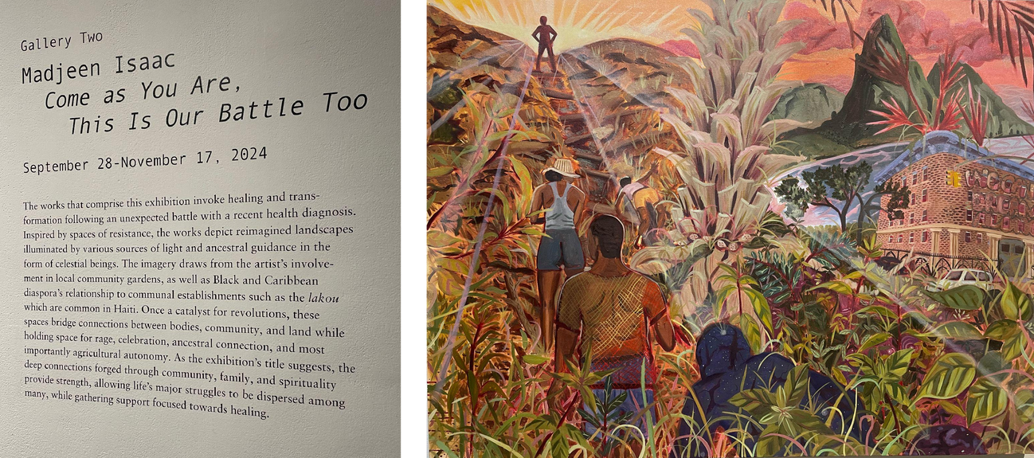
2. SMACK MELLON - DUMBO

Slide 6

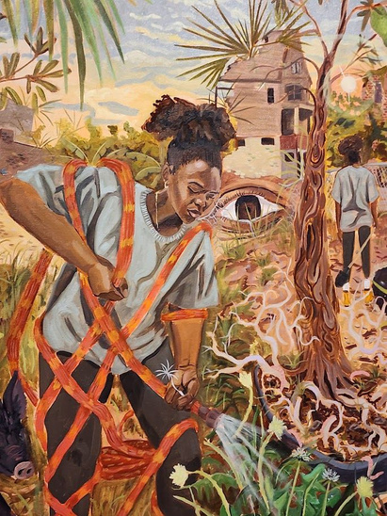
Wow, It's Almost Like I'm There
To all the first generation New York teenagers: it’s okay, I know. New York City is such a melting pot which gives us the advantage that someone who moved to Ohio would not have. Even if you don't actively display your culture at home, you have the opportunity to learn about it for free, whether that be through street vendors or your local mom ‘n pop restaurant. However, as a first generation New Yorker, you might often feel yourself searching for more connection to your culture. If you identify with this dilemma then a great place to start is Madjeen Isacc’s “Come as You Are, This Is Our Battle Too” as it illustrates life in the Caribbean.

Slide 7

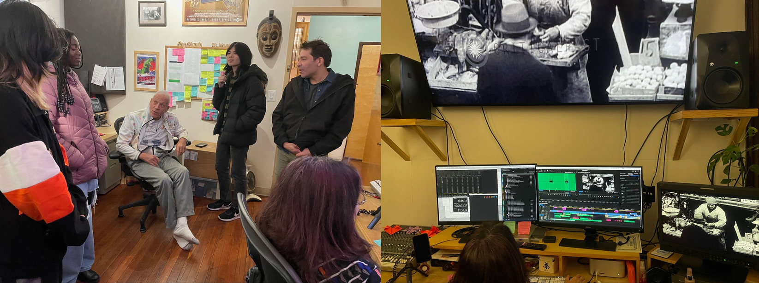

3. DCTV
Here we are with 16-time-Emmy-award winning journalist and founder of DCTV, Jon Alpert, working on his newest documentary, “The Raging Rabbi” about a prize-fighter in rabbinical school.

Slide 8

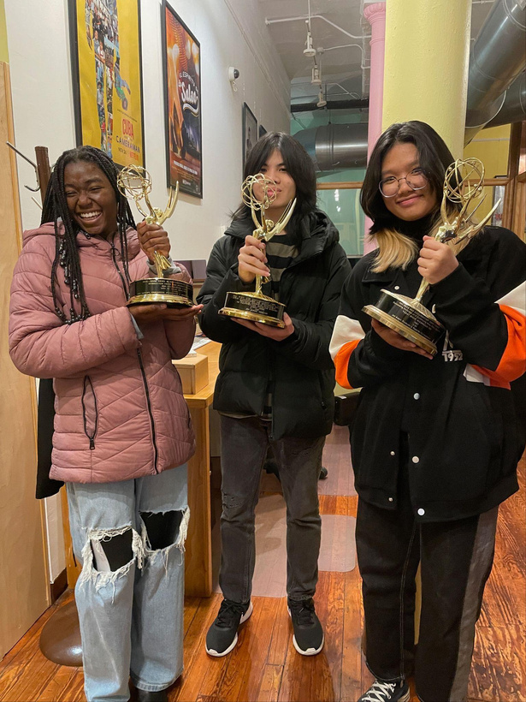


And the winners are…
Us! Because we got to DCTV! Yes, we got to hold Emmys (which was very cool) but that doesn't even begin to describe the DCTV experience. This organization is a beacon for teenagers and young adults in New York City; not only do they offer a gateway to the film industry, they also supply members with food, computers, and other resources that they otherwise might not have access to.If you’re looking for a creative found family or simply looking to try something new to try, DCTV is definitely the place to be!

Slide 9




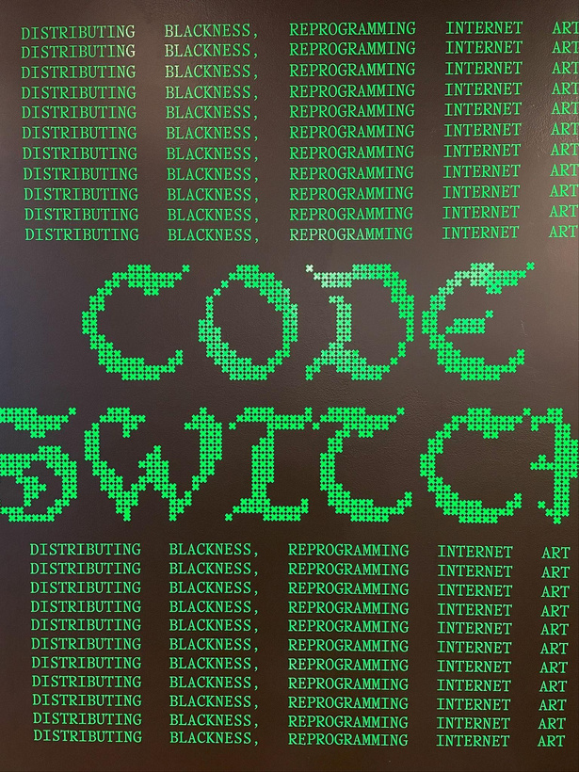
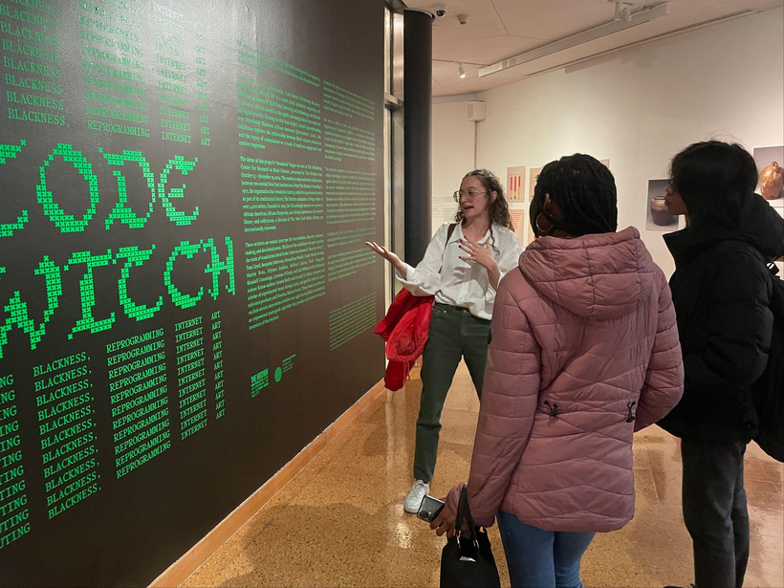
4. CODE SWITCH
Bridget now works at The Kitchen, the org that curated the exhibit, and she showed us around and gave us the VIP arts education treatment! 😊😊😊

Slide 10

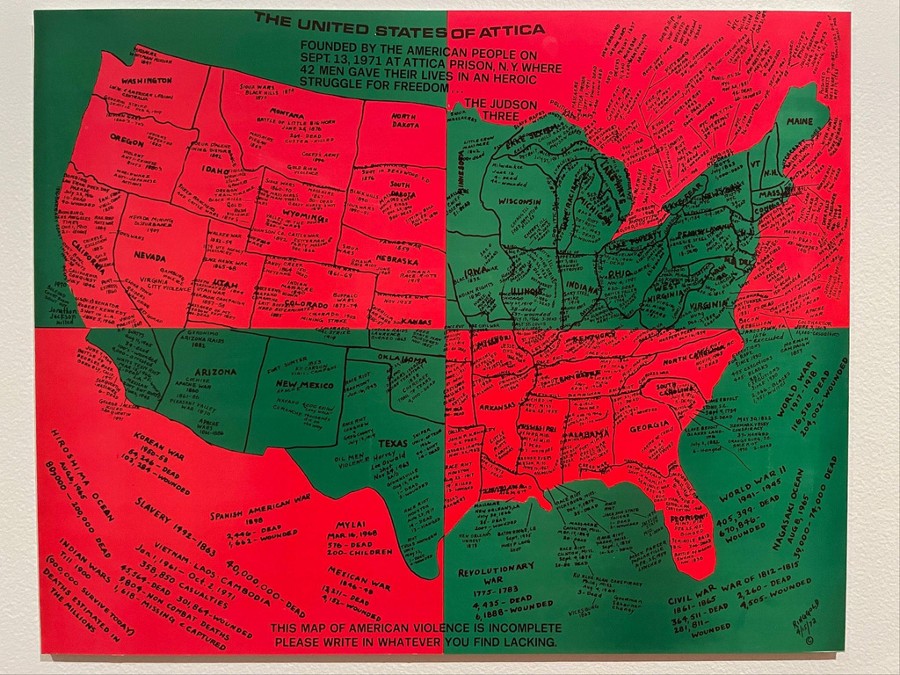
US OF ATTICA*
InSeptember 1971, half of Attica’s
2,000-person incarcerated population took over the prison in a historic week-long uprising that ended in the massacre of 42 people. Artist and activist Faith Ringgold began researching and crafting her next piece immediately. By 1972, it was complete: the United States of Attica. Instead of the flag’s red, white, and blue, Ringgold’s map uses a Pan-African palette of red, black, and green. Instead of marking towns and cities, she painstakingly inscribed events of anti-Black and colonial violence, from the Civil and Vietnam Wars to the Battle of Little Bighorn and the Watts Rebellion. Splitting the map into four quadrants deliberately divides the “United” States. It also resembles the scope of a gun. Everyone on U.S. soil is a target. Ringgold even included a key message: “This map of American violence is incomplete / Please write in whatever you find lacking.”

Slide 11

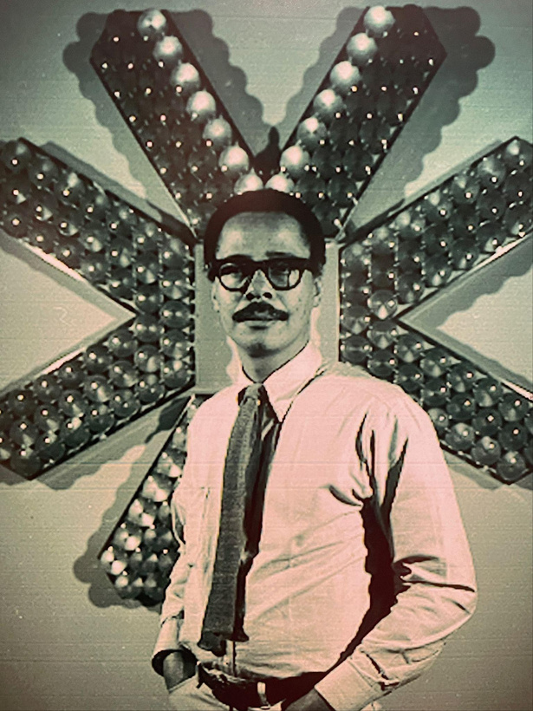



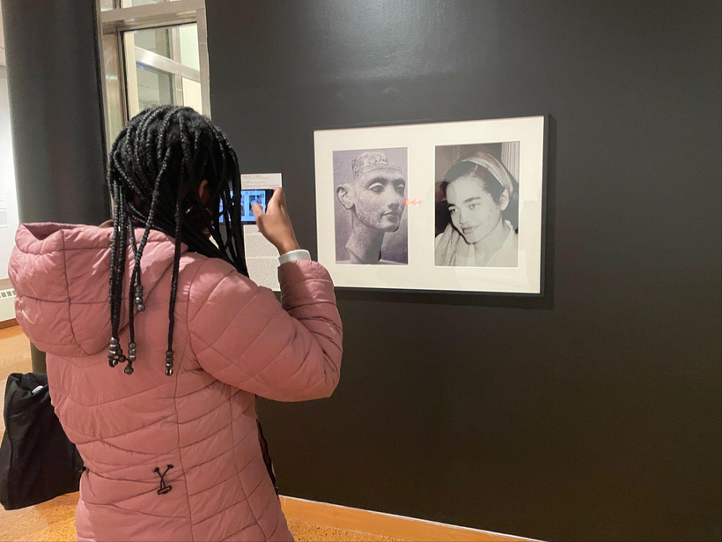
Lorraine O'Grady (September 21, 1934 – December 13, 2024) was an American artist, writer, translator, and critic. Working in conceptual art and performance art that integrates photo and video installation, she explored the cultural construction of
Artist, activist, and community organizer Tom Lloyd worked primarily in abstraction and technology to create unique, electronically programmed light works.
identity – particularly that of Black female subjectivity – as shaped by the experience of diaspora and hybridity.

Slide 12



Ulysses Jenkins
“He’s a meme on tiktok.”
A pivotal inﬂuence on contemporary art for over 50 years, Ulysses Jenkins (b. 1946, Los Angeles) is a groundbreaking video artist who emerged in the late-1970s. His video and media work is remarkable for its fusion of forms to conjure vibrant expressions of how image, sound, and cultural iconography inform representation. Using archival footage, photographs, image processing, and elegiac soundtracks, Jenkins pulls together strands of thought to construct an “other” history that consistently interrogates questions of race and gender as they relate to ritual, history, and state power.

Slide 13

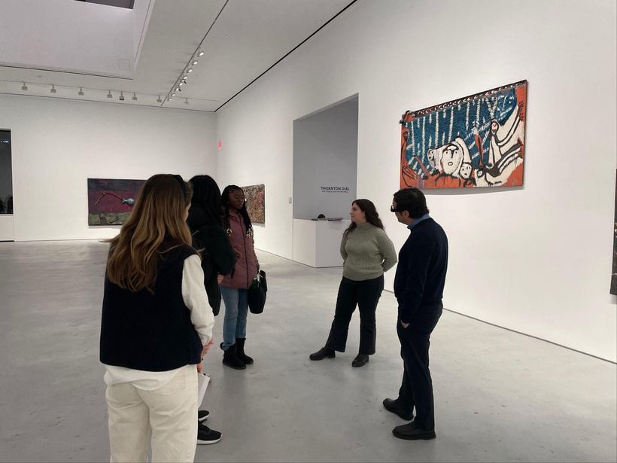
5. THORNTON DIAL
Thornton Dial has a different perspective on America that you may or may not be used to. As a Black person growing up in a time period of racism and slavery, Dial saw many injustices and was subject to them himself. He could not read hence his artwork, which became a way for him to express his views and opinions with the world. His work, though stemming from reasons that are sad and abhorrent, though sad, may give more information than some history books today do. Thornton Dial's most notable artworks, such as “Mr. Dial’s America” give insight into just how America, the so-called “land of the free and home of the brave” has been to Black people. Dial, though not able to use words, communicates to his viewers that the society we have been living in, while obviously unfair, might be more messed up than we thought.

Slide 14

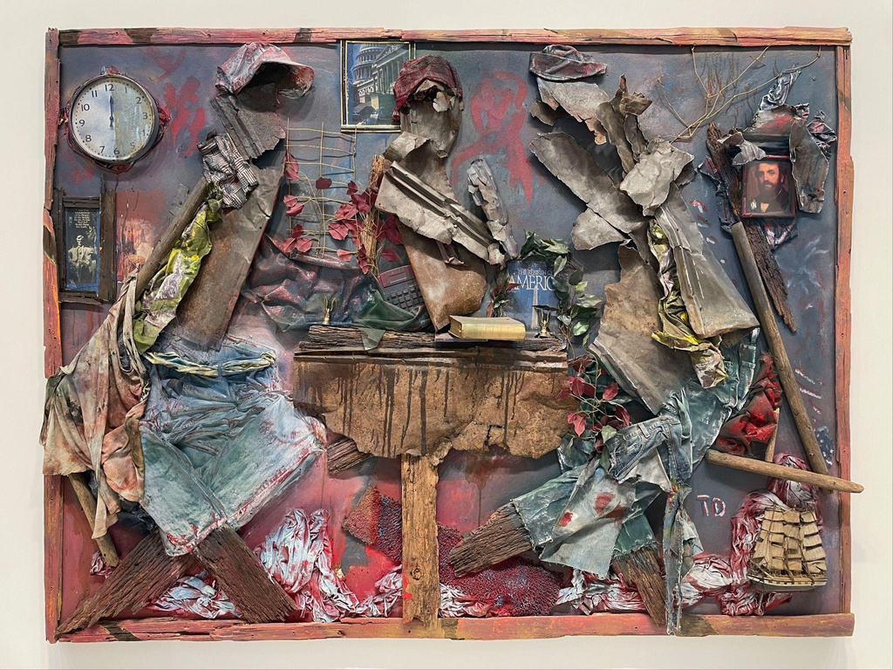
Mr Dial’s America
Mr. Dial’s America is riddled with symbolism, both blatant and hidden. While it may seem like a simple piece on the surface, the longer you stare at it, the more you notice. Do you think that you can find the hidden symbols?

Slide 15
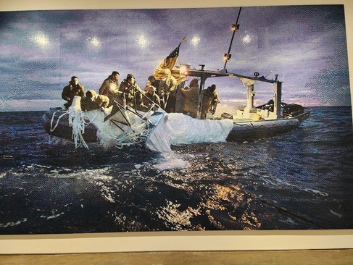


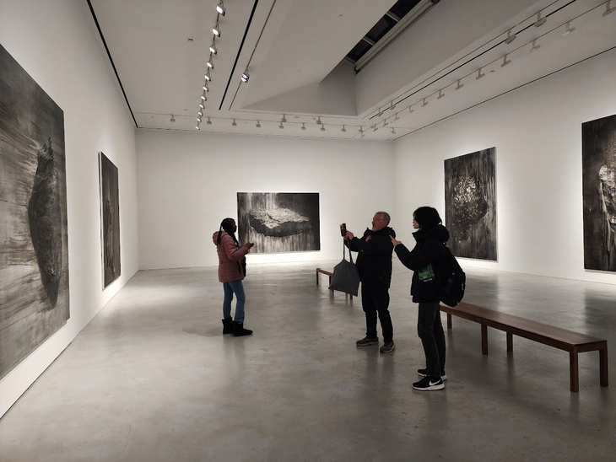

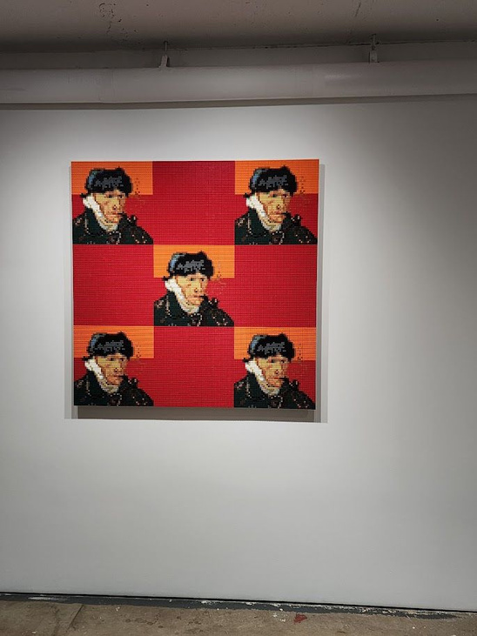

Slide 16


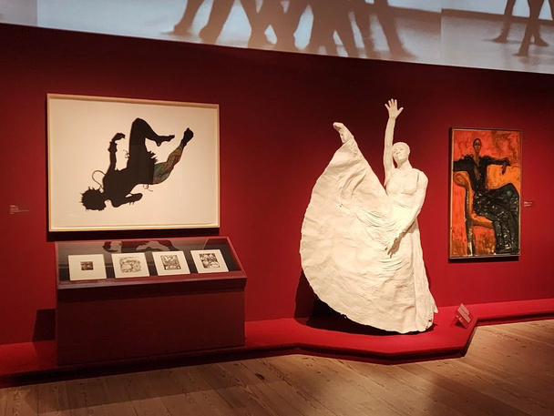
6. EDGES OF AILEY @ THE WHITNEY
“Edges of AIley” at Whitney showcased Ailey’s artistic legacy and the establishment of Alvin Ailey American Dance Theatre ( AADT). It consisted of a huge installation which played the recordings of AAADT including the creation of his iconic work “Revelation”. The timeless choreographies depicted Ailey’s upbringing as an African-American navigating the culture.
Ailey’s presence comes across through video surrounding
the upper and his personal effects, in a floor filled with
artworks by over eighty artists. These works are arranged
by themes that shaped Ailey’s life and dances. Sections
span an expanded Black southern imaginary that enfolds
histories of the American South with those of the Caribbean,
Brazil, and West Africa; the enduring practices of Black
spirituality; the profound conditions and effects of Black
migration; the resilience for and necessity of an
intersectional Black liberation; the prominence of Black
women in Ailey’s life; and the robust histories and
experiments of Black music; along with the myriad
representations of Blackness in dance and meditations on
dance after Ailey.

Slide 17

OUR BIG ART QUESTION
What would you do if you were trapped in a museum or gallery overnight?
Here’s an article from the British publication The Guardian about such things:
Nights at the museum: tales of being trapped in galleries, a cathedral … and a 'hotel'
We’re probably the most like Louis Morris Murphy Jr, mostly for the 911 call LOL

Slide 18


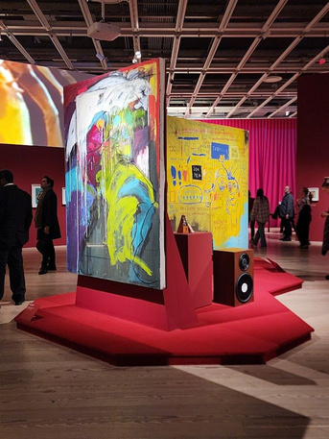

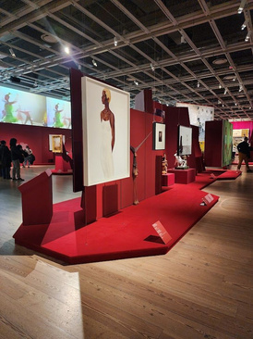


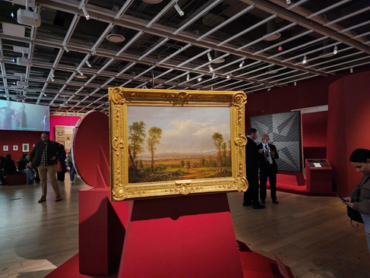

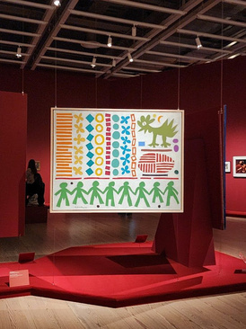
Ailey and more
…
The exhibit also included many artists of color working in different media that connected to the Ailey aesthetic. It was amazing to see works by artists like Basquiat, Mickalene Thomas, Faith Ringgold, Jacob Lawrence, William H. Johnson, Barkley Hendricks, Ralph Lemon, Glenn Ligon. We couldn’t help but notice those works and artists that Multi-Arts TRaC had seen at other exhibits (like Code Switch) or that Map Free City saw last summer at the Giants exhibit at BAM or the Harlem Renaissance exhibit at The Met.

