Slide 1
MULTI-ARTS / MEDIA TRaC
SPRING 2025

Slide 2
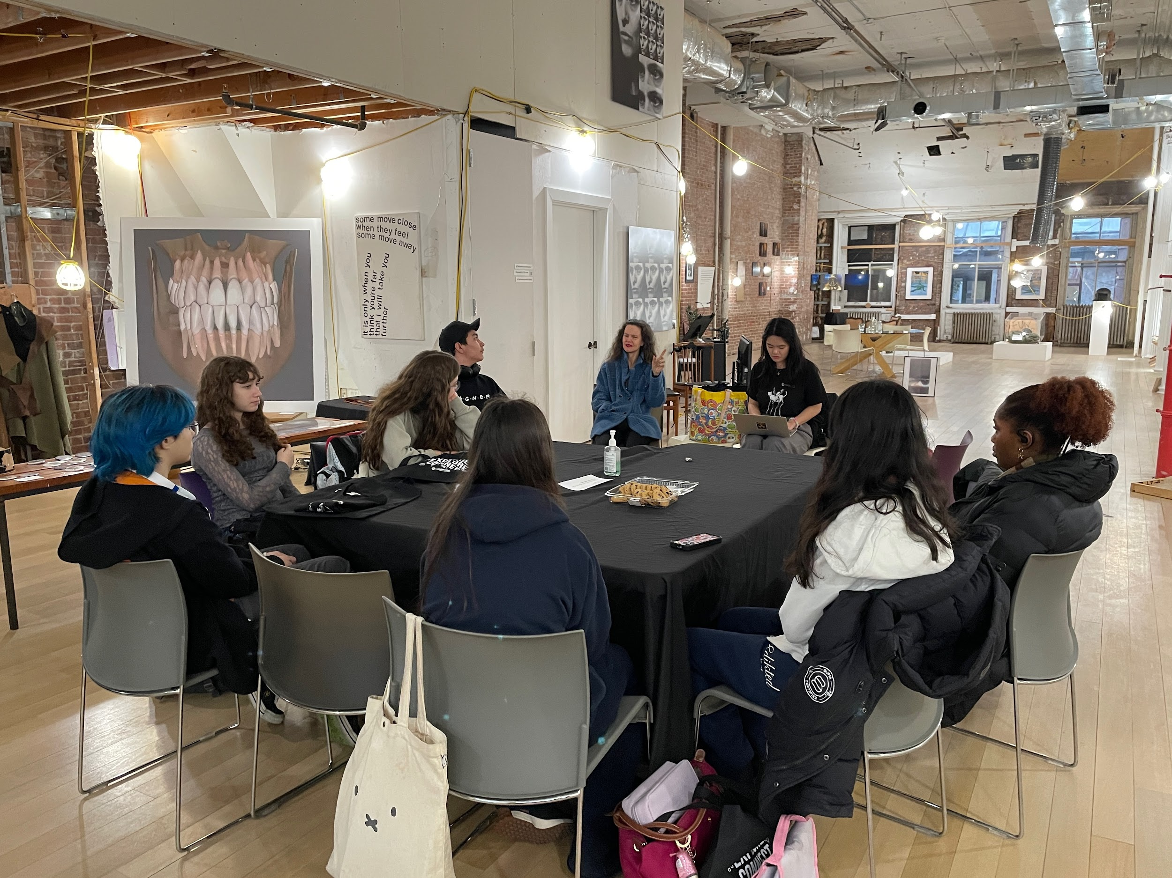
@ The Development Gallery in Tribeca

Slide 3
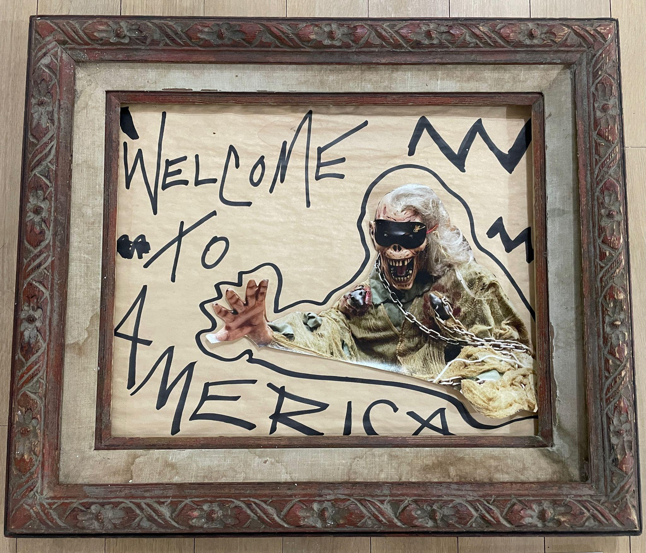
Host Artist Jennifer Elster
Jennifer Elster is an American experimental artist, filmmaker, writer, photographer, musician, and performer. She is the founder of The Development, a film and art studio based in New York City. She is best known for her performance artwork, her solo multidisciplinary exhibitions, The Retrospective of an Extroverted Recluse, and The Wake The F*ck Up Show, as well as her artistic collaborations transforming the late David Bowie into different characters and having written lyrics Yoko Ono performed for the online cinematic excursion Elster helmed entitled ITW Pathway featuring Will Oldham and the late Glenn O'Brien. Elster conceived and directed her upcoming fourteen year film project ...In the Woods (and Elsewhere), which features subjects such as Terrence Howard, Debra Winger, Questlove, Rosie Perez, and Dave Matthews, among others. Elster's performance and video art have been exhibited at the New Museum and Central Booking gallery, in group shows with artists, such as Jonas Mekas and the late Kate Millett, and she has performed at such galleries as Signs and Symbols Gallery, Catinca Tabacaru Gallery, and The Development Underground. Her work focuses on the complexities of humanity and the ongoing fight for social justices. She designs under the J. Elster brand.

Slide 4
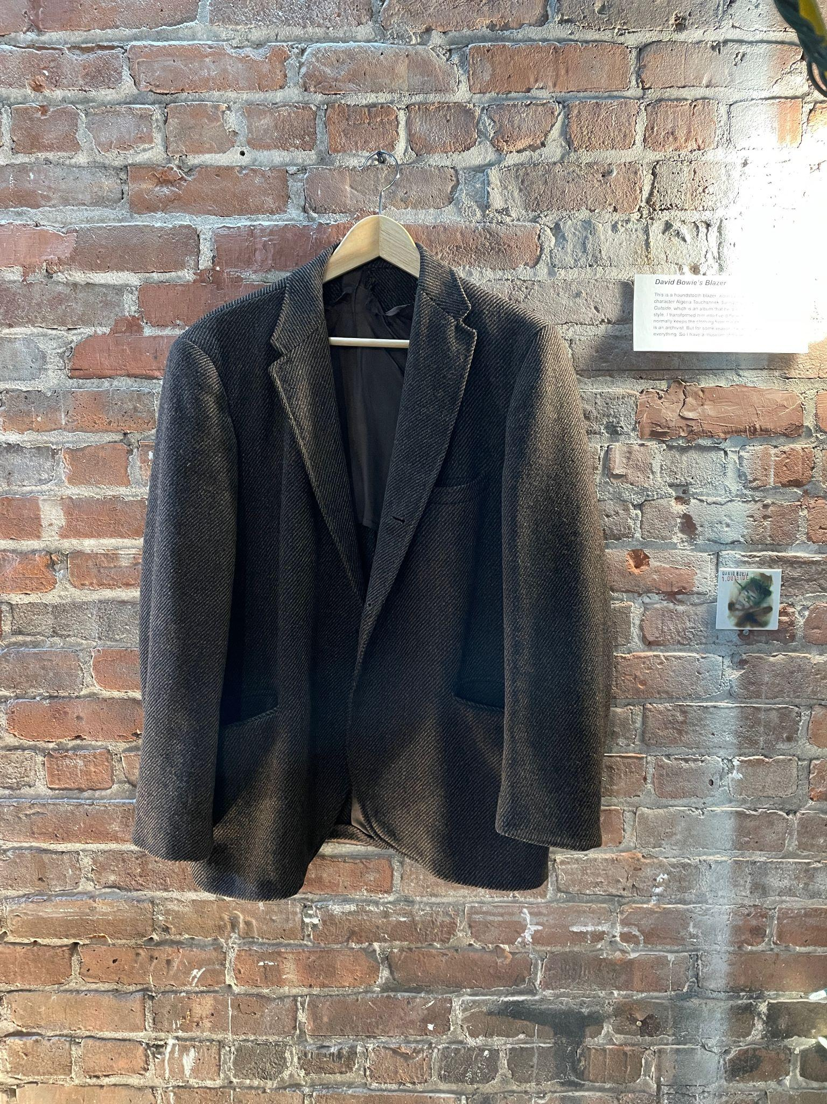
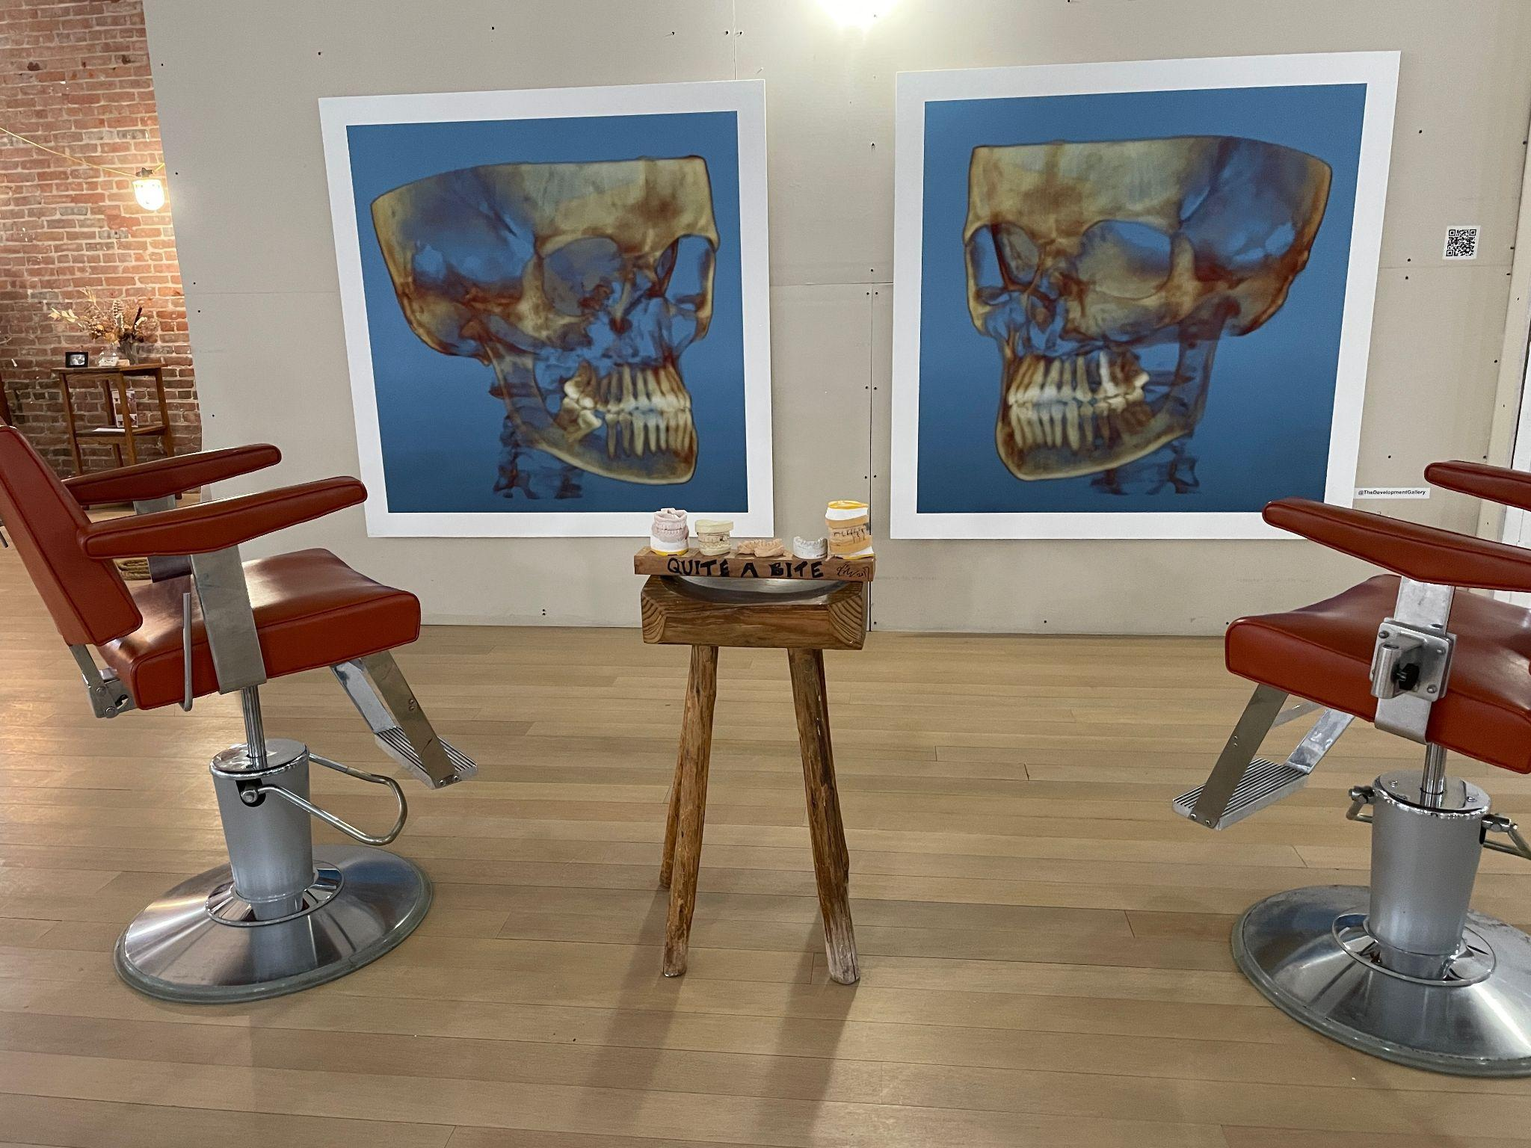
< David Bowie’s Jacket
one of Jennifer’s installation pieces

Slide 5
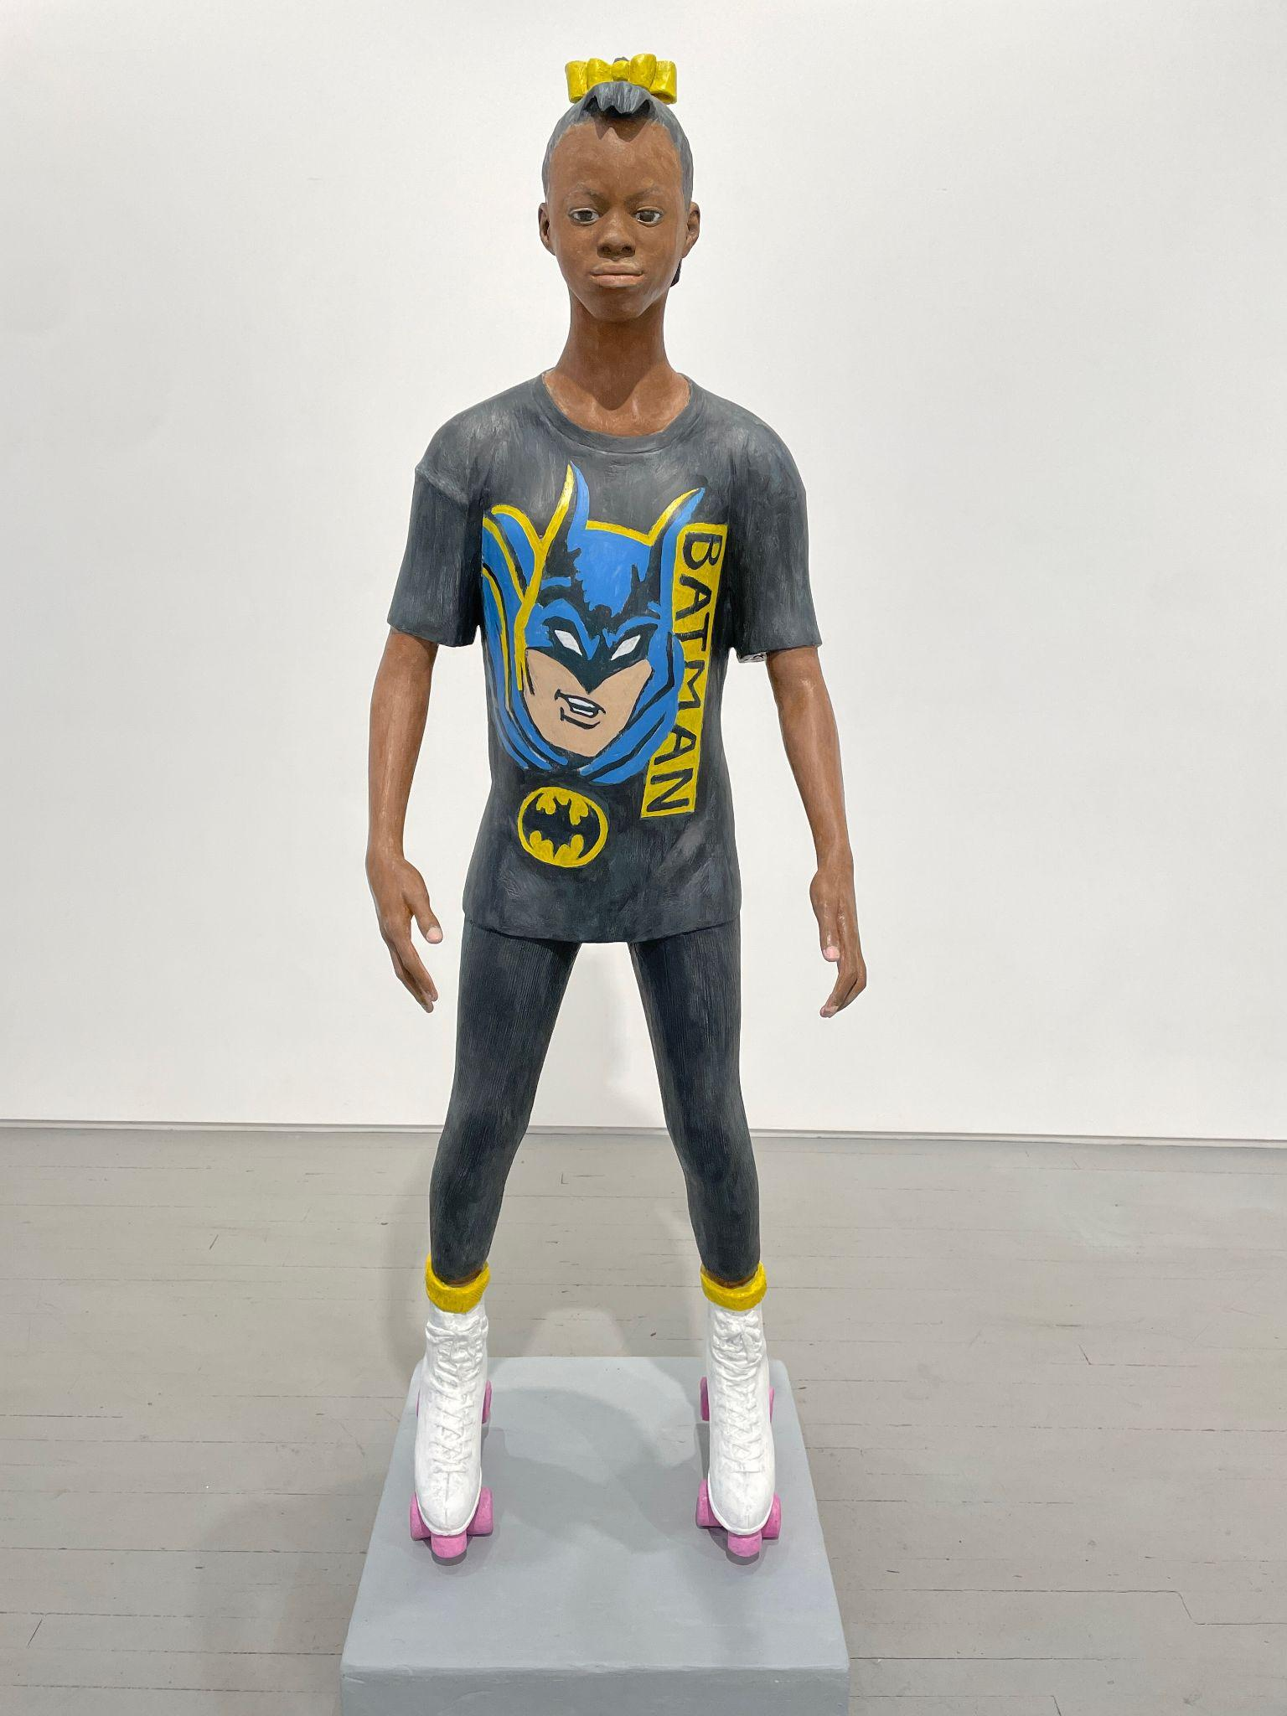
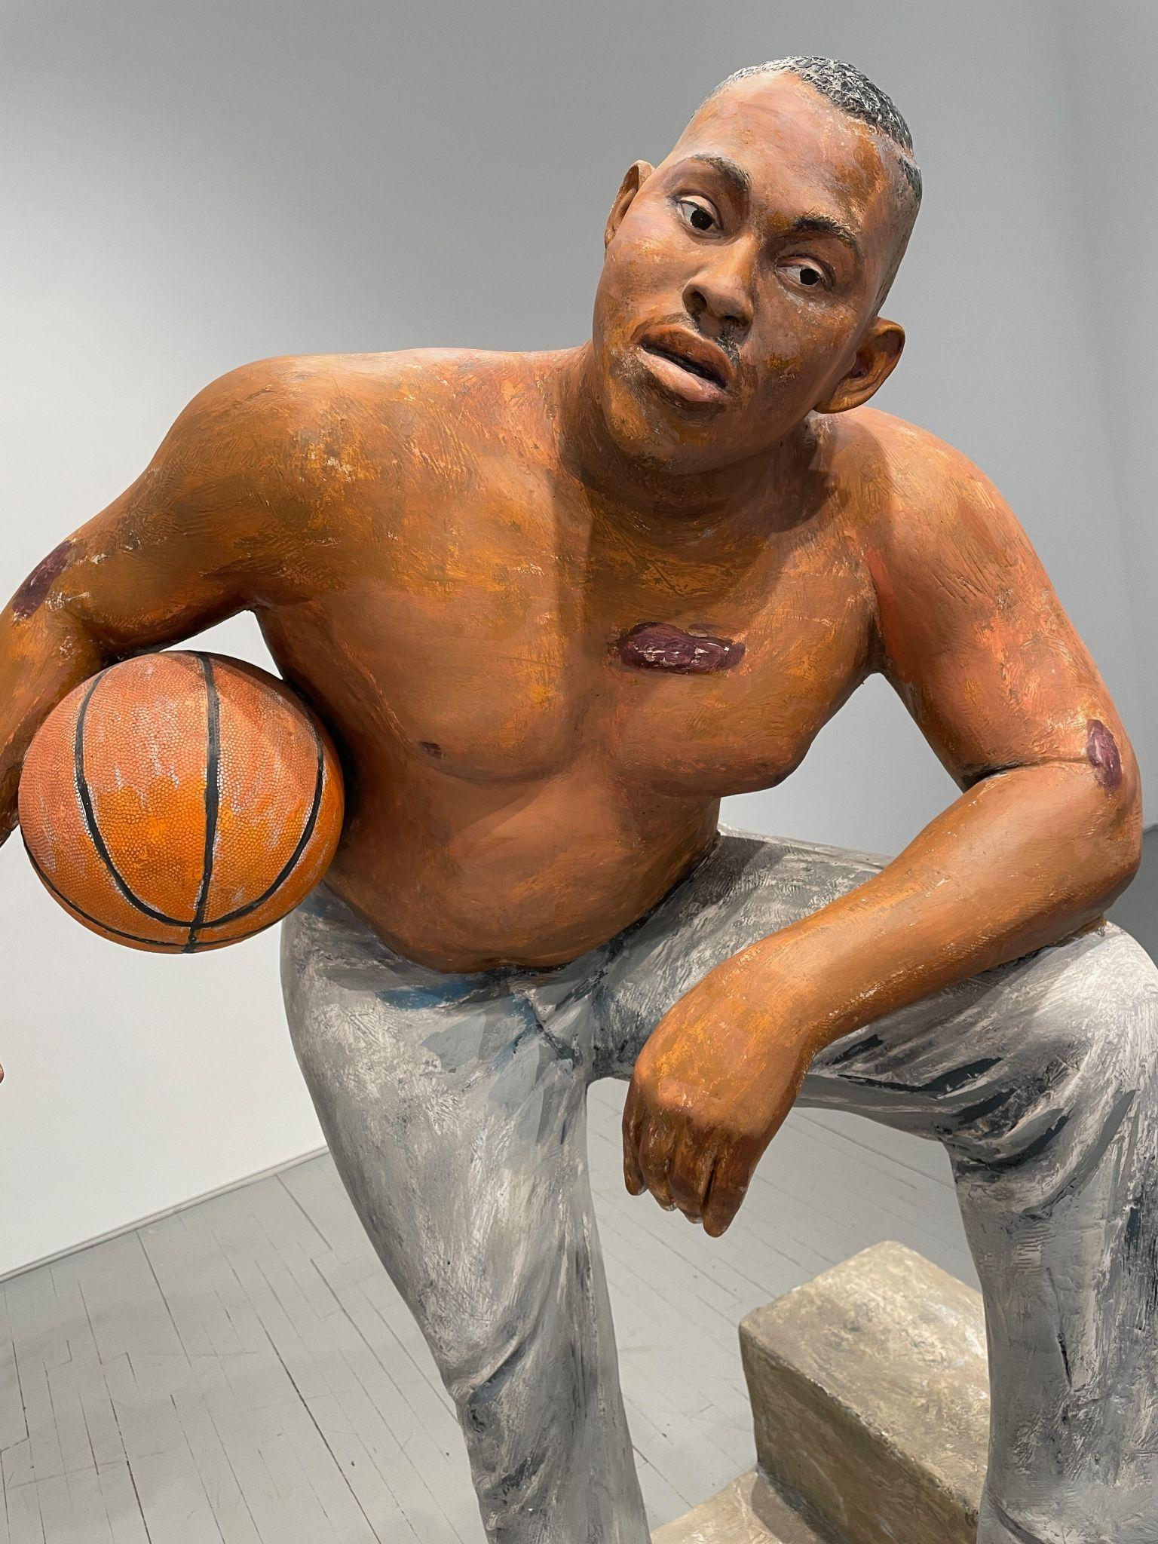
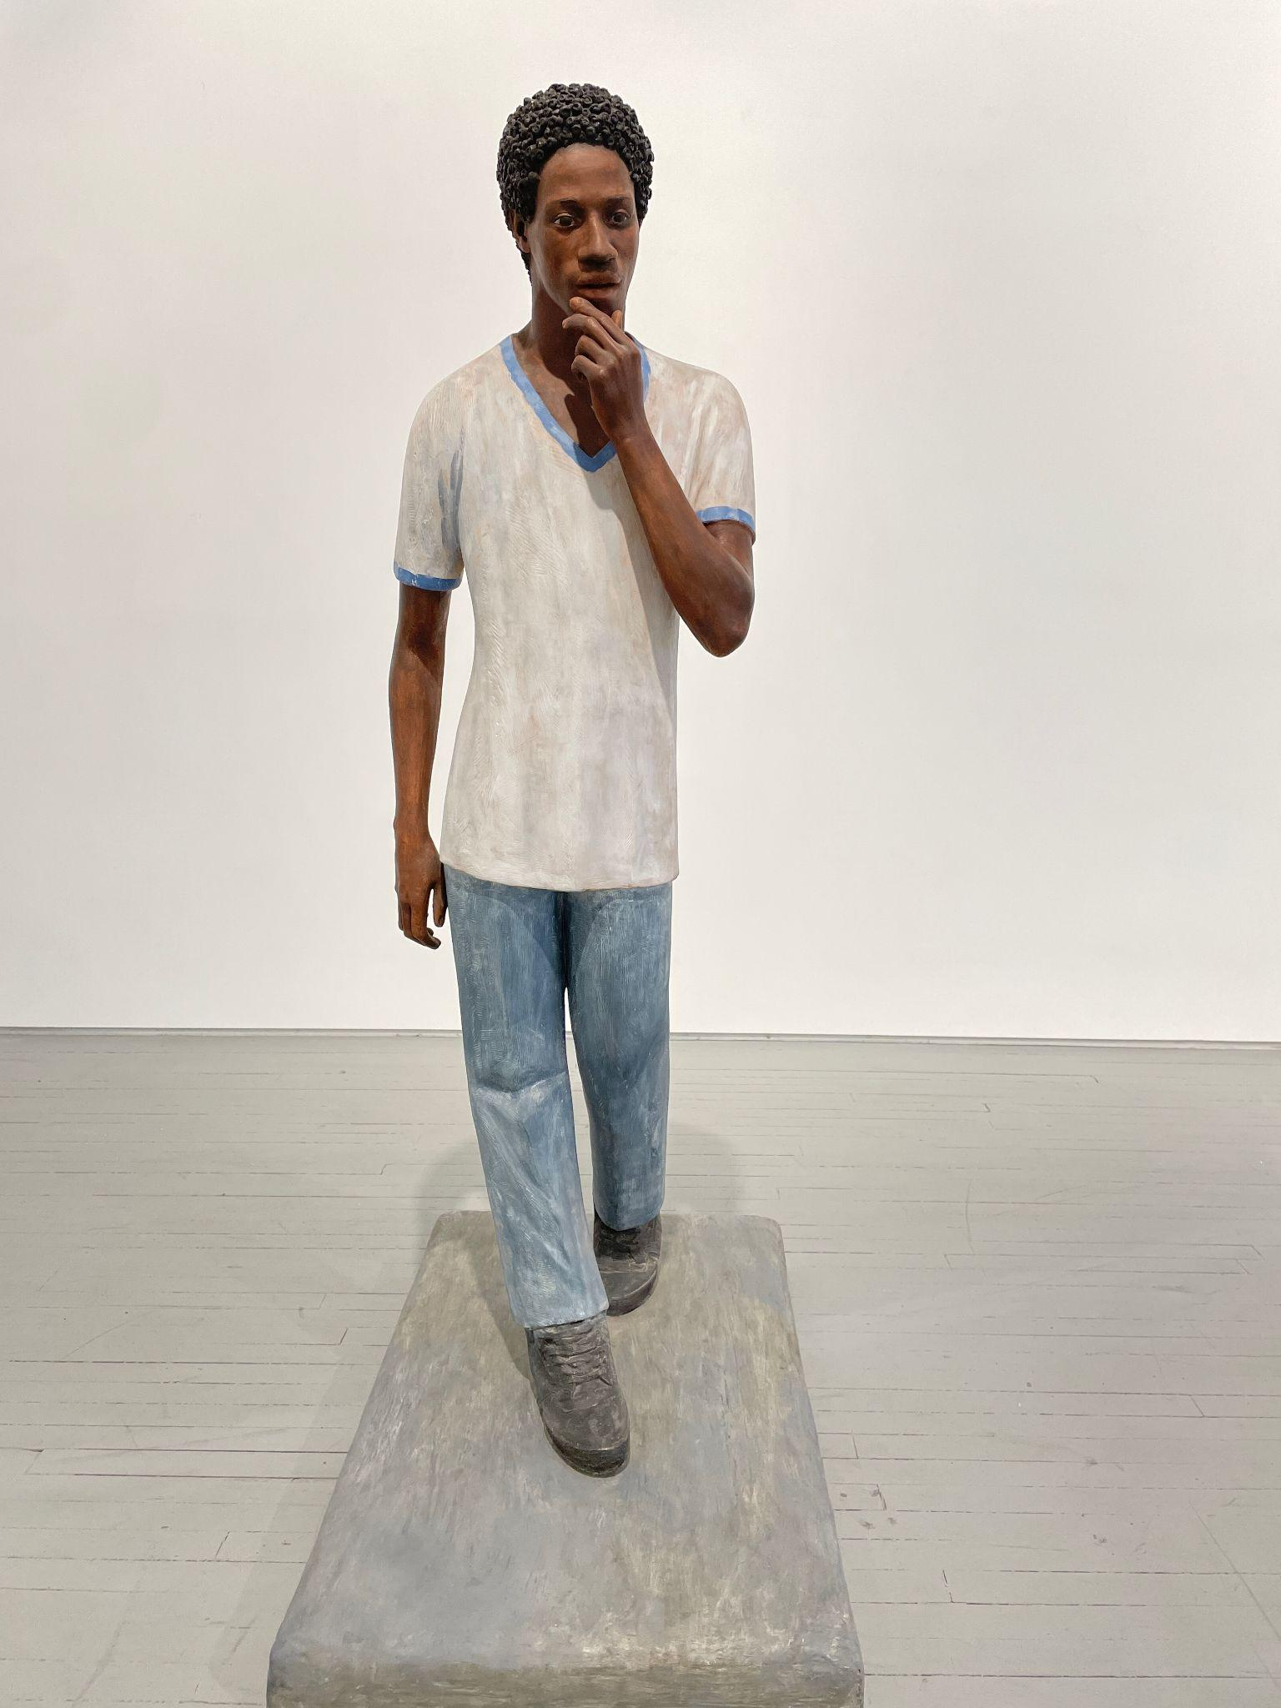
TRIBECA GALLERIES
https://www.culturedmag.com/article/2024/01/08/gallery-new-york-tribeca-neighborhood-newcomers

Slide 6
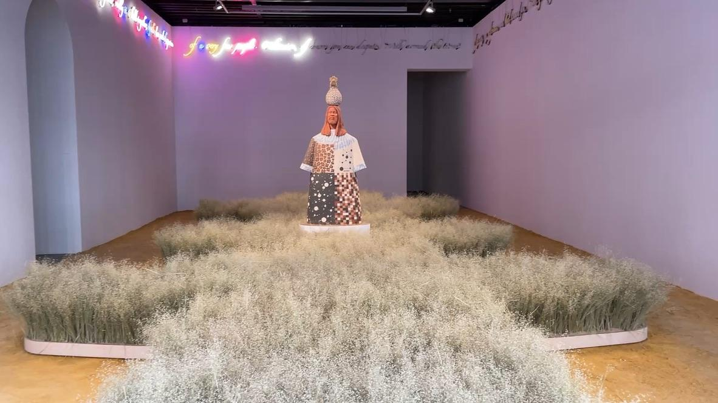
Tavares Strachan @ Mariann Goodman
the room smelled of the rice grass, earthy and mildly sweet.

Slide 7
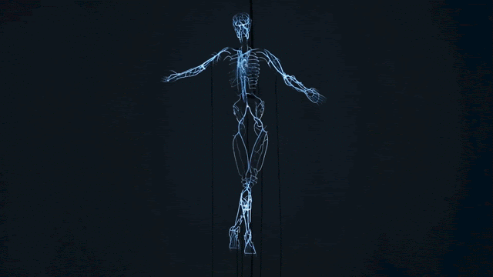
Player pianos / cut in half, emerge from walls / crying their etudes

Slide 8
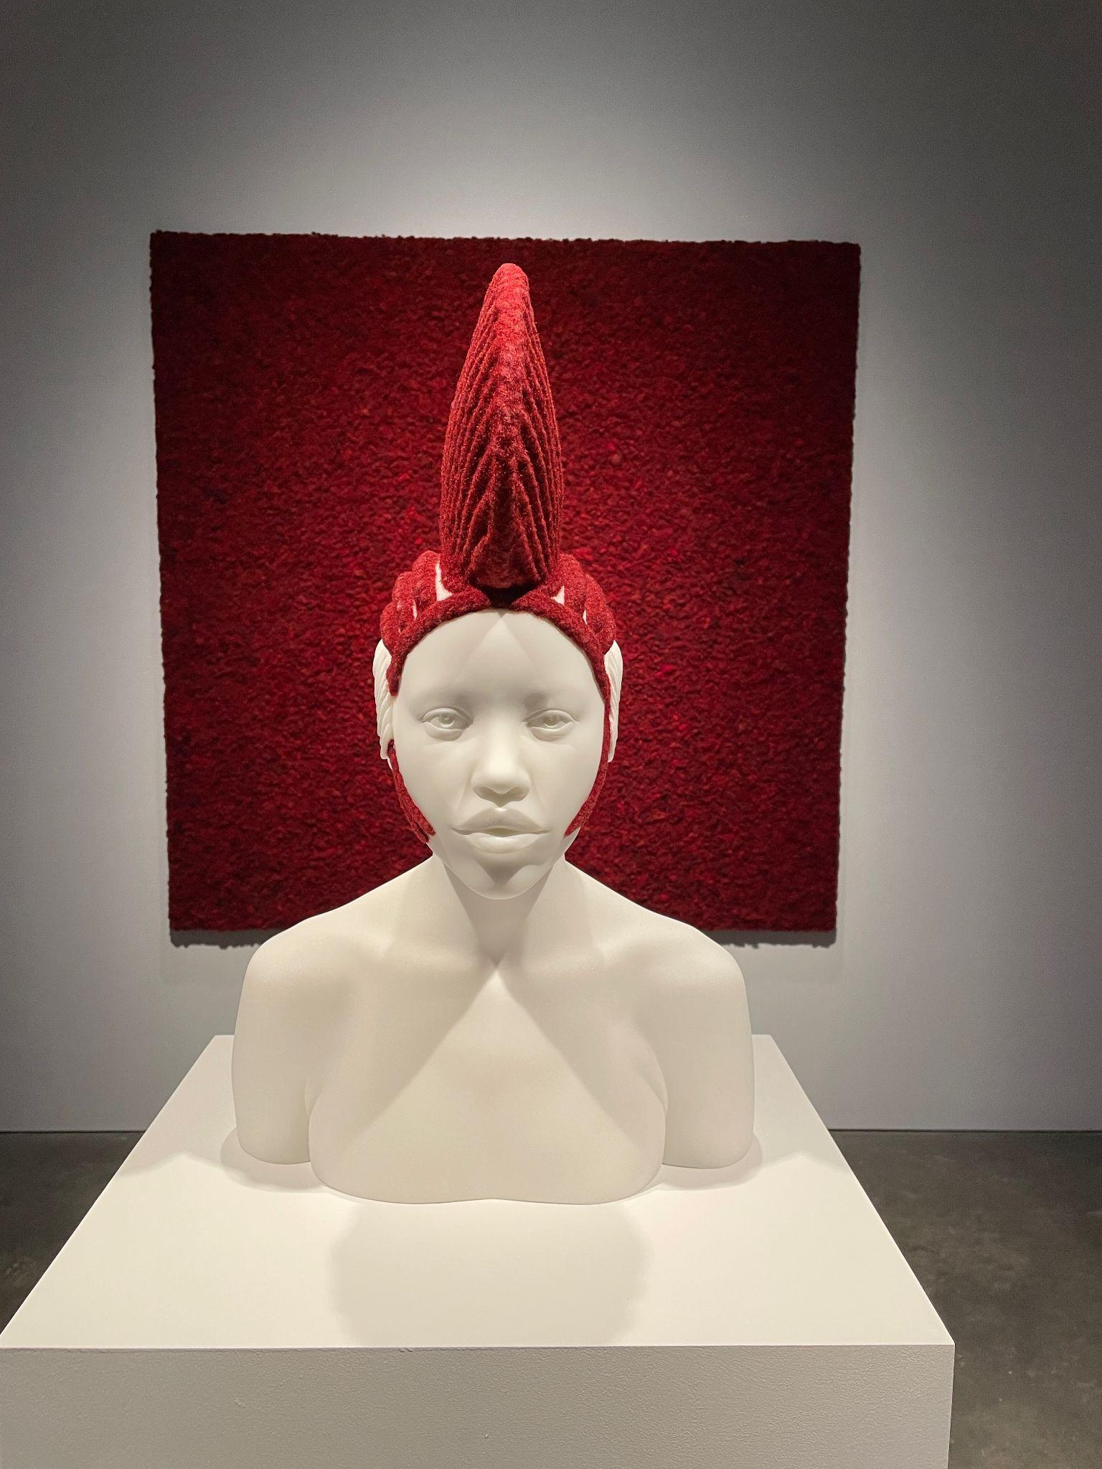
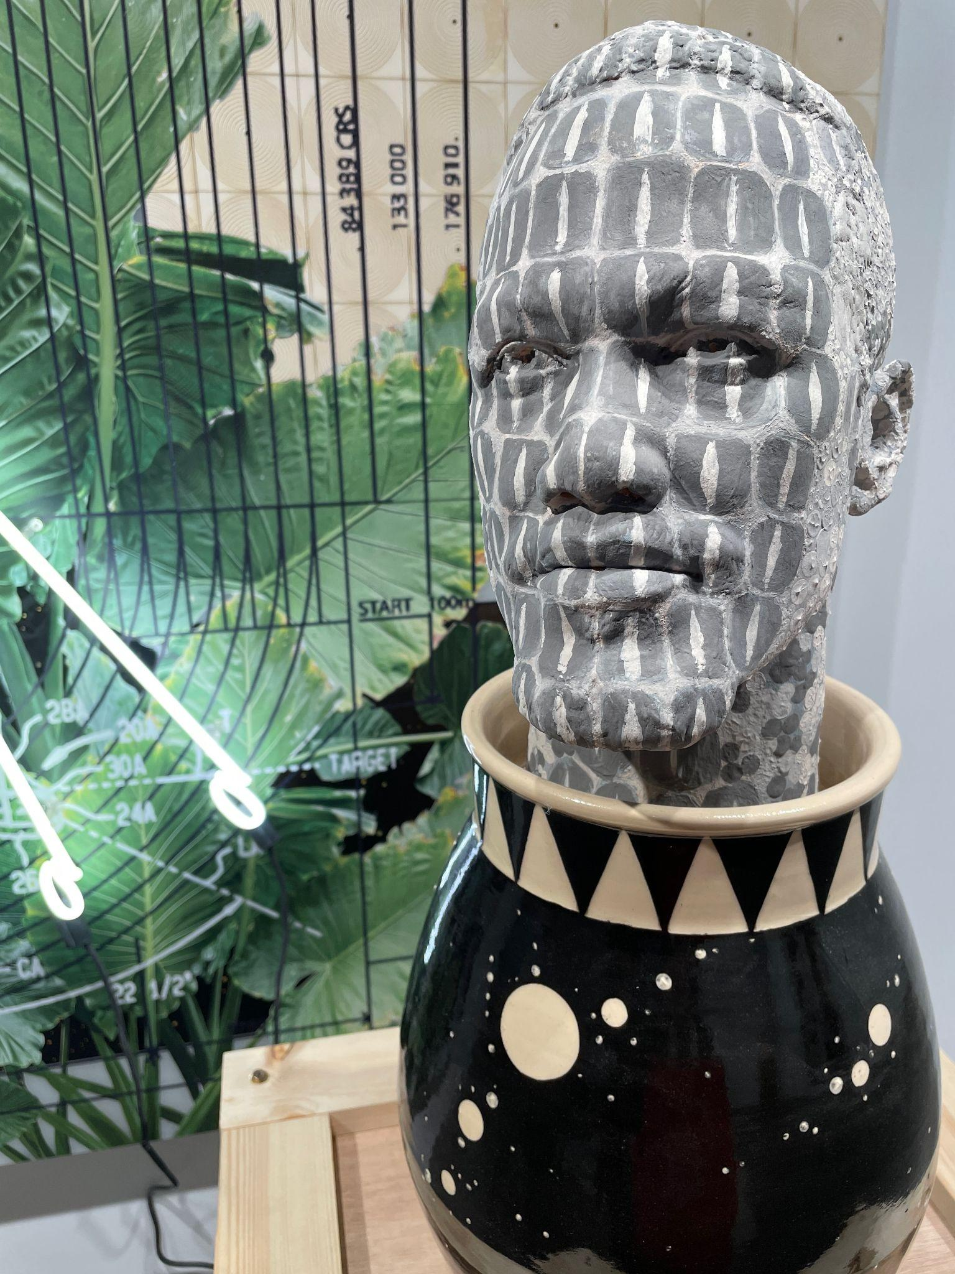

Slide 9
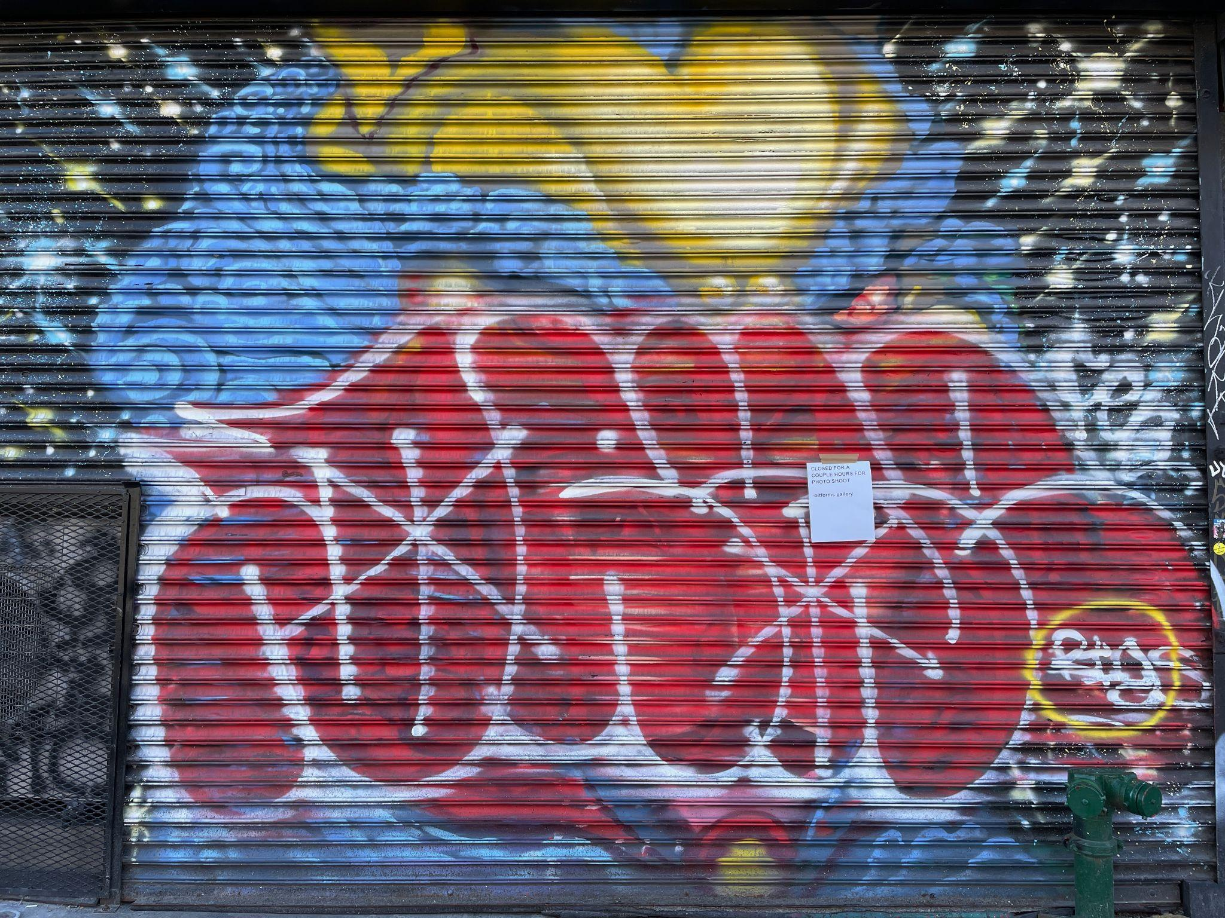
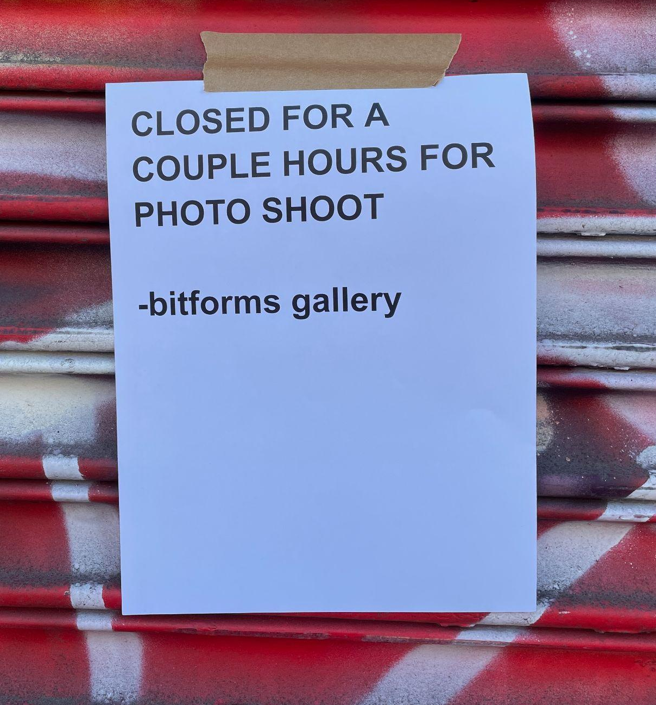
LES (Lower East Side aka Loisaida) GALLERIES
We met up at bitforms but as fate would have it, they were closed for a photo shoot.

Slide 10
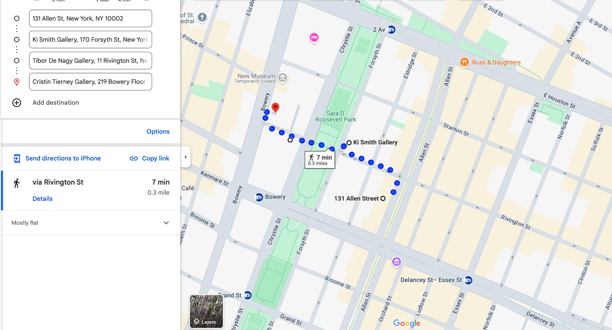
What was not on our plan, but you can see if across from one of our stops, is Freeman Alley, one of NYC’s hidden gems–an immersive outdoor gallery, and “a canvas for urban artists from around the world.”

Slide 11
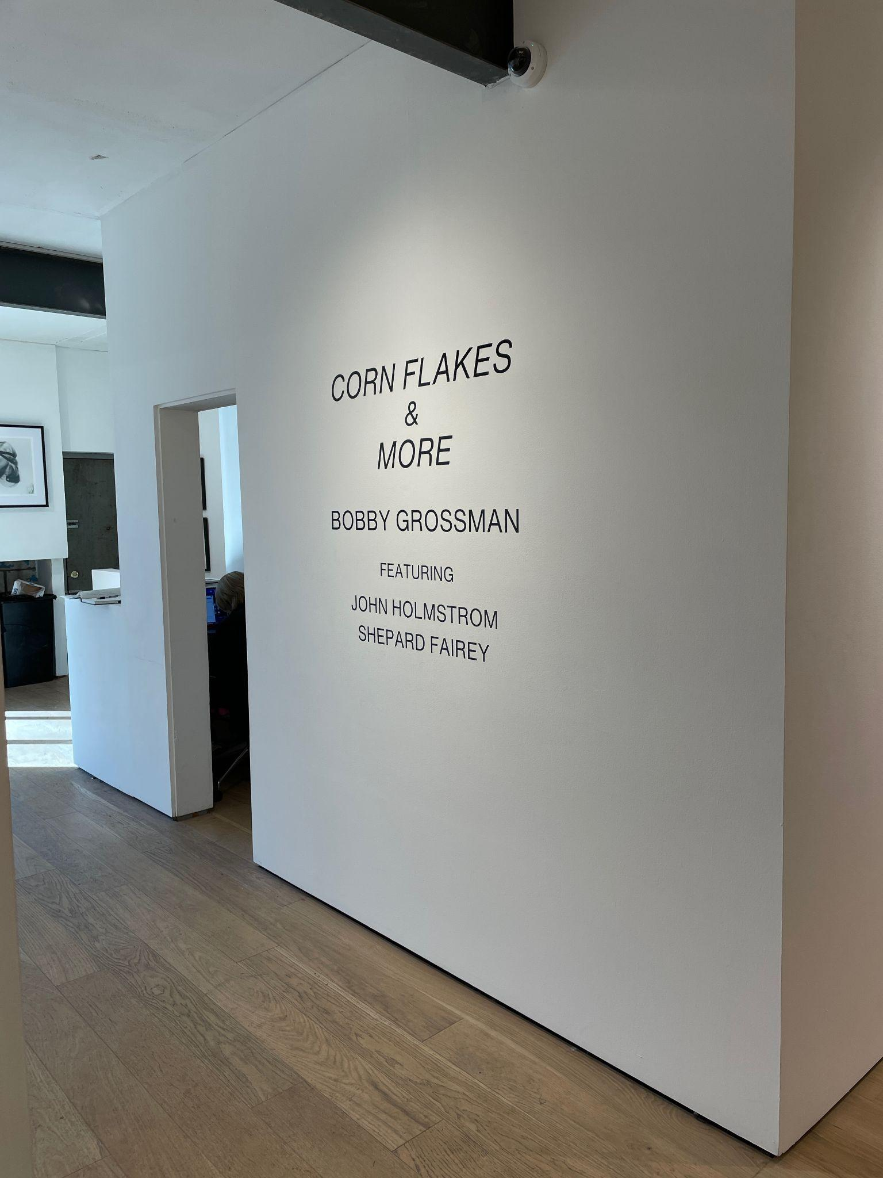
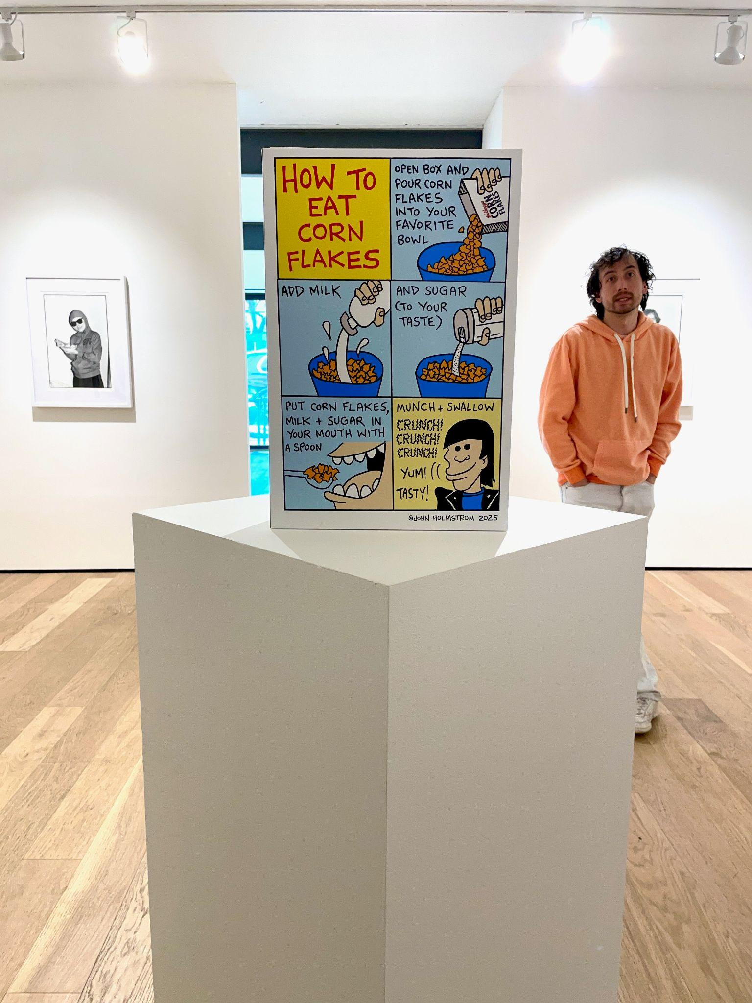
Ki Smith
At Ki Smith gallery, Ki came out to talk to us about the exhibit, the space, and his journey as a gallery owner.
https://www.amny.com/news/bobby-grossman-corn-flakes-pop-stars-images/

Slide 12
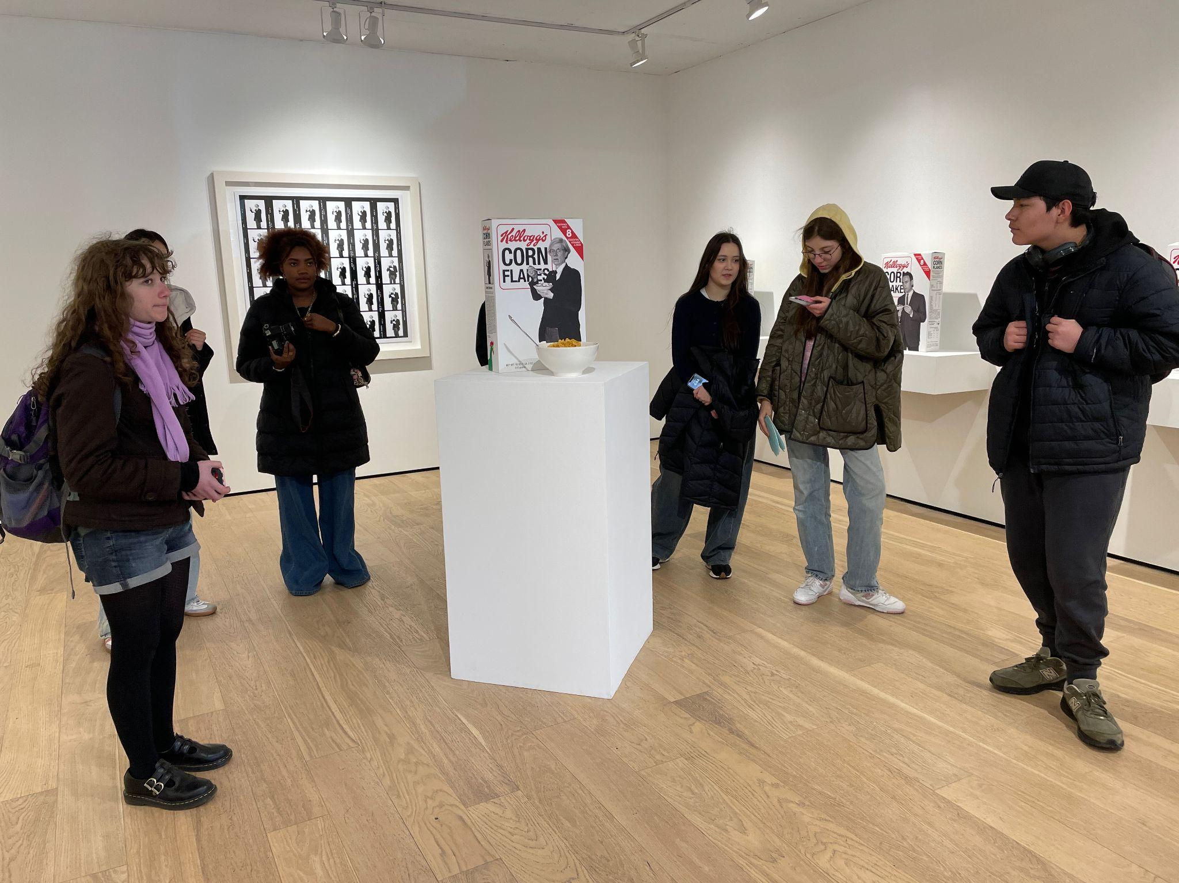
Corn Flakes
What famous cultural icon would you like to see on a Corn Flakes box?
Our answers:
Taylor Swift
Kendrick Lamar
Scott Cawthon

Slide 13
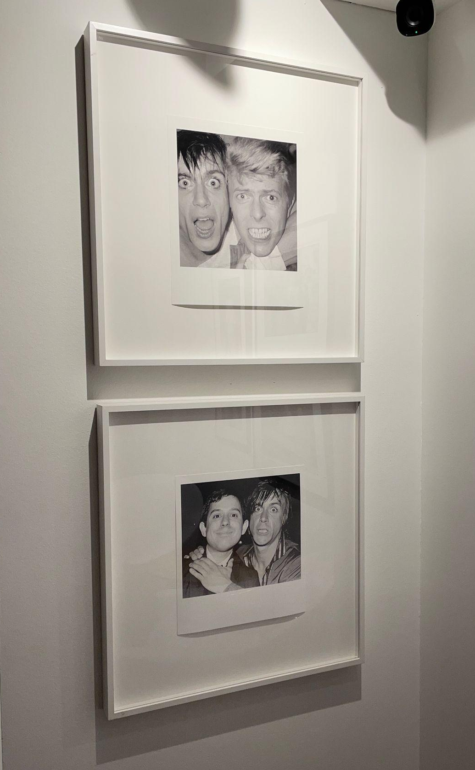
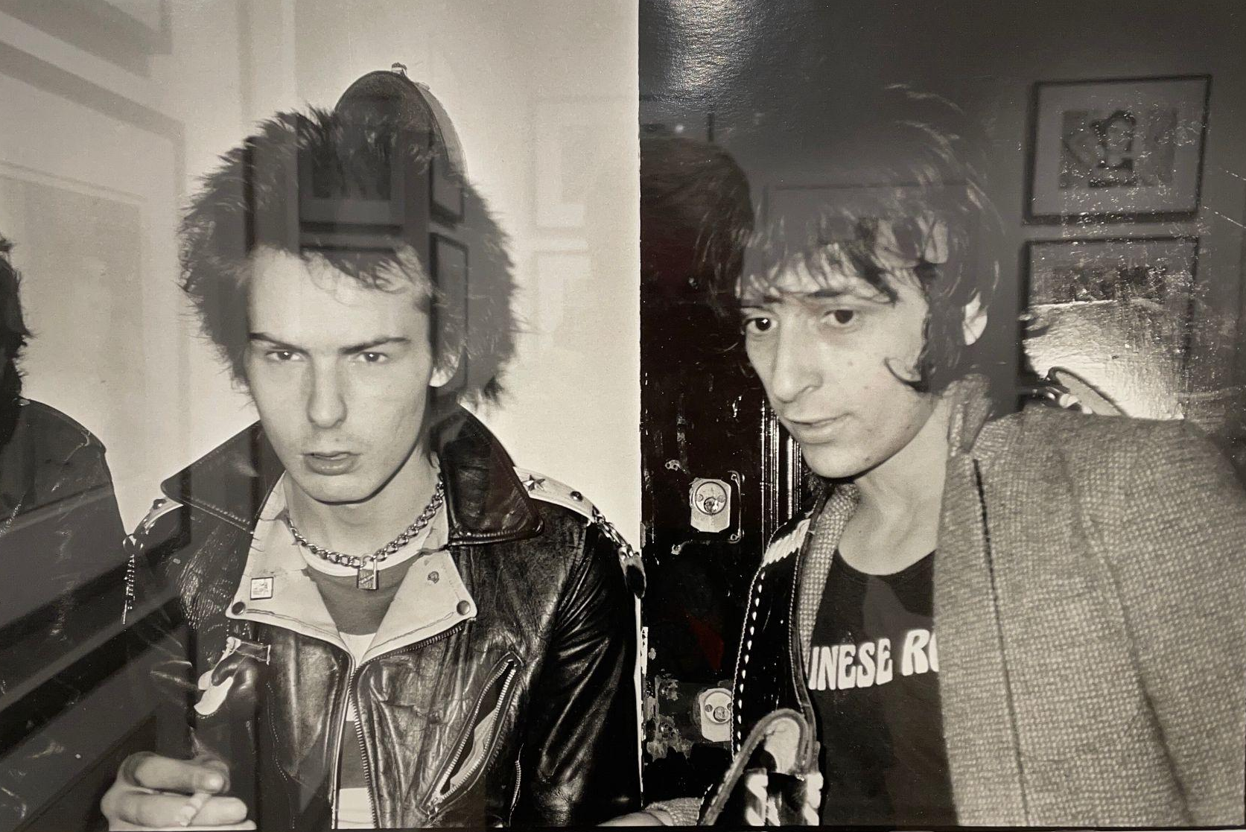
Downstairs was a literal archive of 70s music icons.

Slide 14
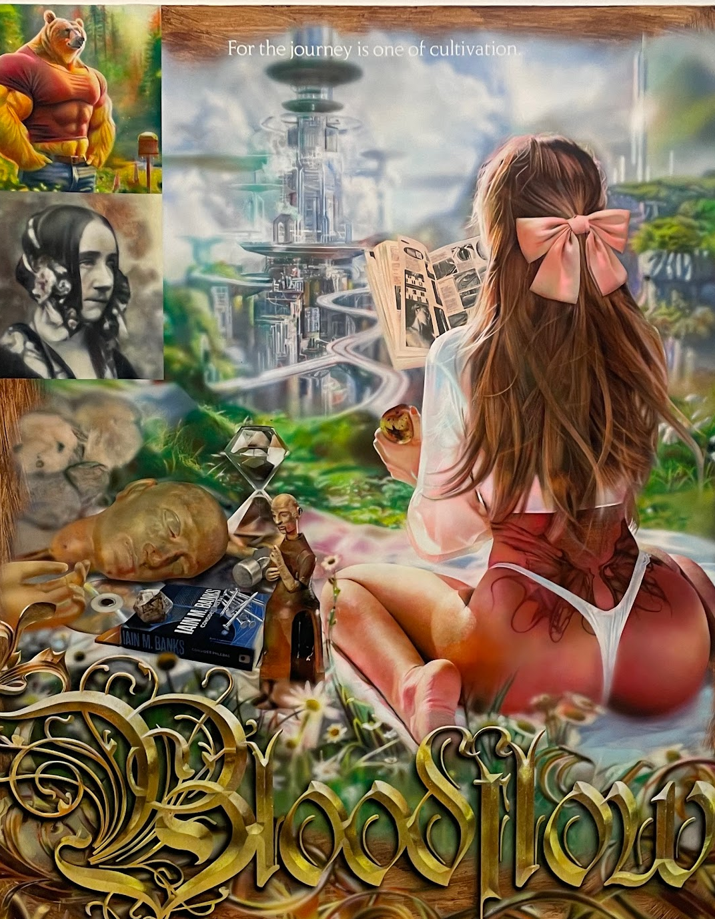
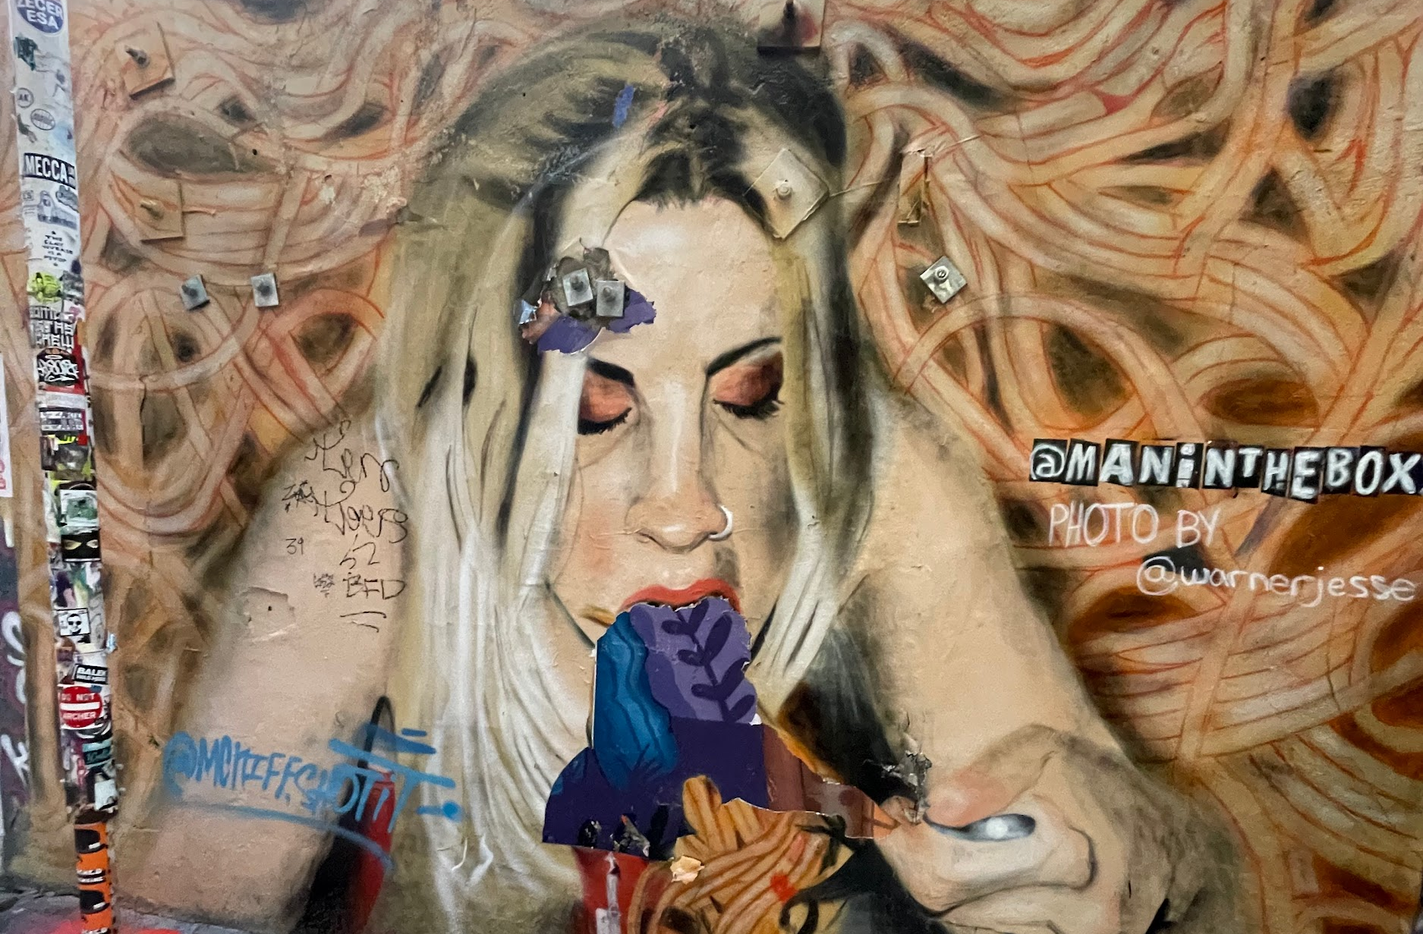
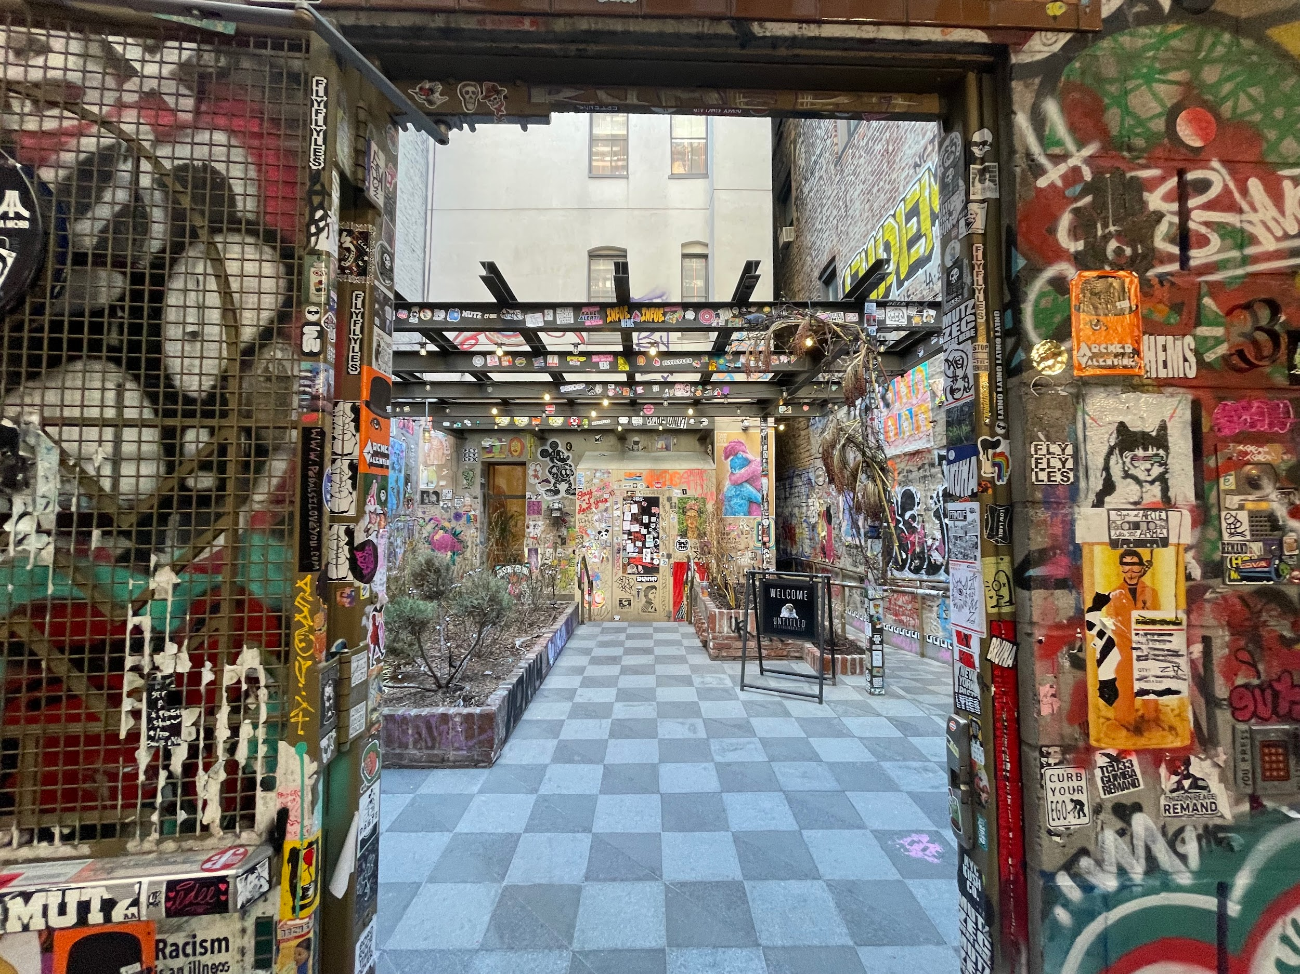
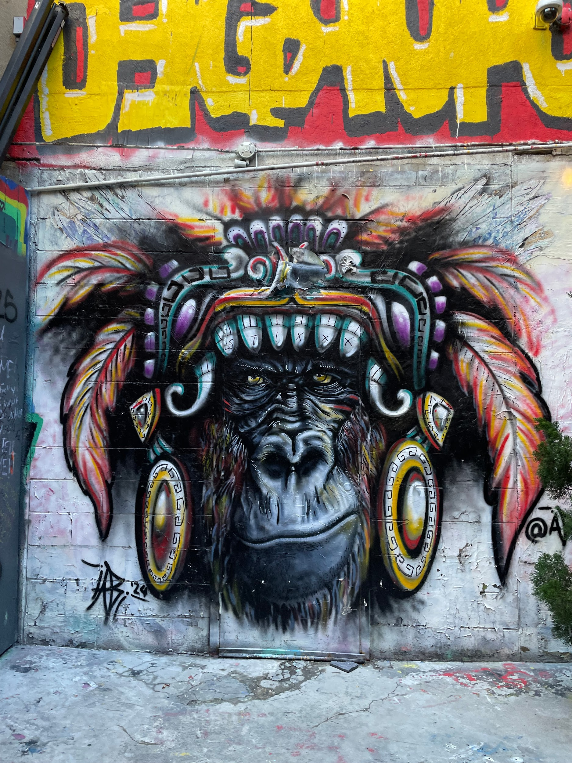
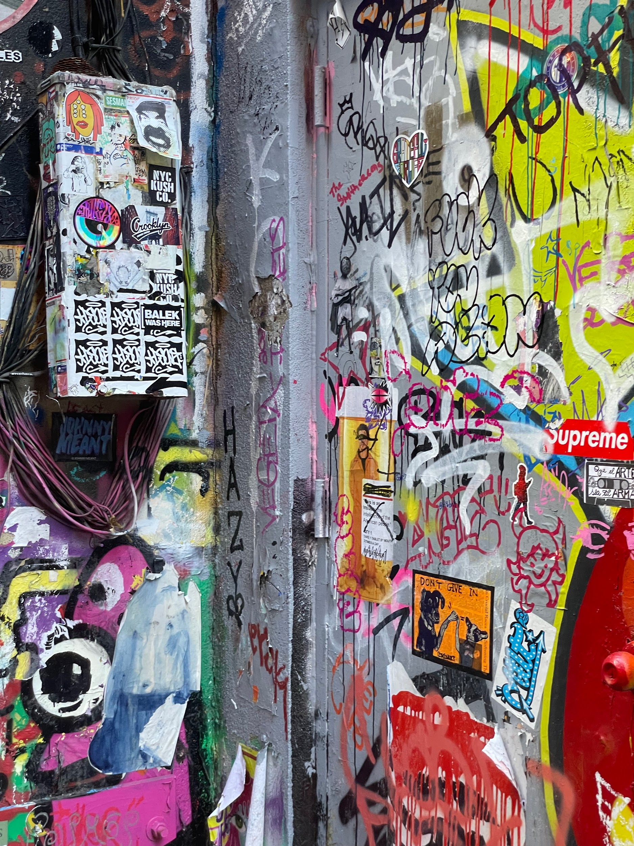
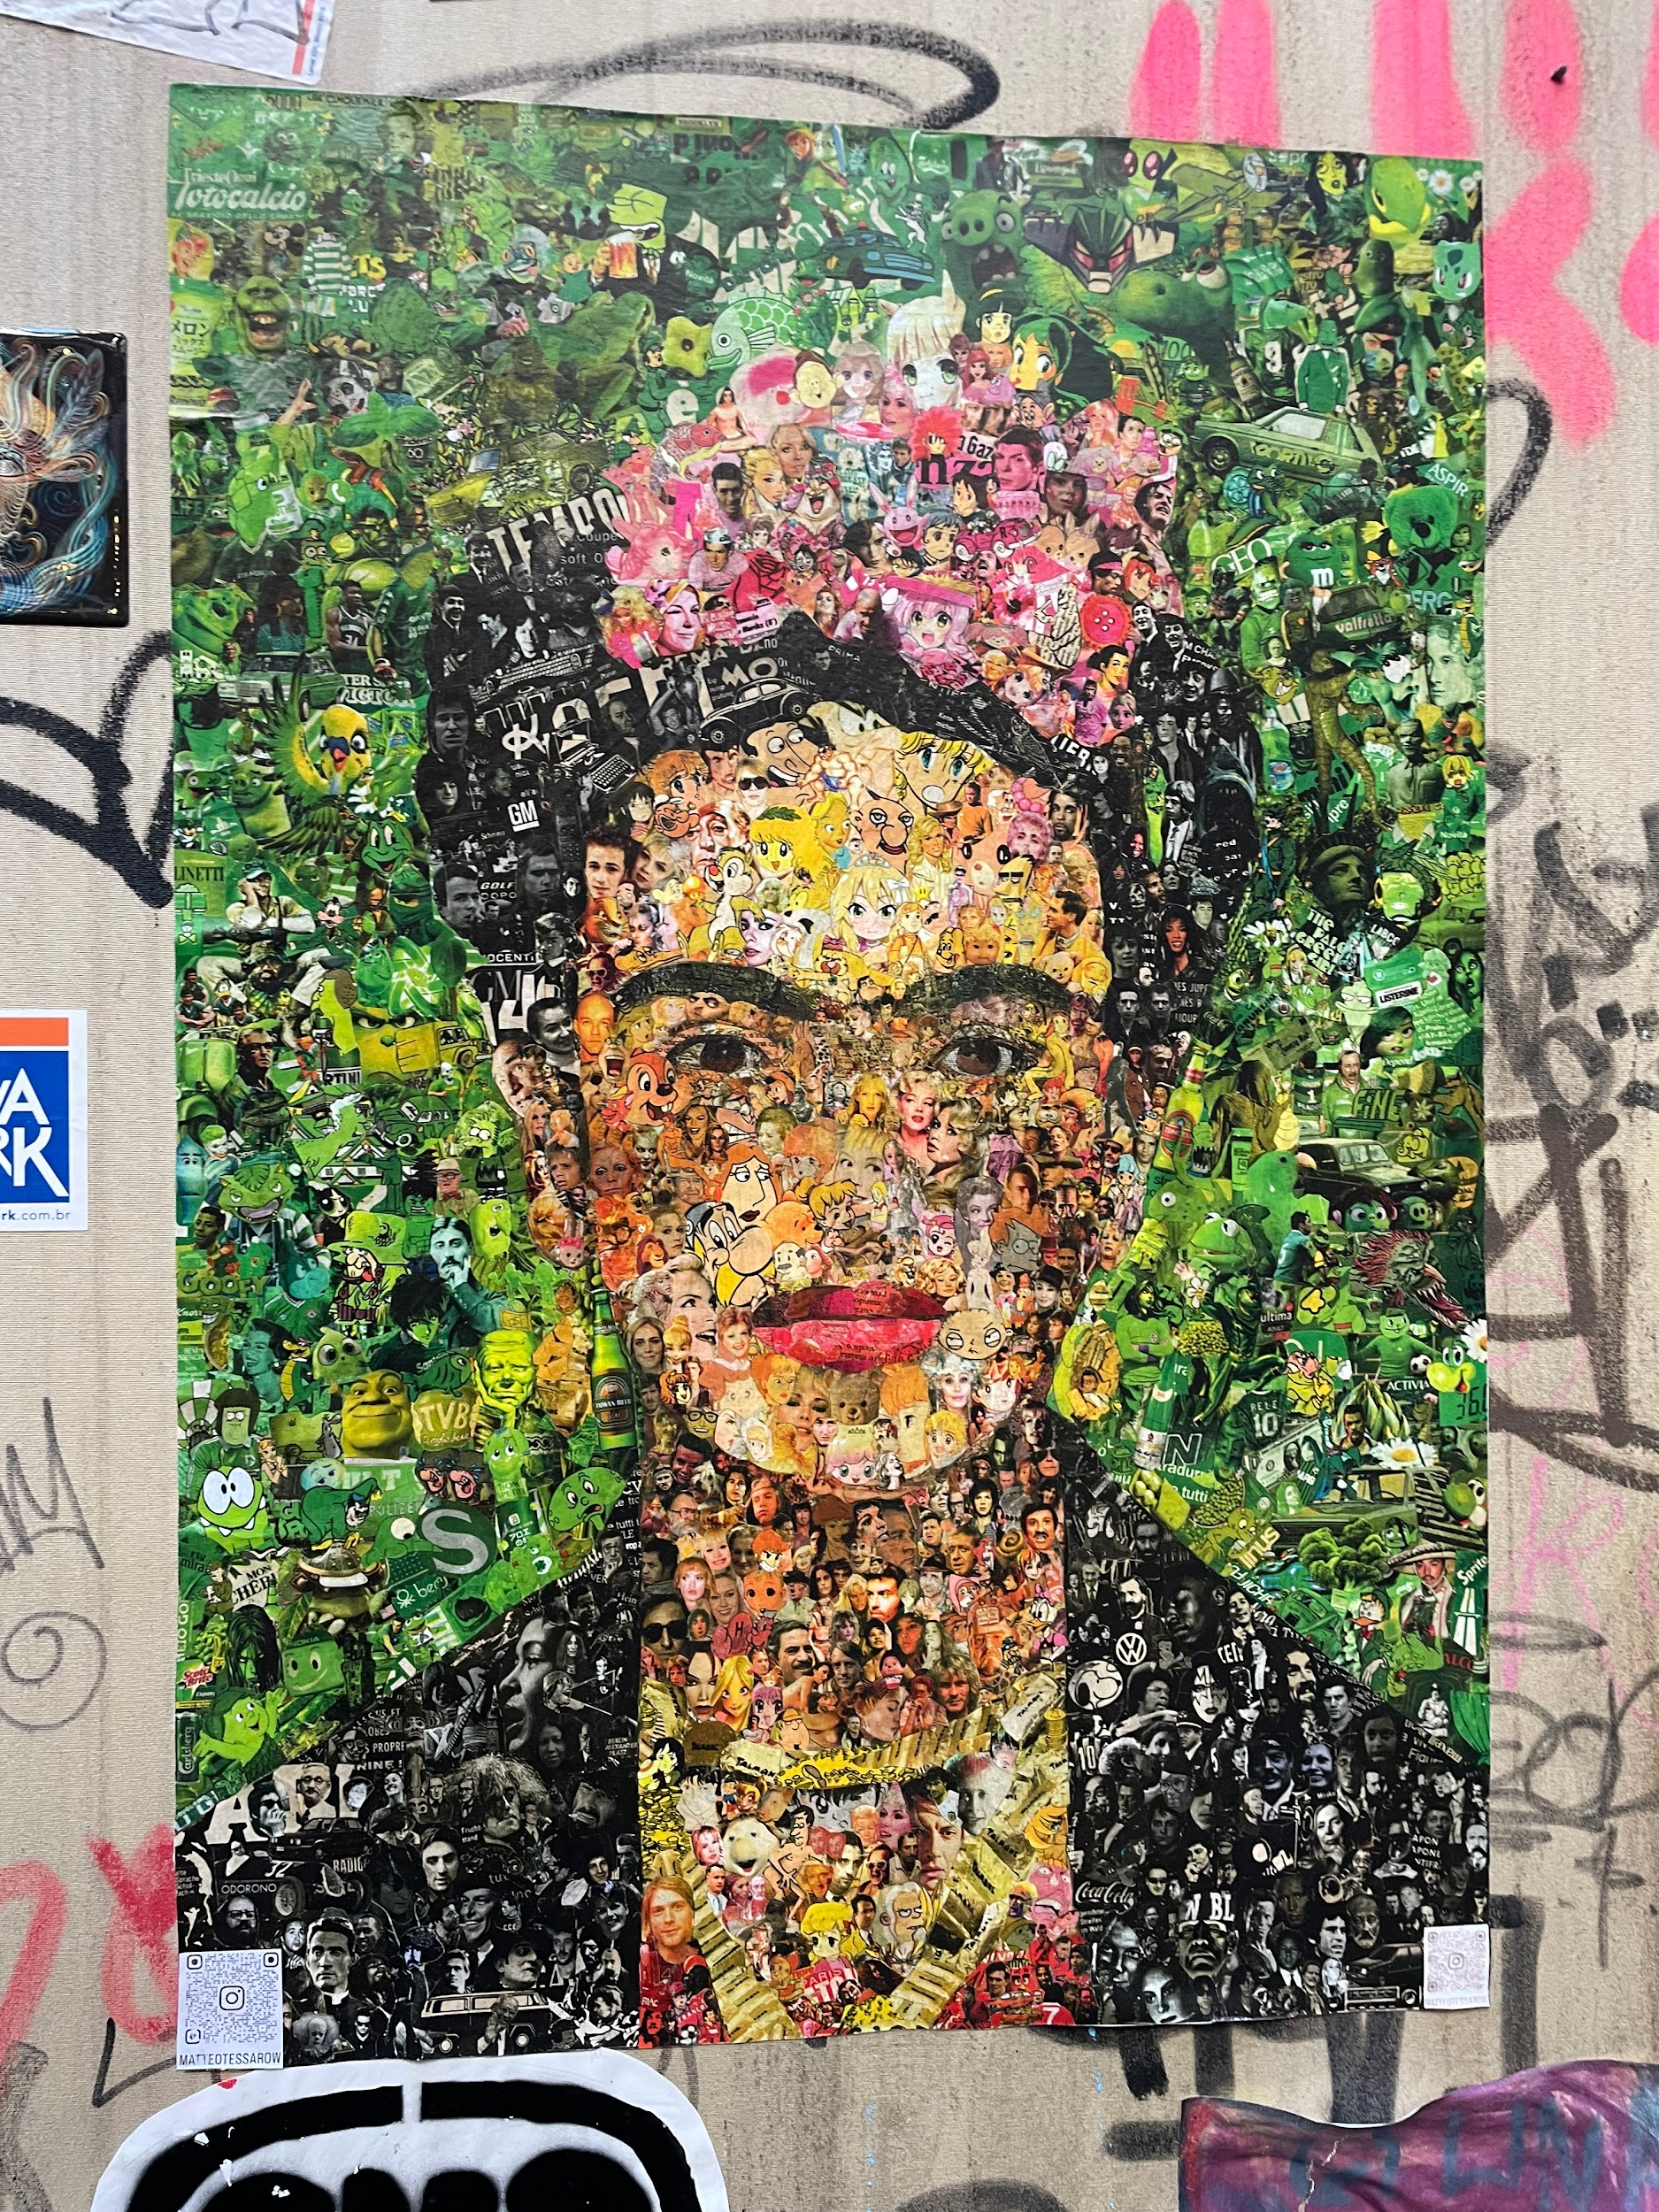
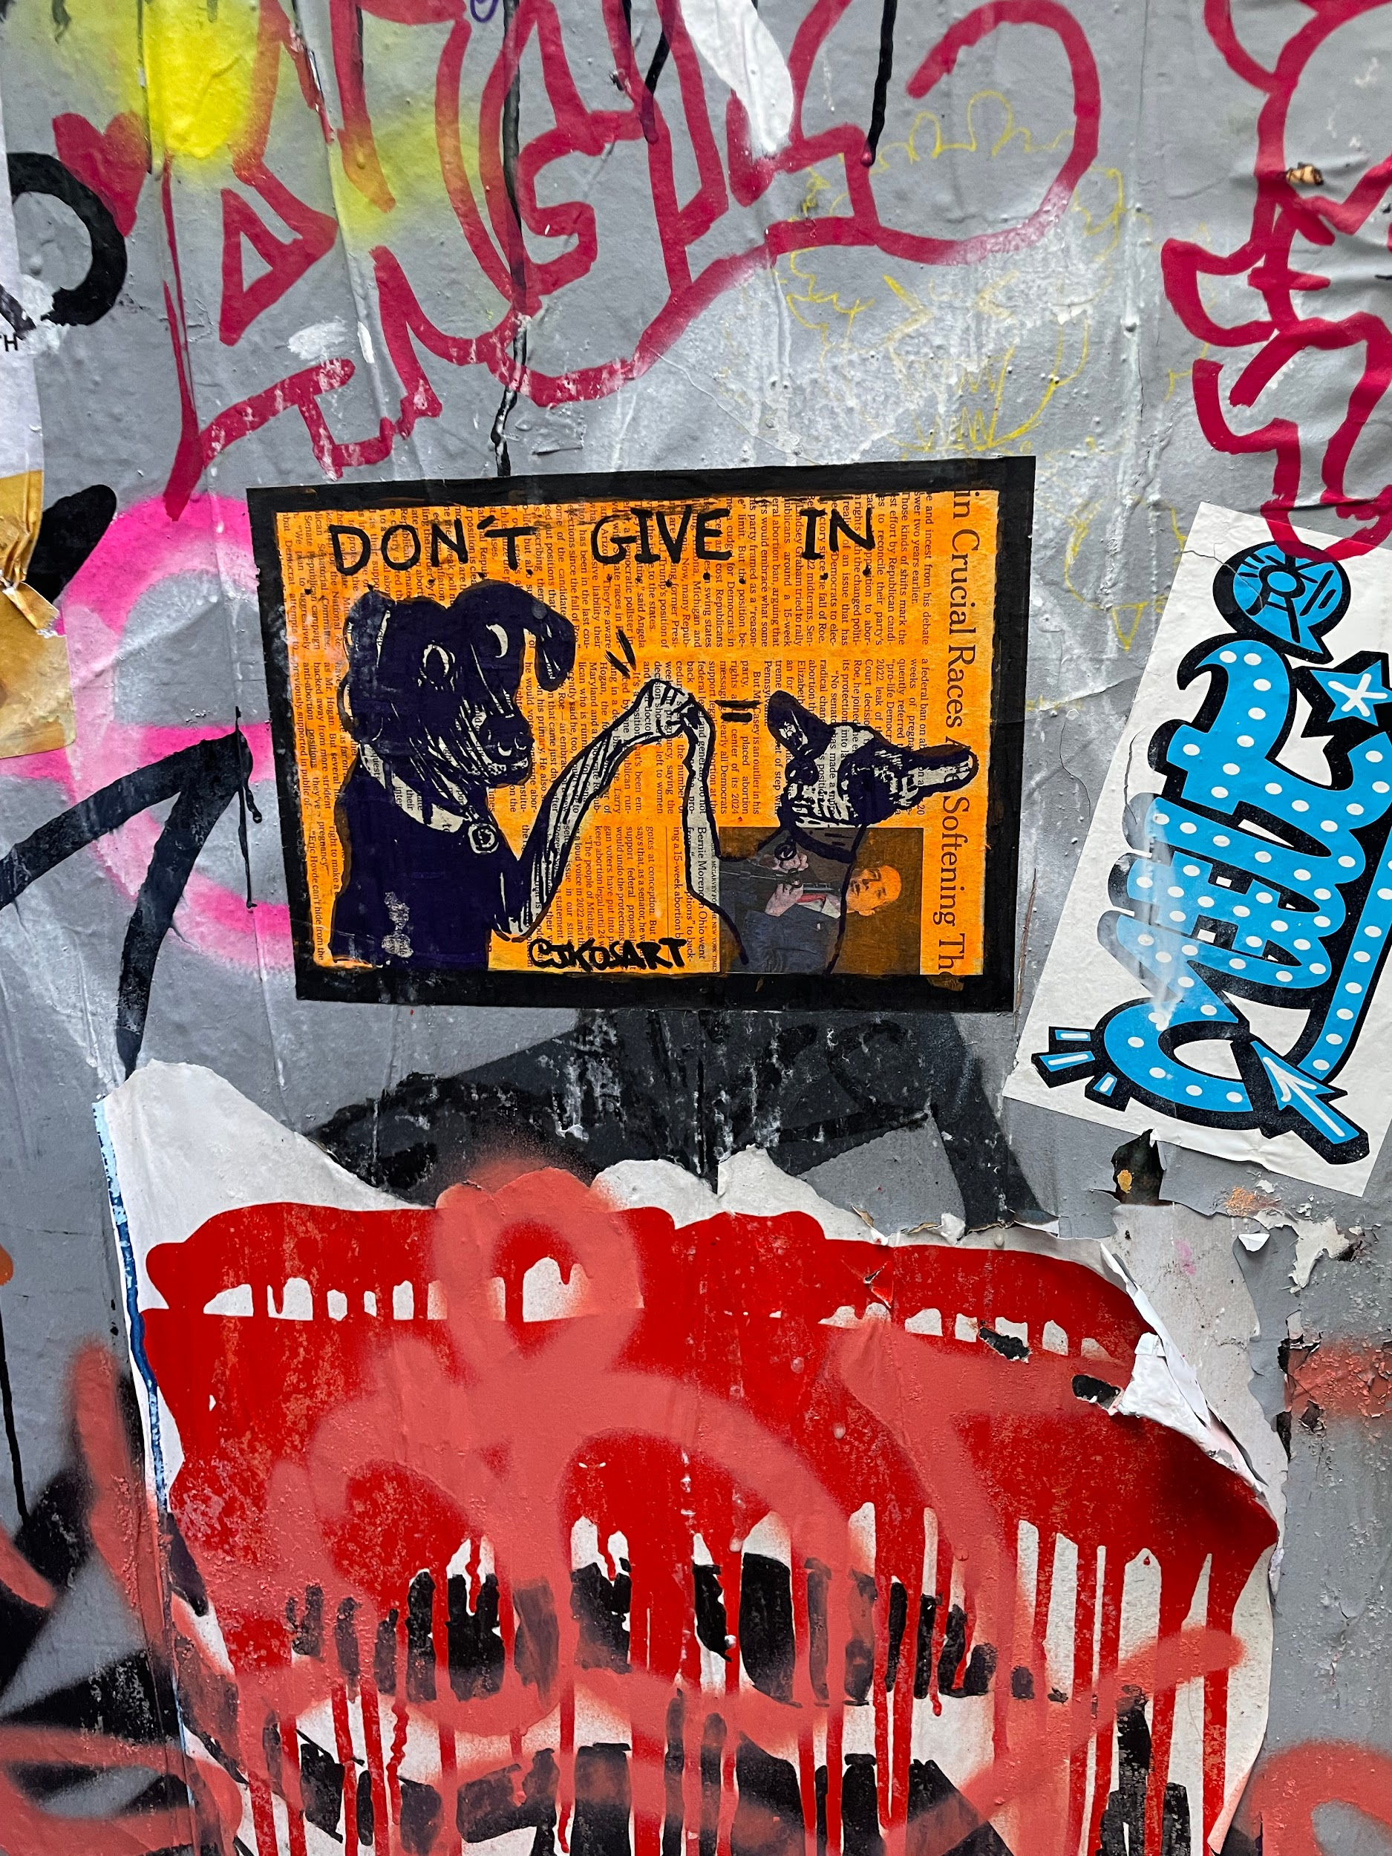
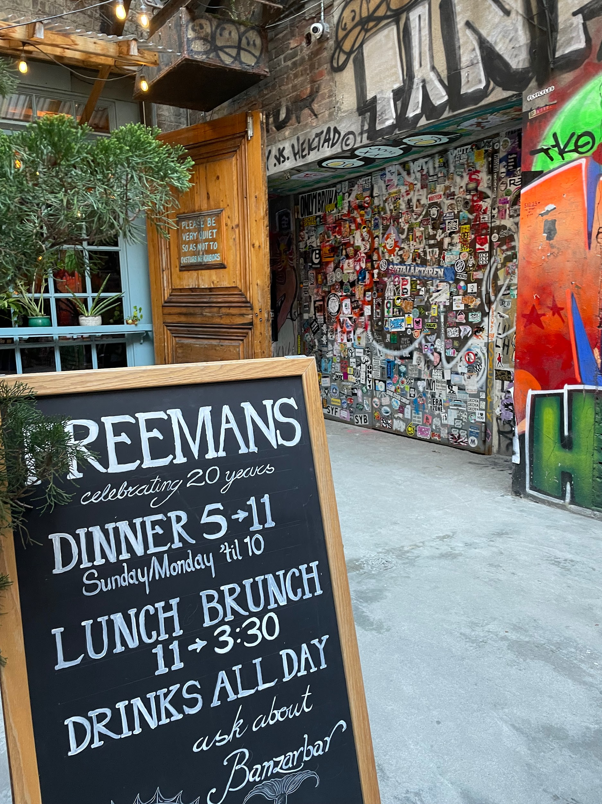
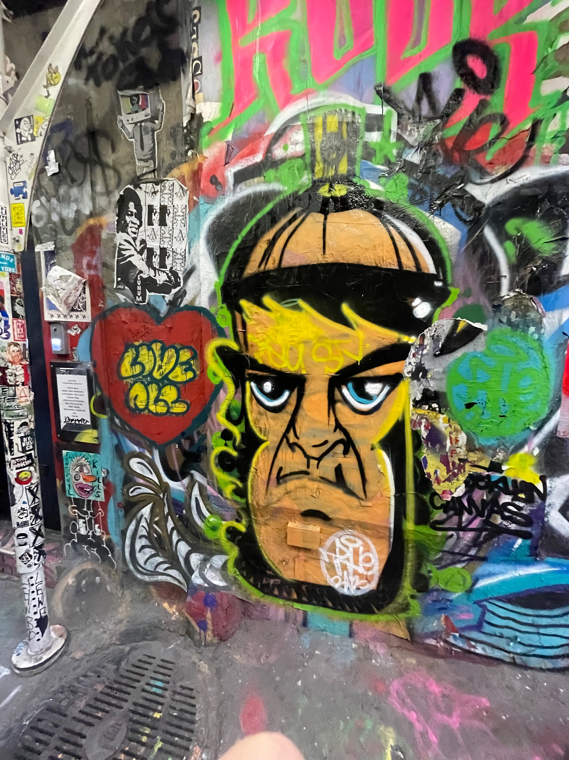
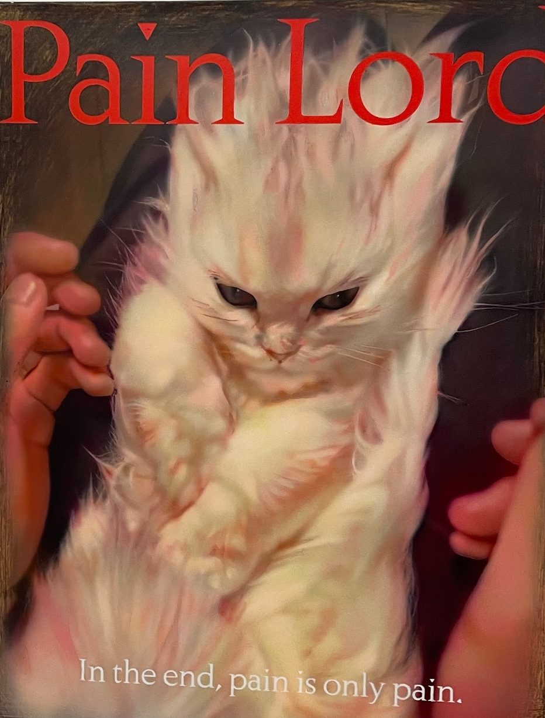
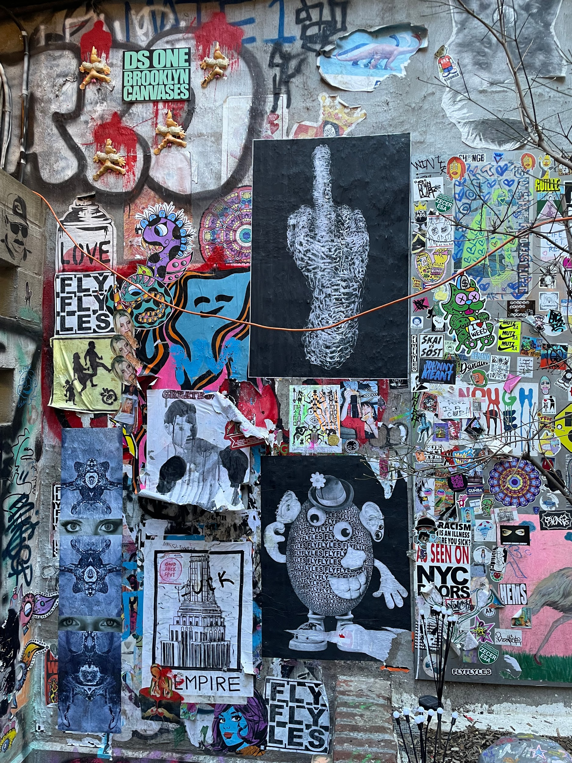
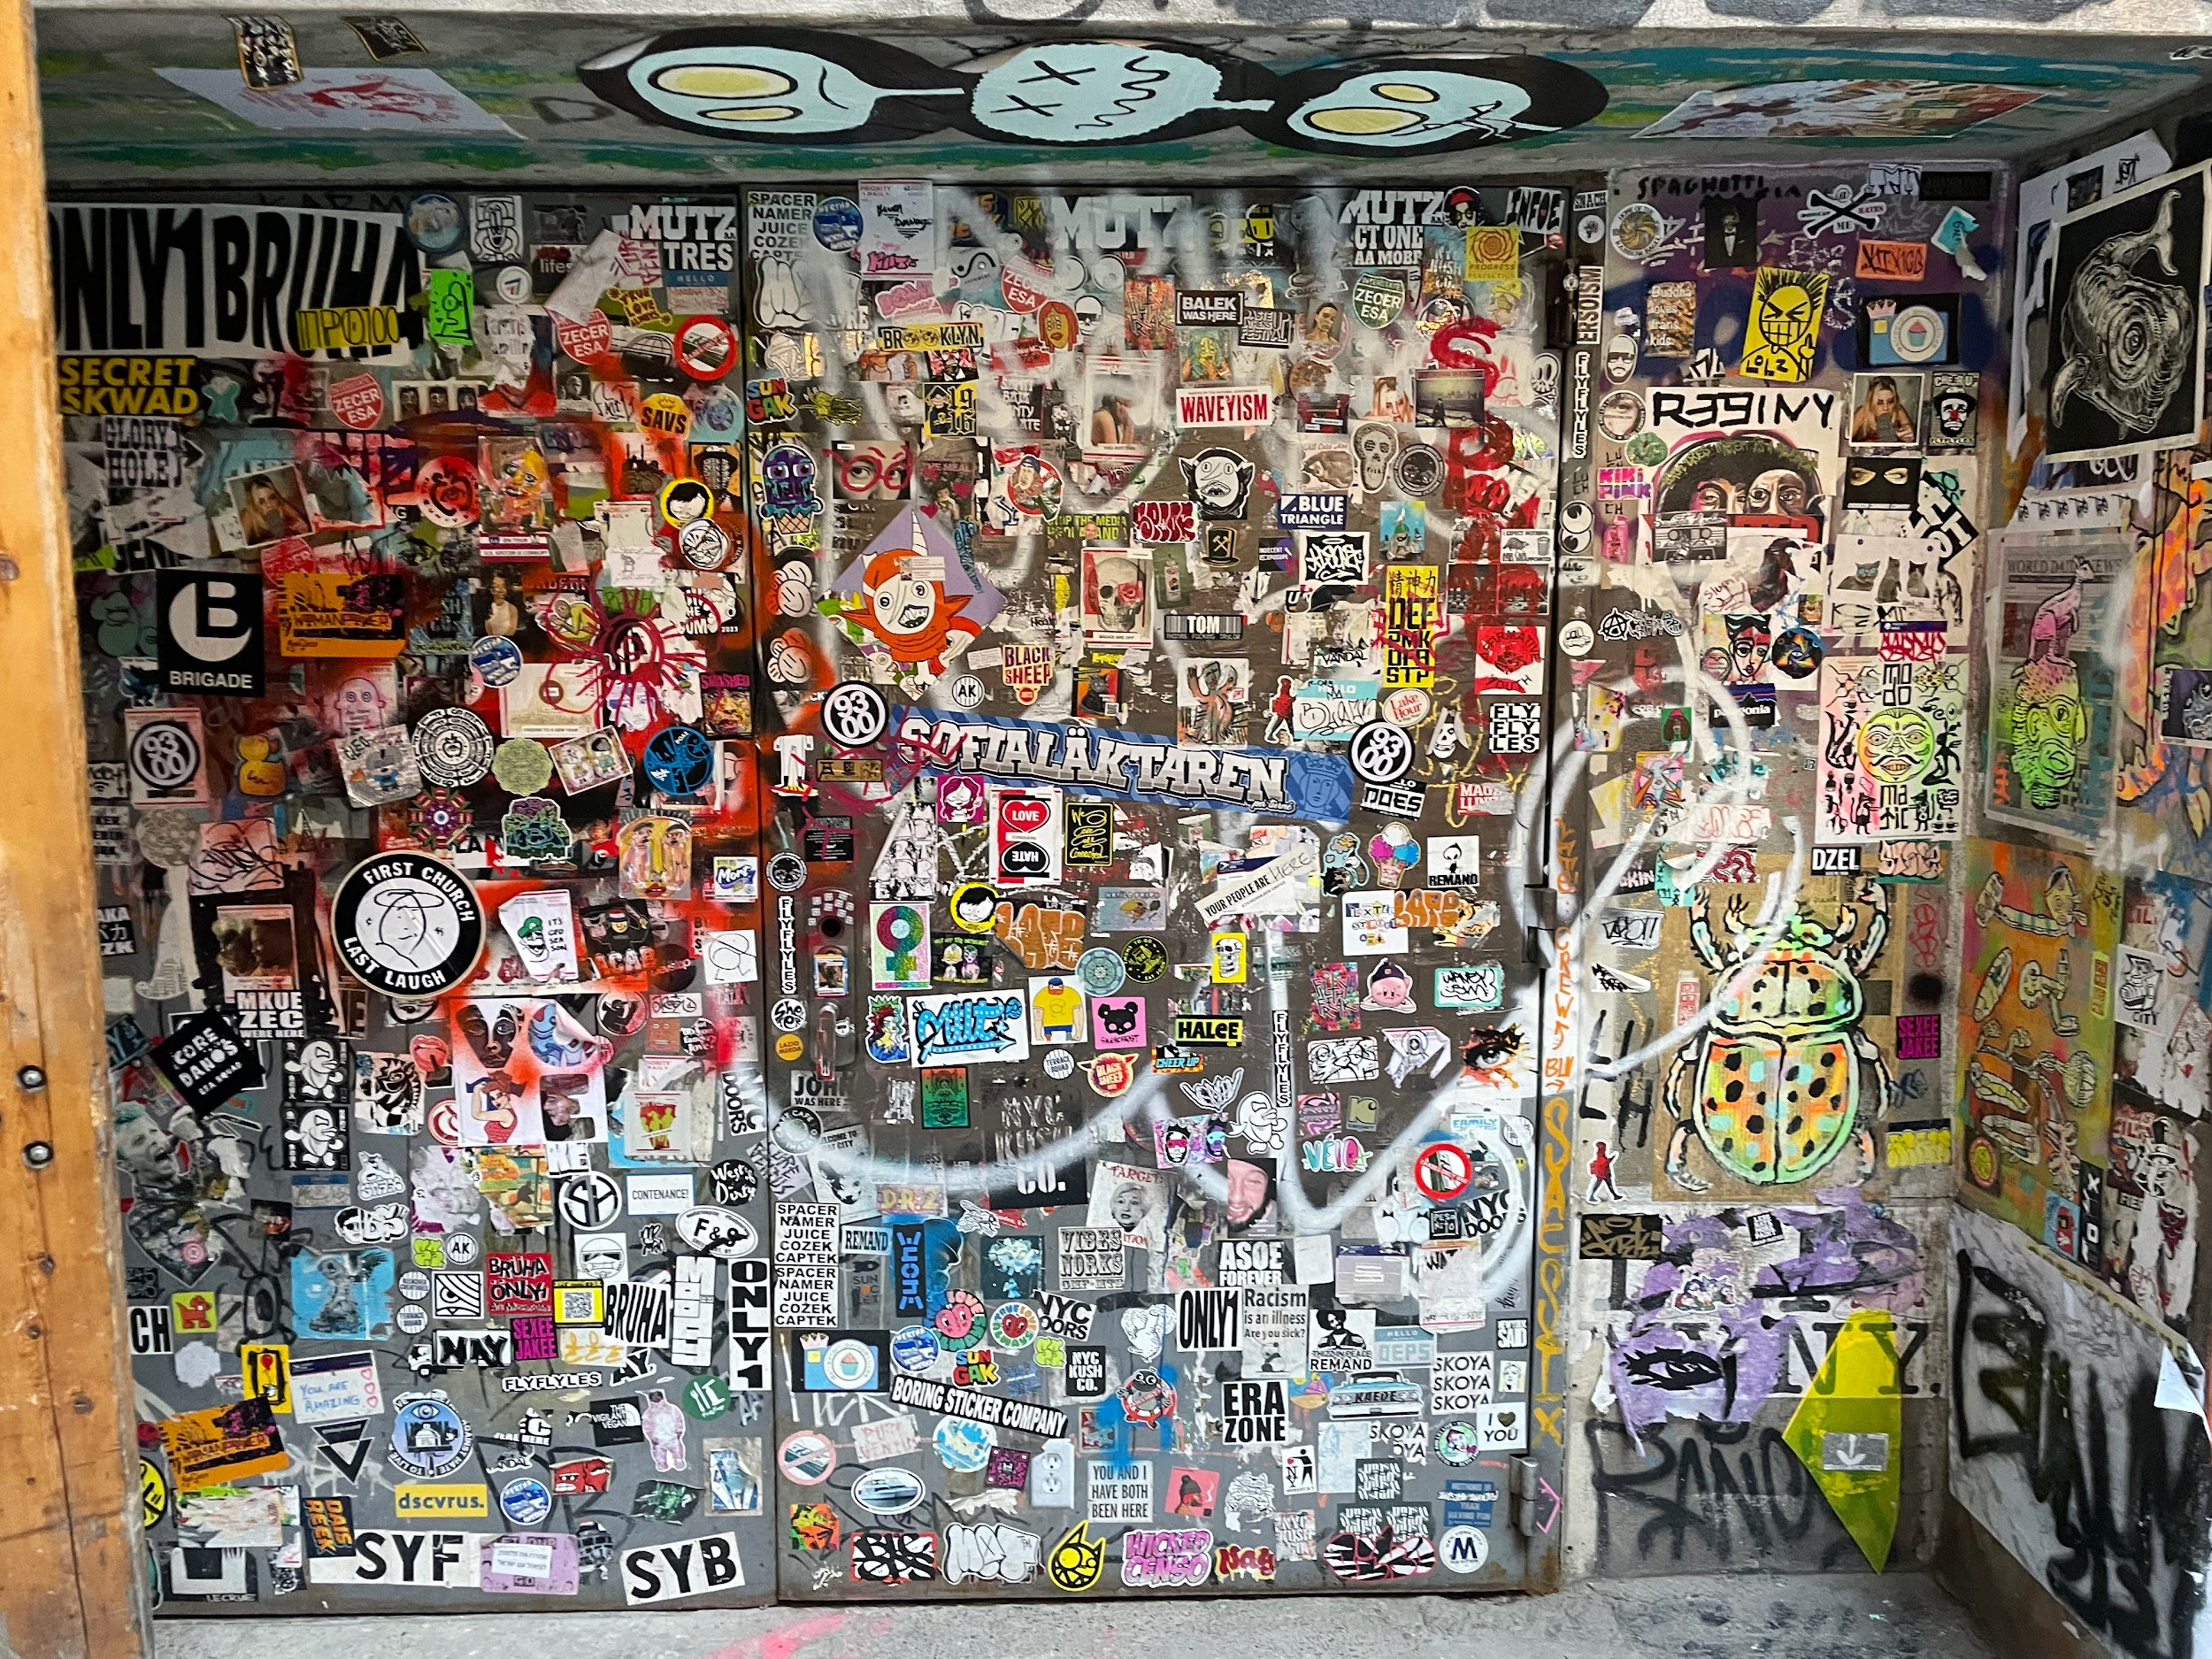
FREEMAN ALLEY
While we were visiting Timor De Nagy, we unexpectedly found a small alleyway containing diverse type of art and art styles. Gallery included different political, cultural, and personal topics that overall worked together to create a unique gallery that was free for anyone to see. While walking through this alley, we found a gallery called ”Amanita” showed artworks representing clickbait, the internet, and different controversial topics. While all the artworks looked digital, they all were painted with high degree of detail. Overall, this experience was shocking fun and was the main highlight of the week.

Slide 15
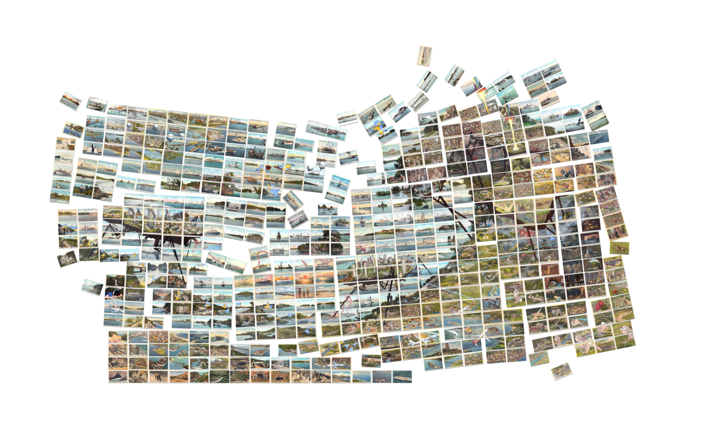
DAVID OPDYKE @ CRISTINE TIERNEY

Slide 16
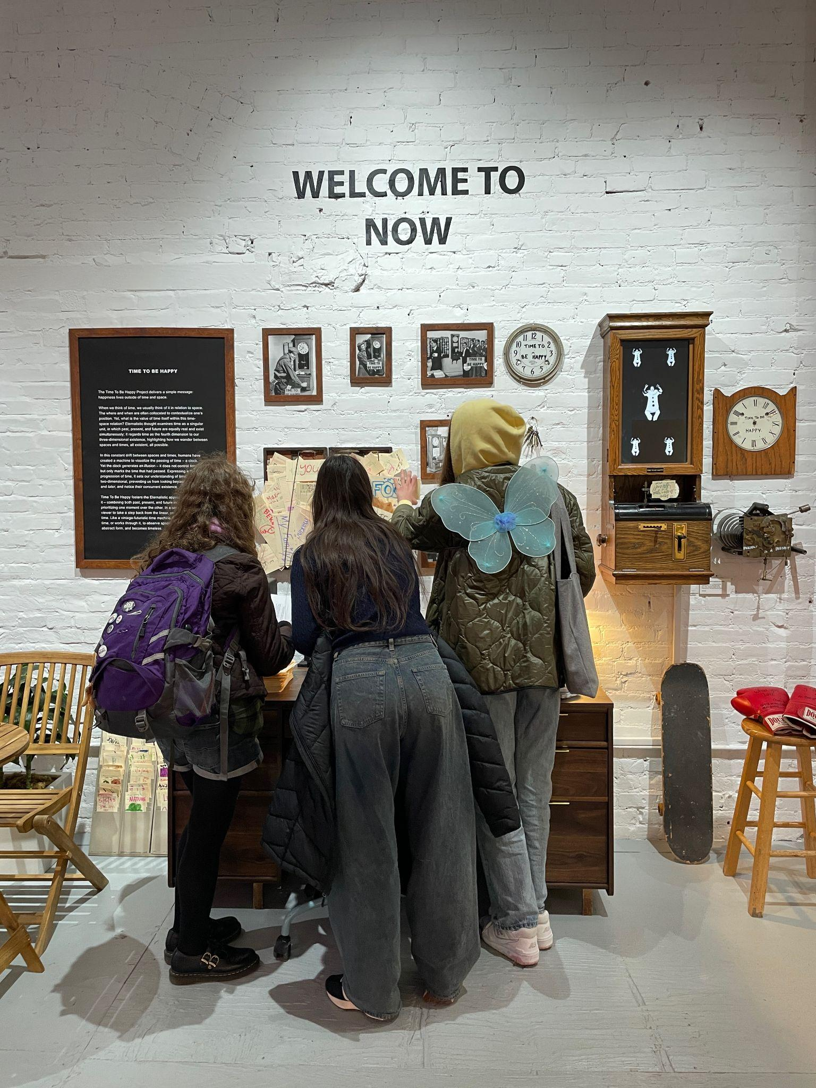
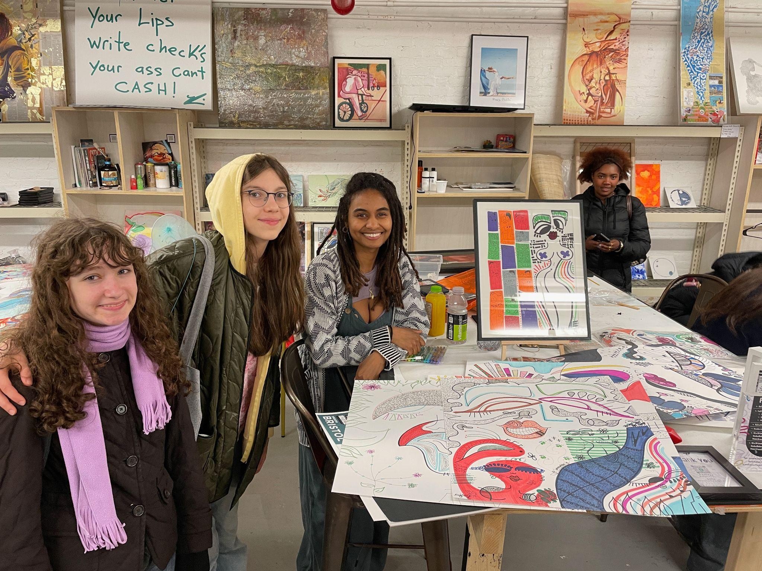
A TIME TO BE HAPPY residency @219 Bowery

Slide 17
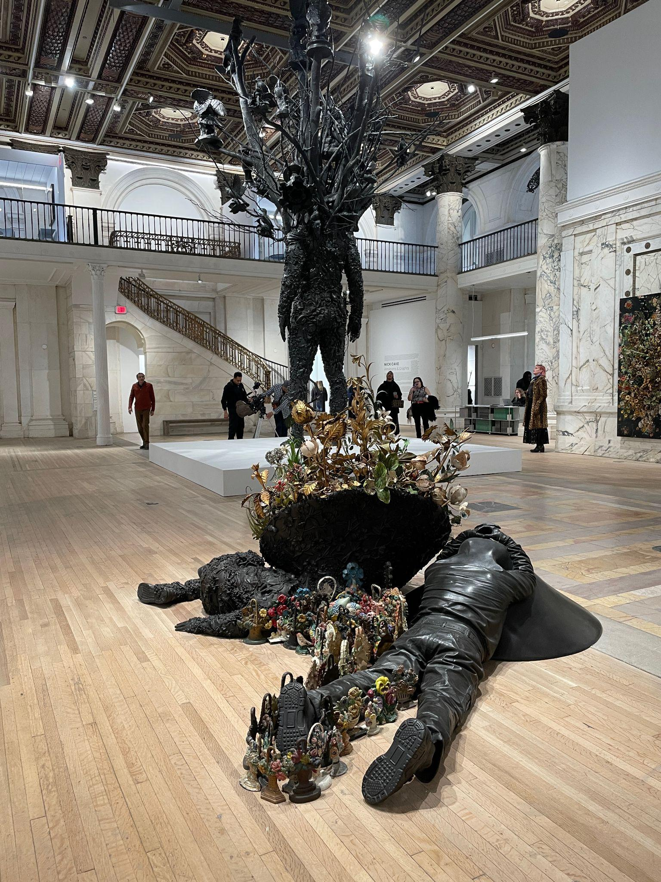

NICK CAVE @ JACK SHAINMAN in TRIBECA

Slide 18
MERCER LABS
Immersive. Enclosed. Rooms and passageways with walls full of fractal visual images. Swings and foam boulders for adding or stopping your own motion to the journey. Up and down stair wells painted black, emerging in another part of the maze. At the end, a vision of the future equally sad and beautiful. A Kuka industrial robot arm encased in glass cage, reacting to the energy in the room, drawing and writing on the sand covering its floor space. Programmed to do certain things. It reminded me of an episode of the Twilight Zone, or the film After Yang, in that it made me question the idea of what it means to be alive, what freedom means, and robot rights in a way I never had before.

Slide 19
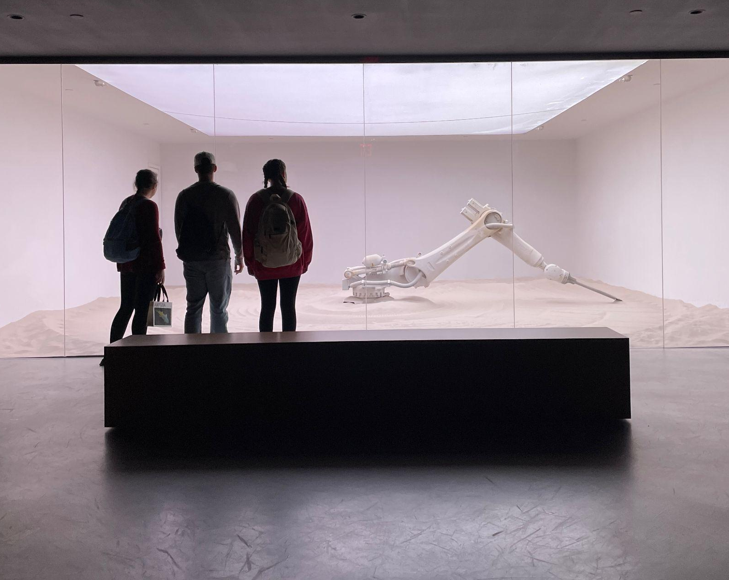

Slide 20
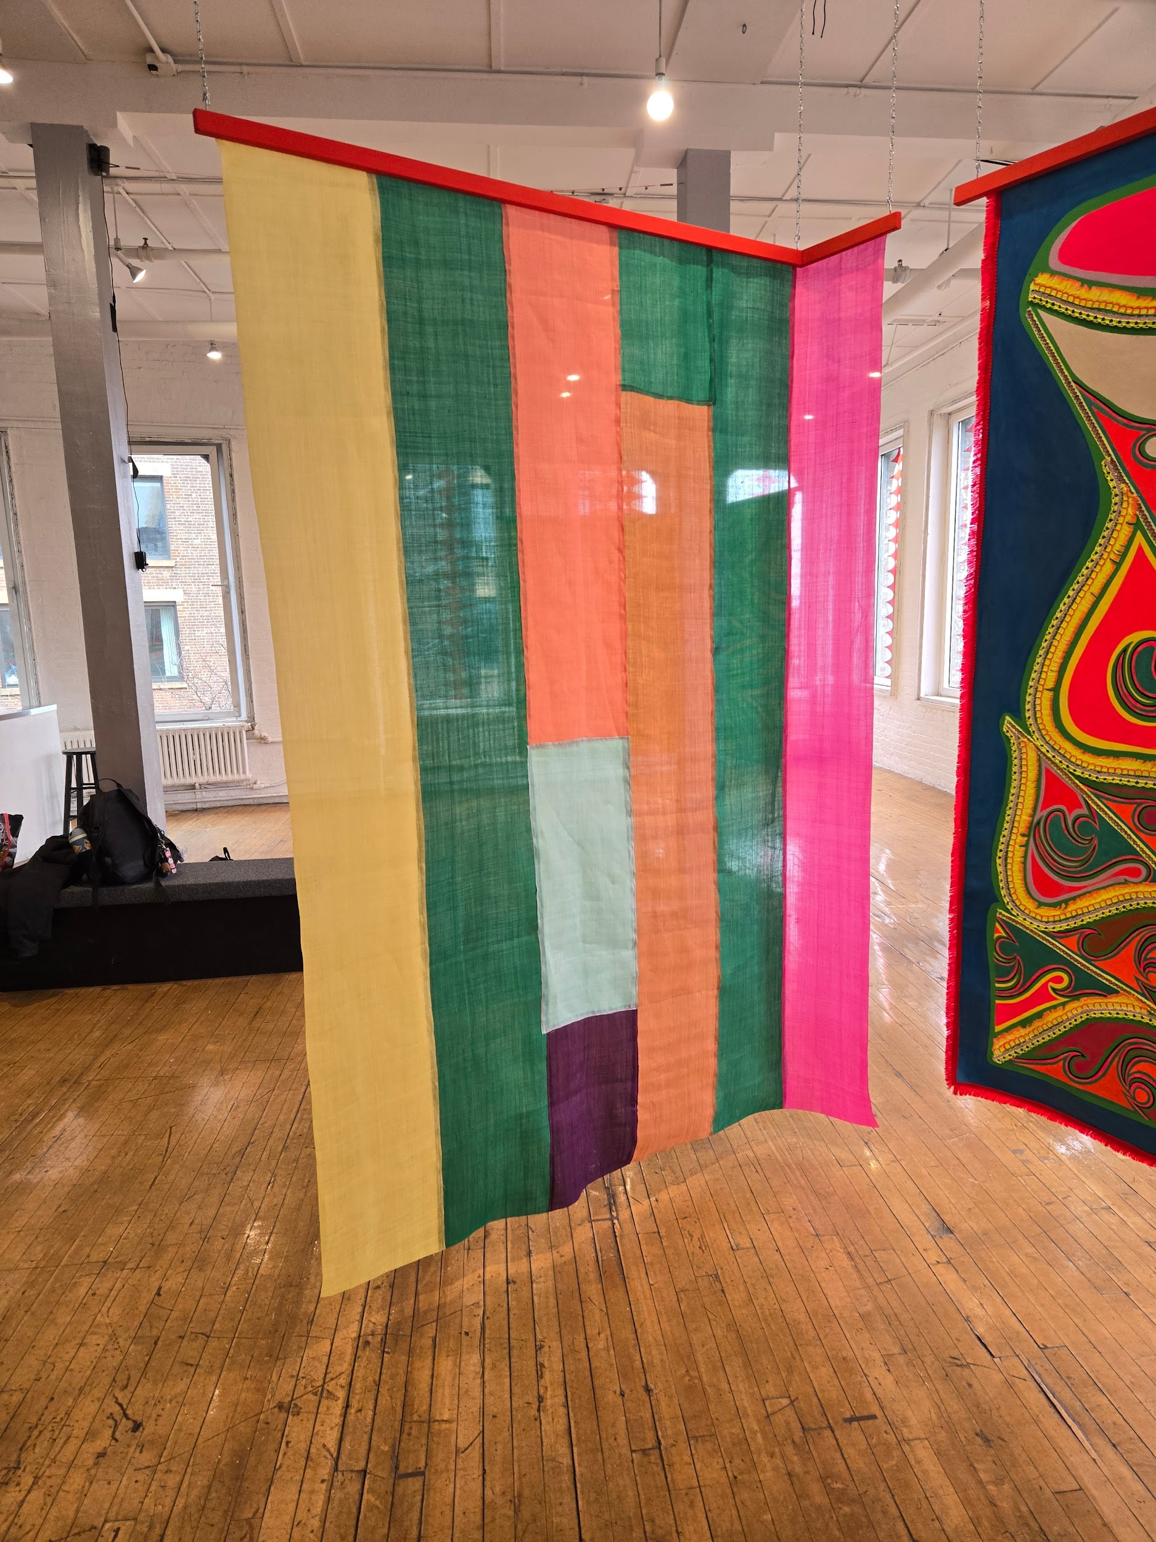
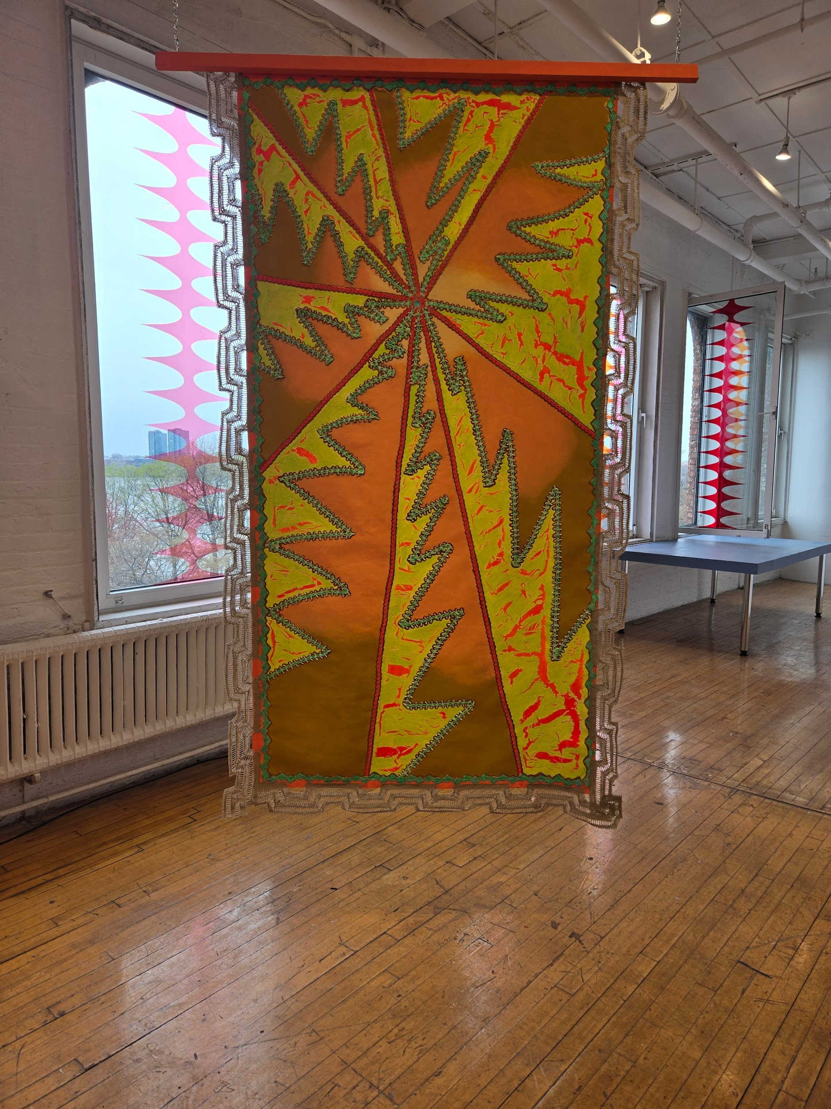
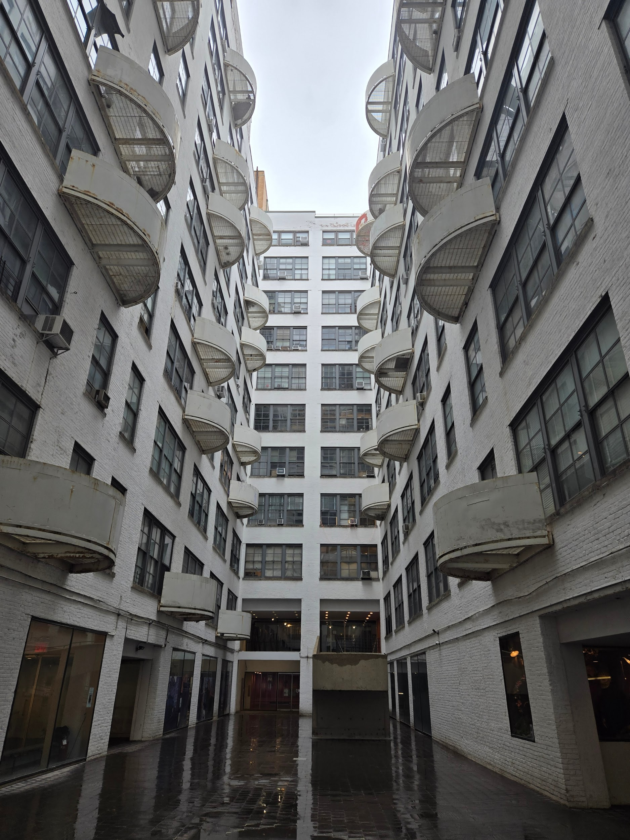
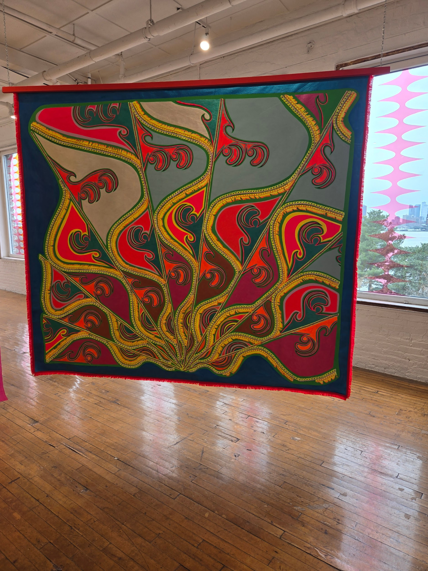
LISA ALVARADO @THE KITCHEN
The Kitchen Gallery
The Kitchen is a small but very interesting gallery associated with the artist Lisa Alvarado. This gallery is part of the Westbeth Artists Community, a space that houses an art studies department. In addition to The Kitchen, other galleries that enrich the artistic community can be found in this location.Focusing on Lisa Alvarado’s work, what stands out the most is the variety of her creations, which include painting, photography, collage, and textile design. Her work is characterized by an ambitious approach to abstractionism, with a touch, in my opinion, of monochromaticism in her textile pieces. This style was particularly appealing to me. Without a doubt, The Kitchen was one of the galleries that impressed me the most this semester.

Slide 21
COOPER-HEWITT SMITHSONIAN DESIGN MUSEUM
Media vaccine. // Another Antithesis. //Art as antidote.
Andrew Carnegie’s House. Landmark upper east side mansion.
Every room an installation–like Mercer Labs, but here the spaces were bright and open, the staircases broad, the way finding obvious. Three floors of themes about home: What it means, looks like, how it moves, ages, adapts, transmits, preserves, reclaims. One small room lined with bunches of tobacco leaves, their smell of sweet musk filling a sense often neglected by the arts–and here we were for the second time, entering a room that was designed to smell of the earth.

Slide 22

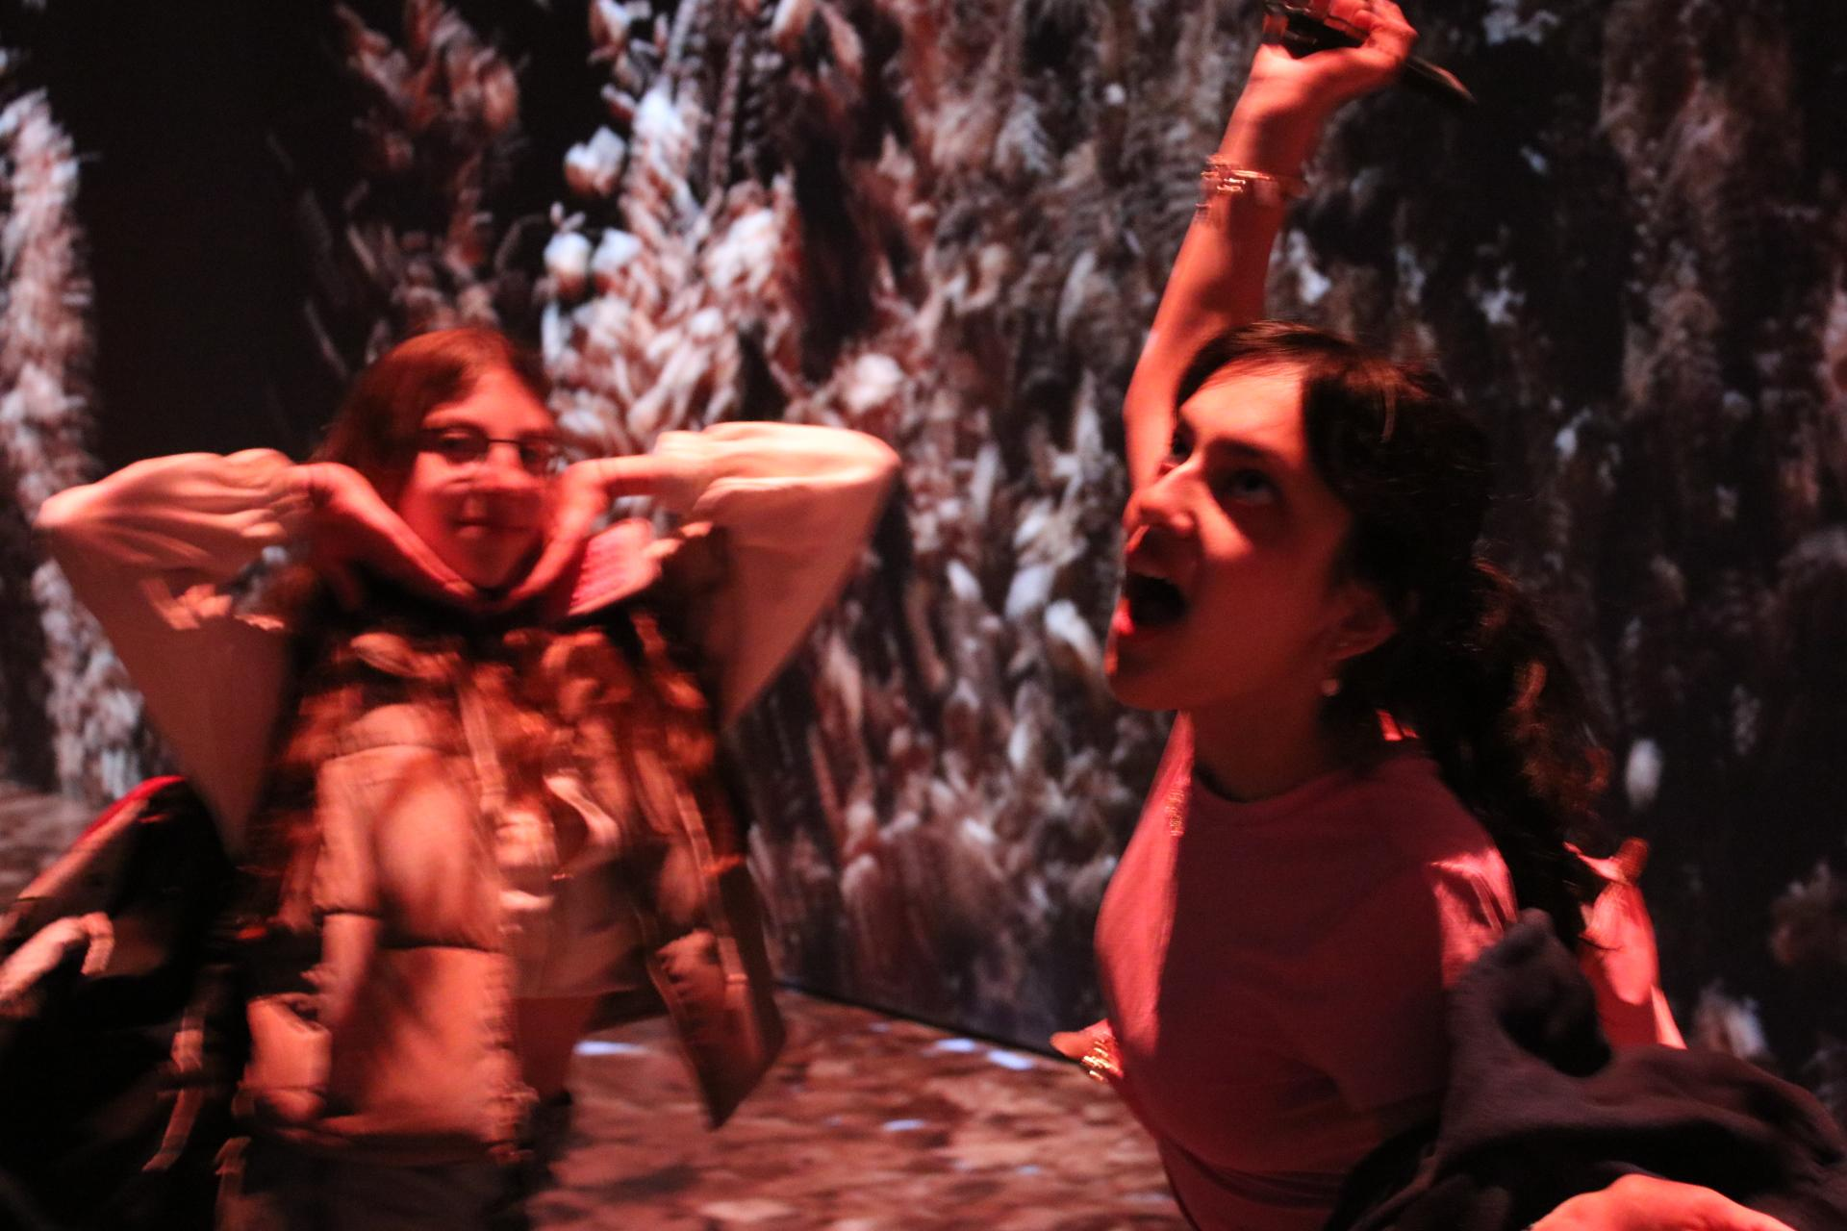
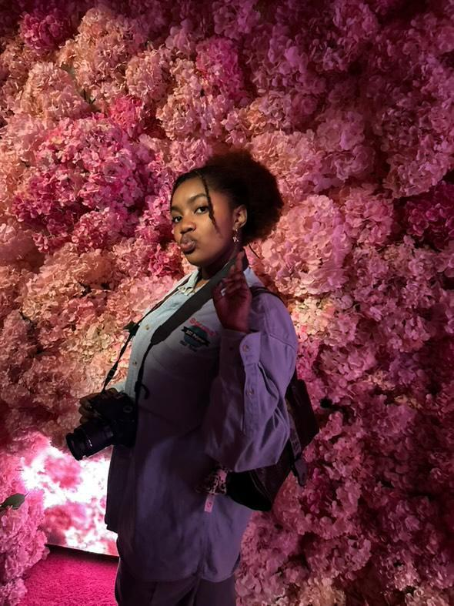
The friends i've met along the way.
The Friends I’ve Met Along the Way
On the first day, I found out another girl had the same name as me. Her name was also Laila, she’s a Pisces too (just four days after me!) and we both love purple. From that very first moment, we clicked. It felt like meeting someone who was just like me.
Then we met Liz. She was someone we instantly connected with—so talkative, kind, and sweet. The three of us became friends naturally, like it was meant to happen.
And we became a little trio.
As the photographer, they kind of became my muses. Capturing our laughter, our quiet moments, our shared joy through the lens. With their weird laughs, funny movements, and radiant smiles, every photo holds a piece of who they are. Each one tells a story.
Not only have the museums inspired me they have as well. Through their presence, they’ve shown me new ways to see beauty, joy, and connection.
I can’t wait to see how our friendship grows and where it takes us.

Slide 23
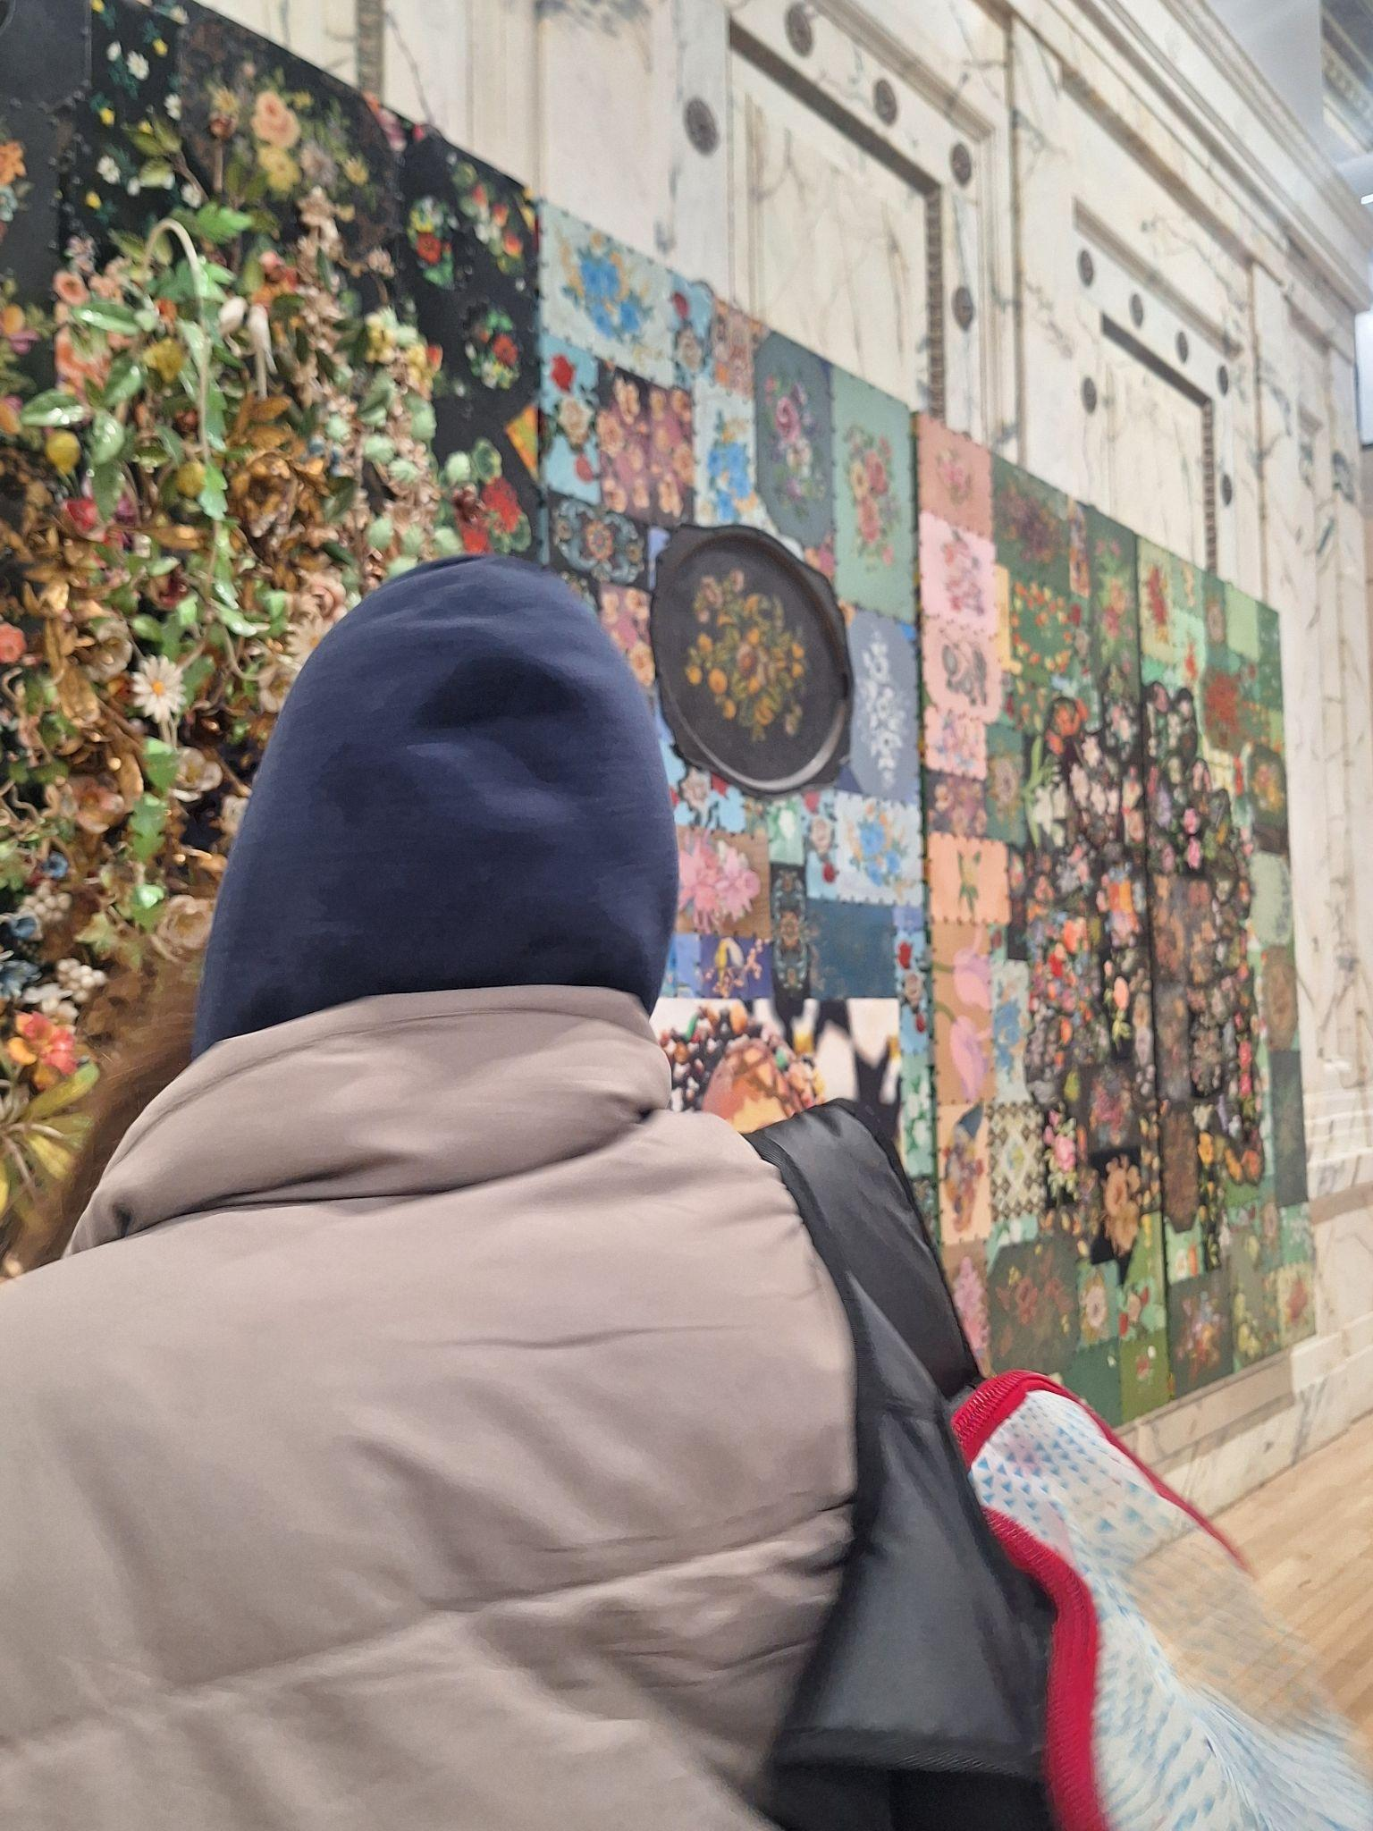
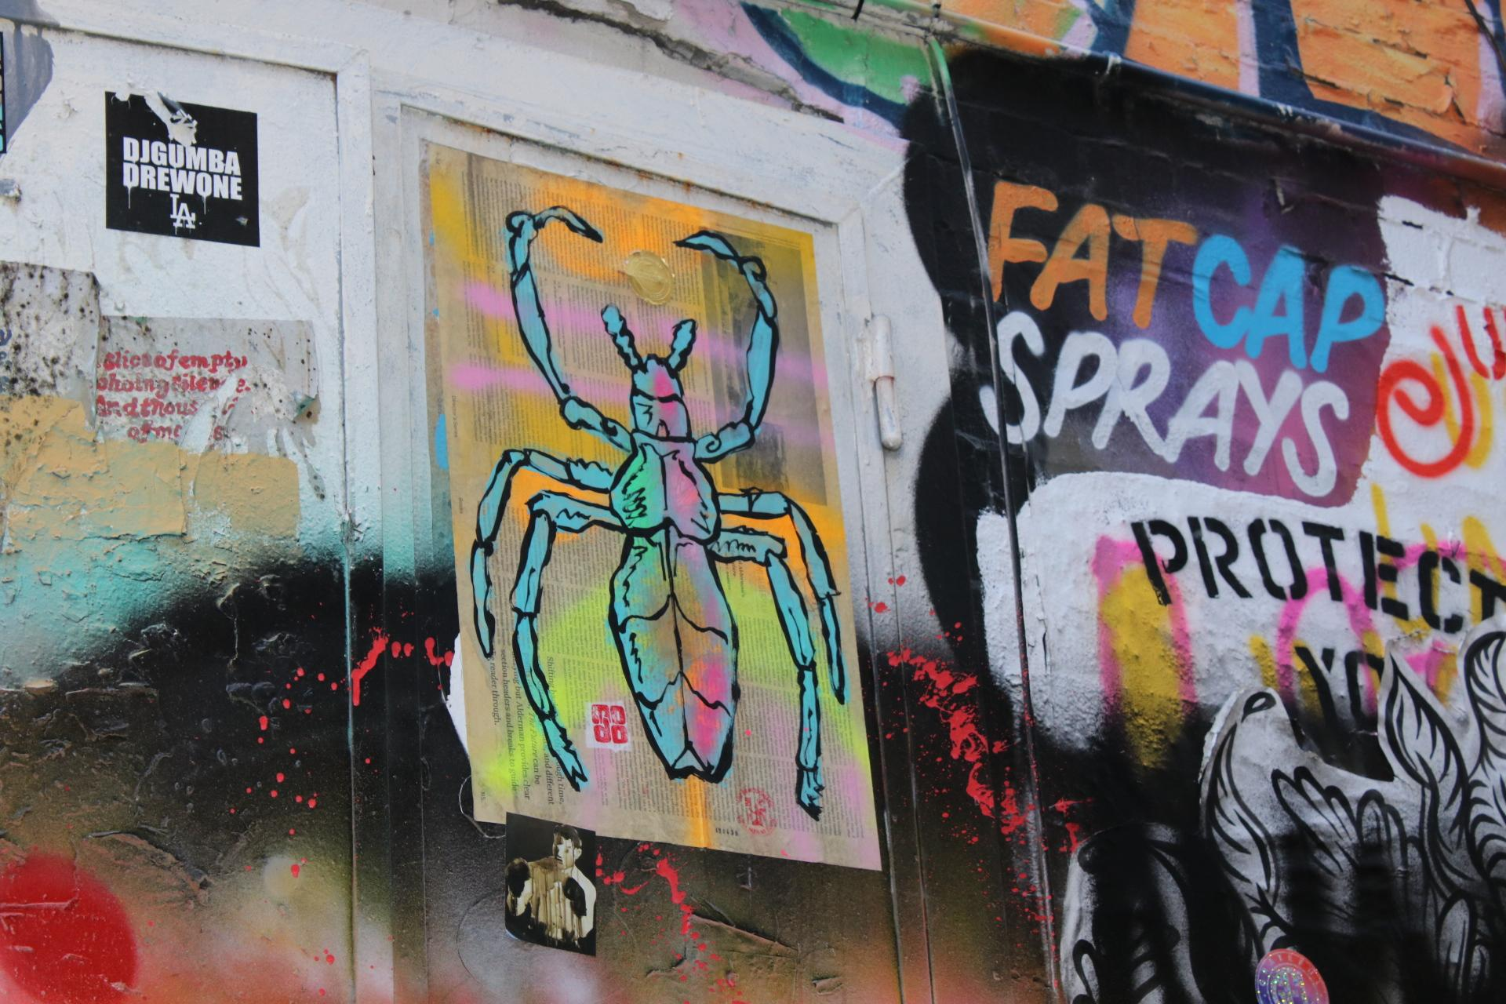
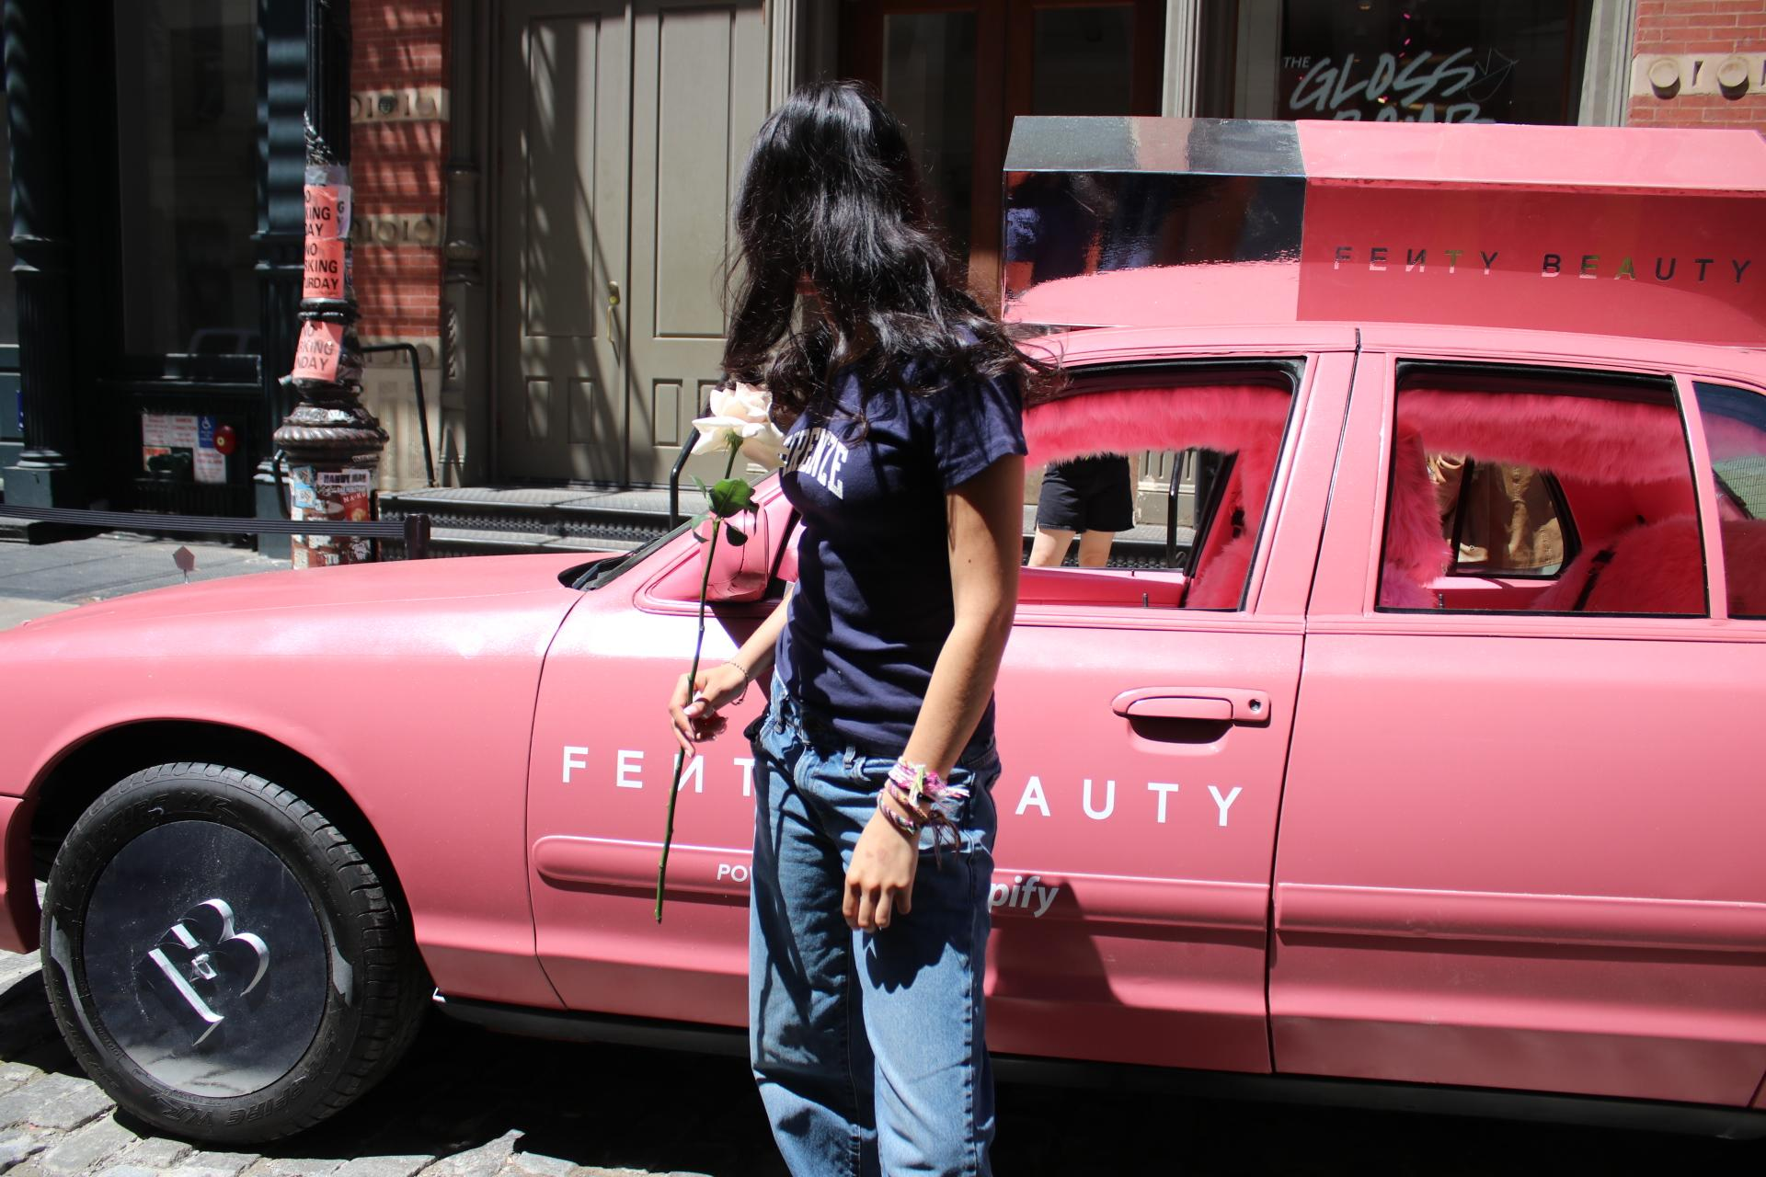
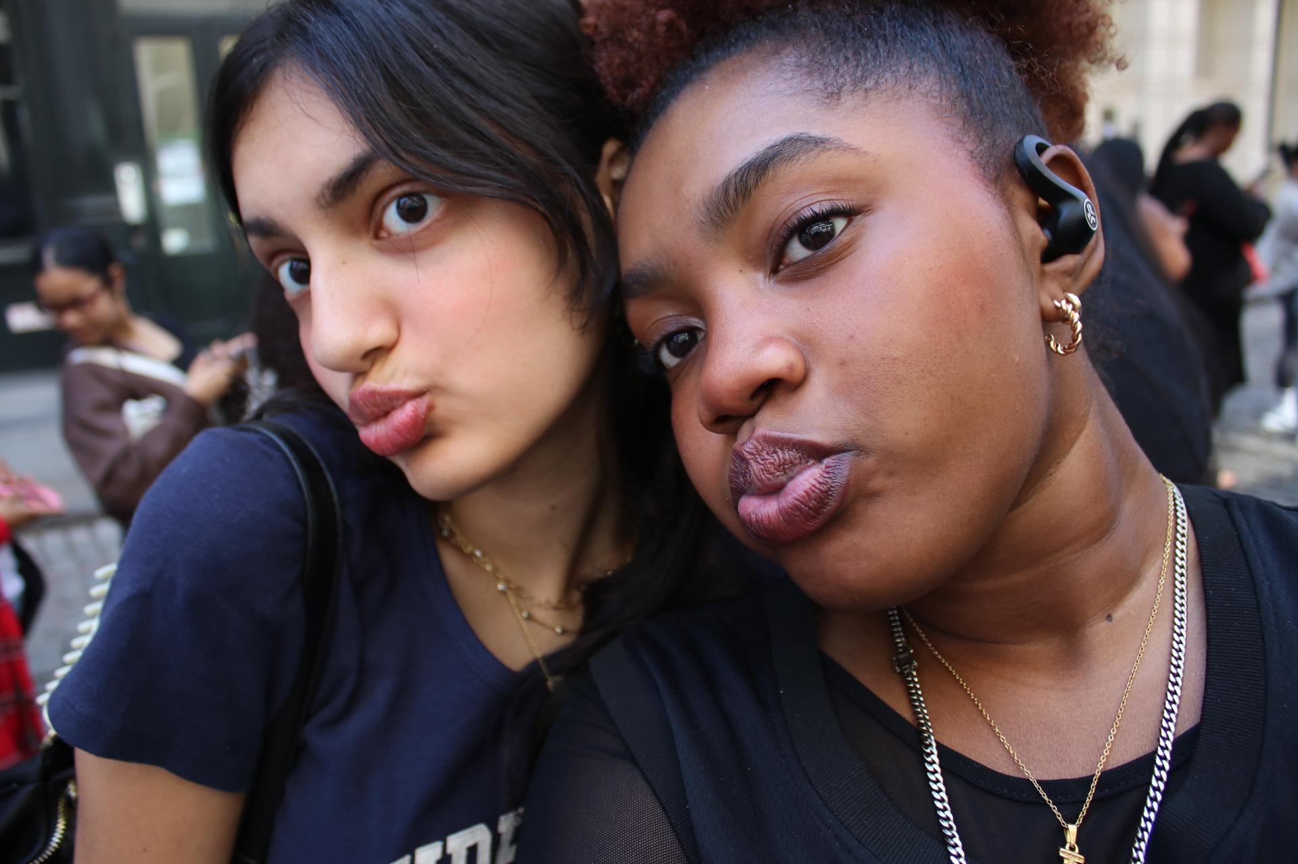
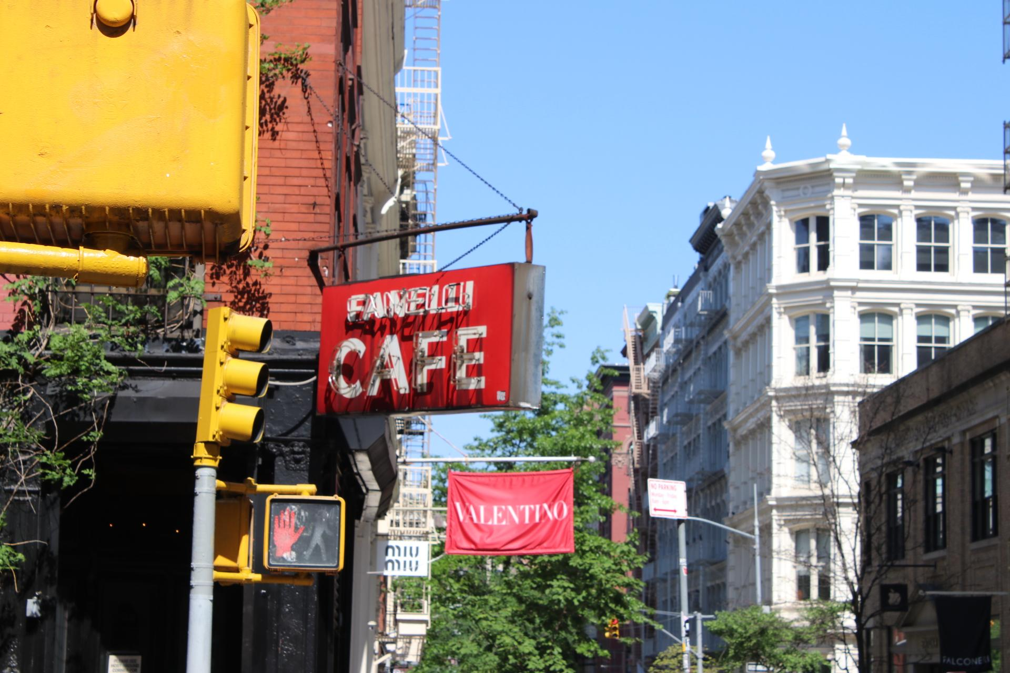
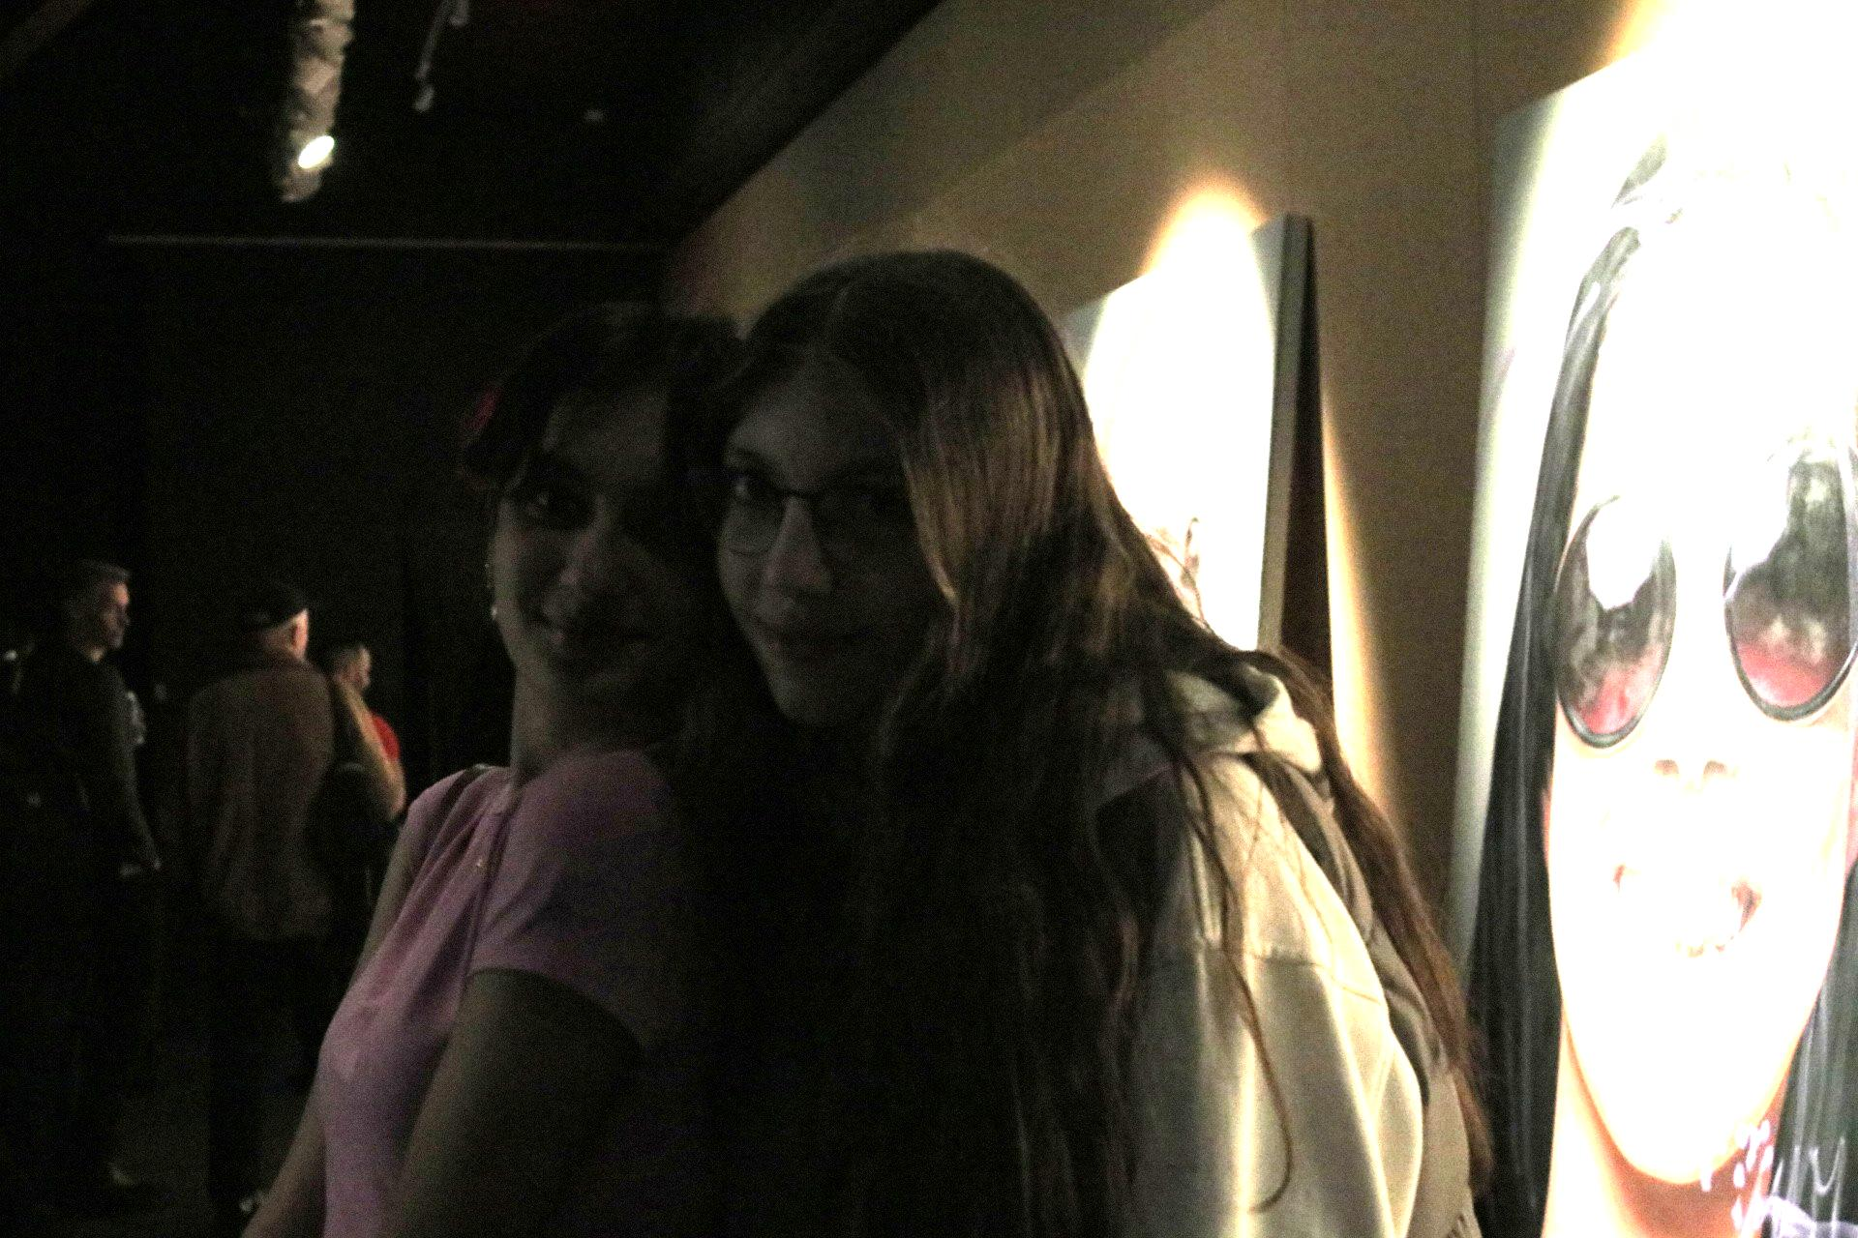
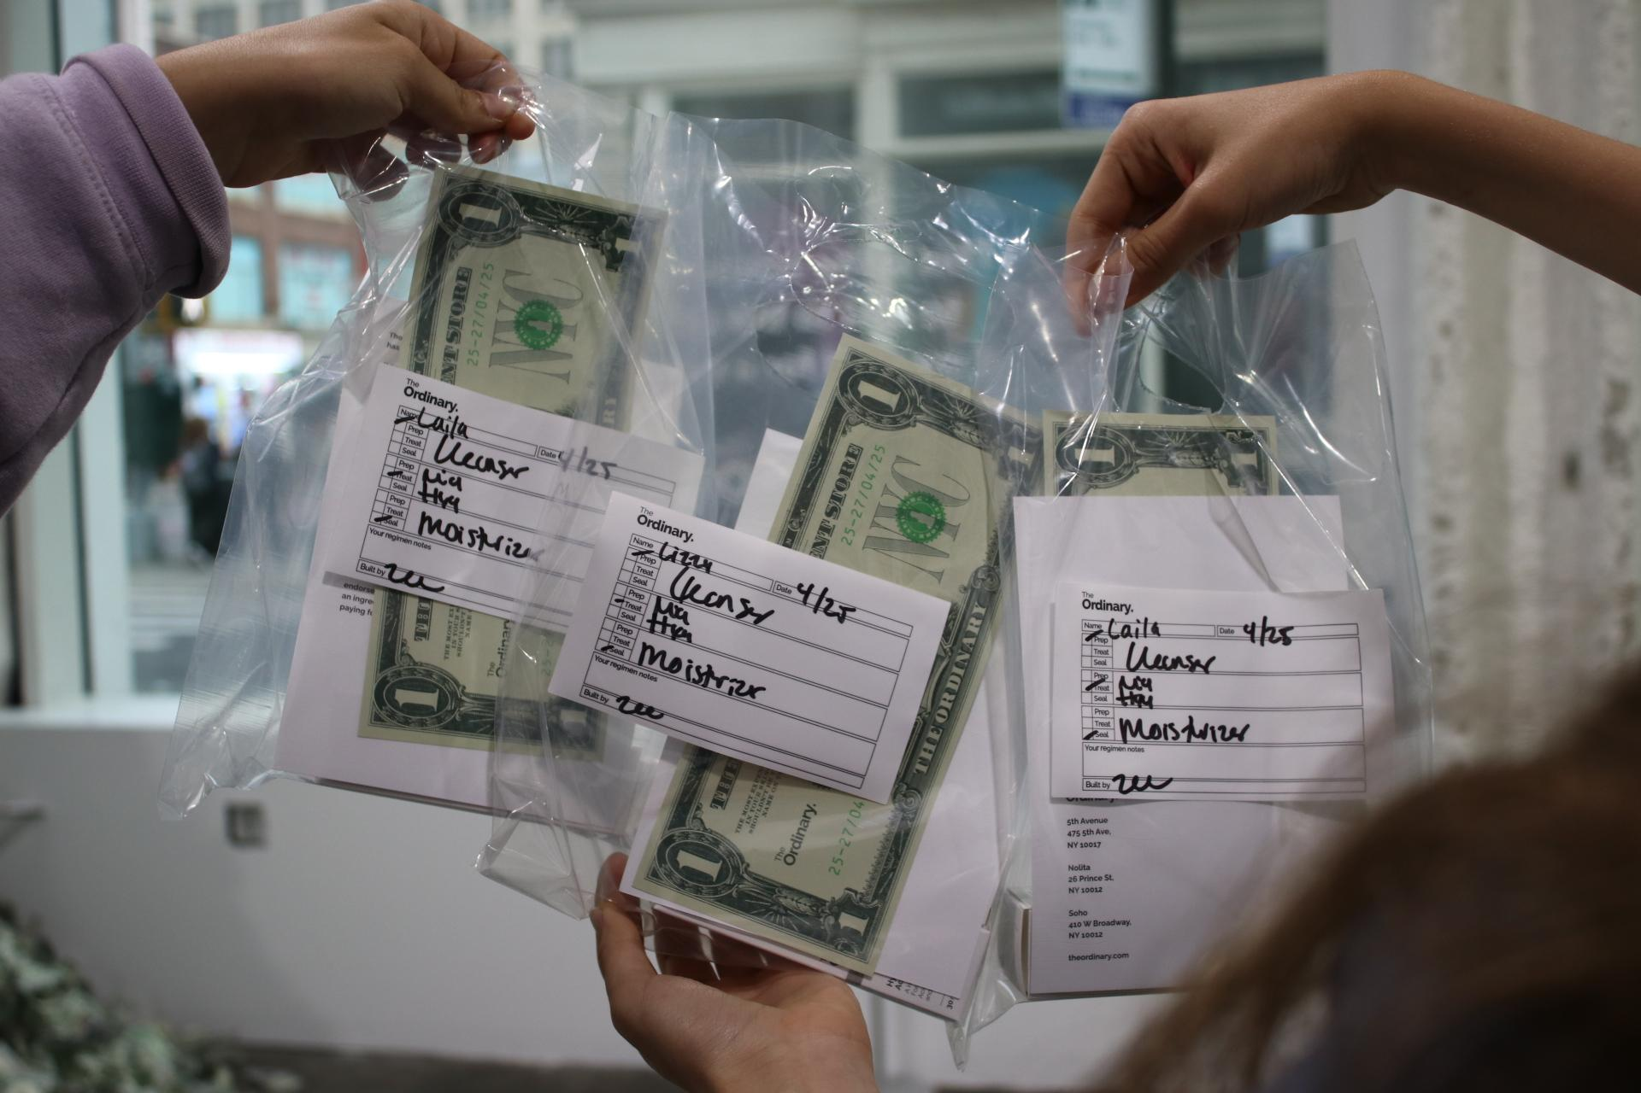
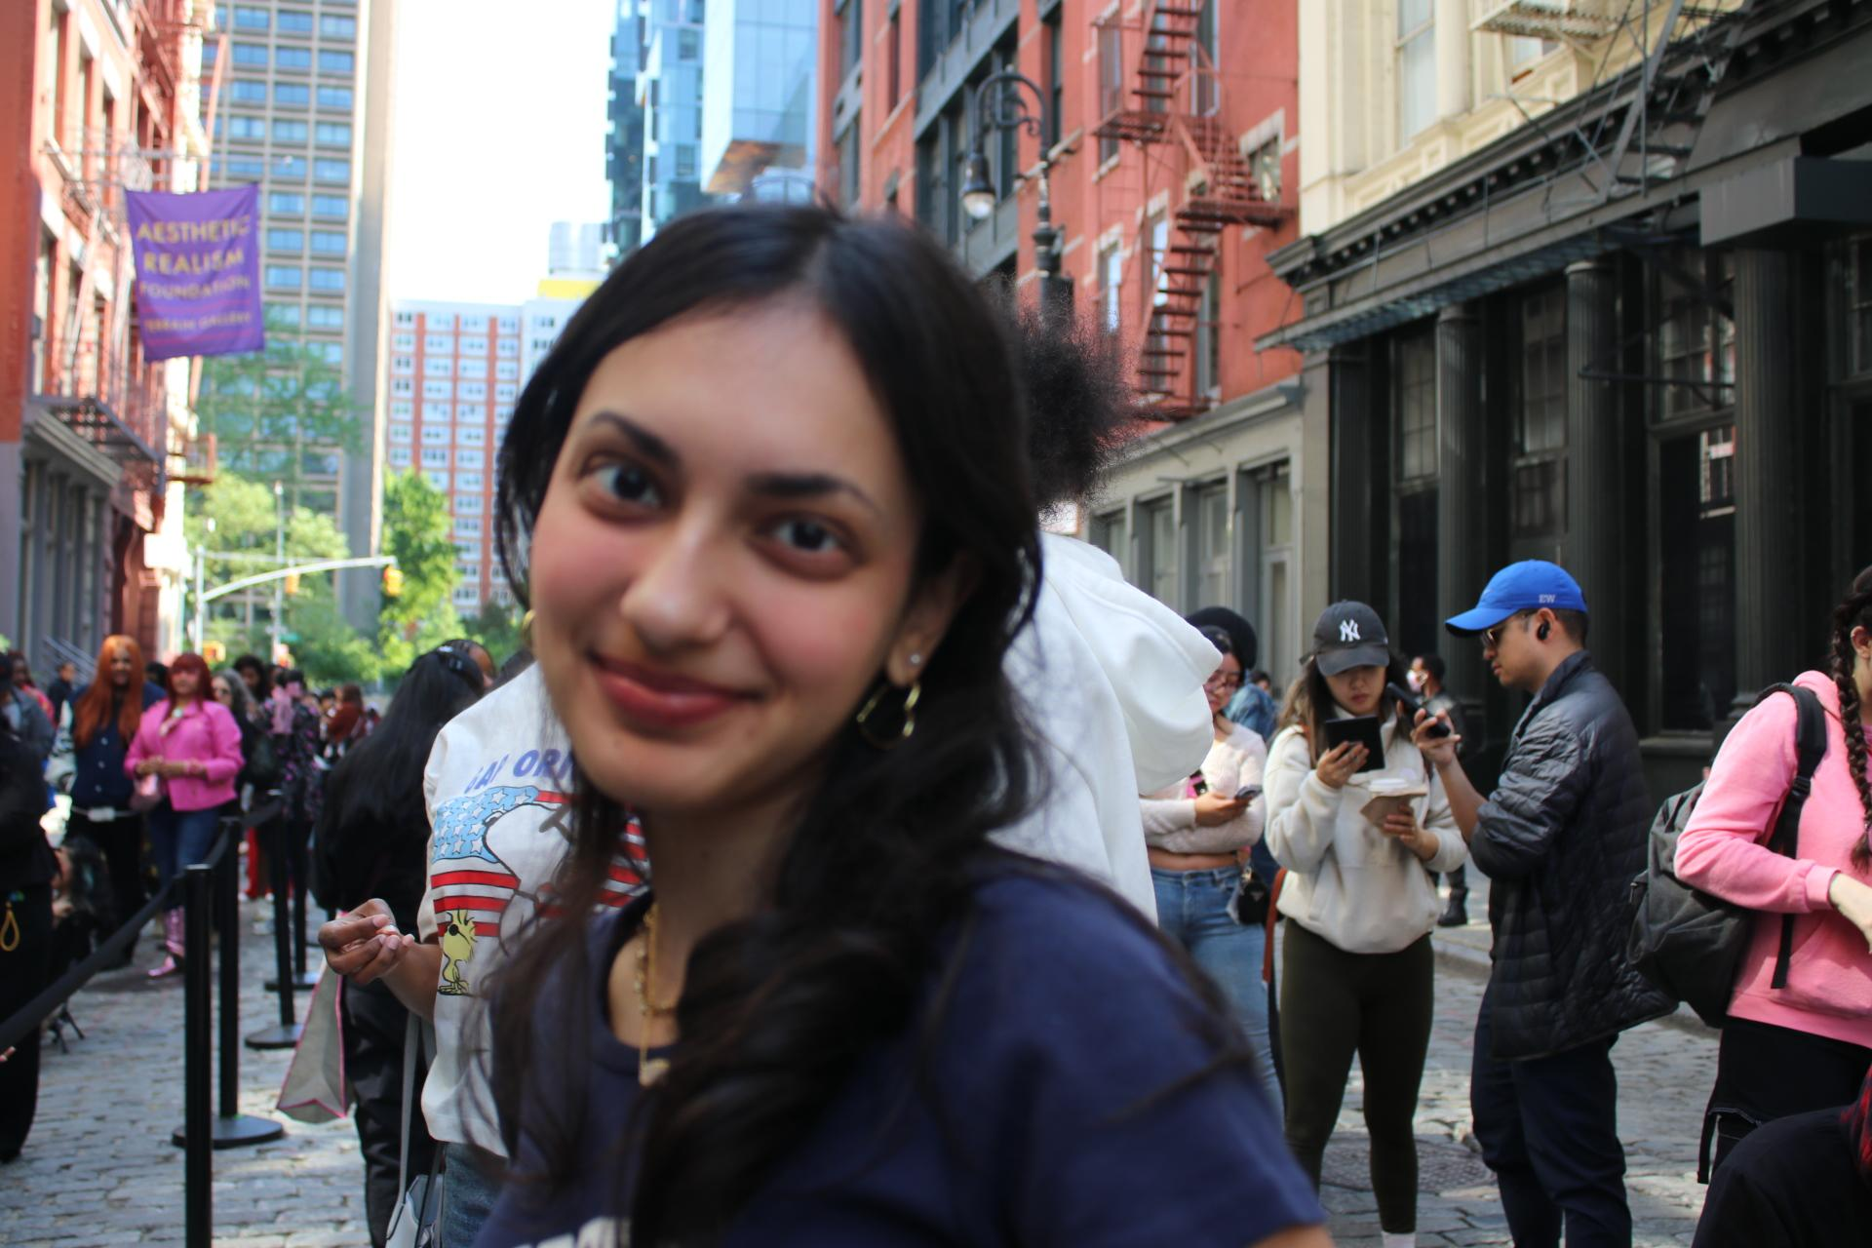












Slide 24
Our teacher Brian was a great example of this too. He's hilarious, corny, old, knowledgeable, and open. Especially about how he wanted us to think about each museum and every piece we saw. He's changed the way I feel about art, giving me permission to look deeper, feel more, and form my own understanding. With him, art became a conversation, not just a display.

Slide 25




